Slide 1
Oil and Gas Outlook
For
Independent Petroleum Association of America
November 13, 2014 | Palm Beach, FL
By
Adam Sieminski, Administrator
U.S. Energy Information Administration

Slide 2
Recent research
Growth in light sweet crude oil production
  U.S. supply of lighter API gravity crude will continue to outpace that of medium and heavier crudes; more than 60% of EIA’s forecast of production growth for 2014 and 2015 consists of sweet grades with API gravity 40+ oil; 28% of production growth in 2015 is Gulf of Mexico API gravity 27-35 medium sour oil
Updated LNG Study
  EIA was asked to assess how significantly increased exports of LNG could affect domestic energy markets, focusing on consumption, production, and prices. The scenarios reach as high as 20 Bcf/d, with these exports phased in at a rate of 2 Bcf/d each year beginning in 2015, sourced from the lower 48 states
Study of the relationship of gasoline and crude oil prices
  EIA looked into the determinants of gasoline prices in the United States, and whether a change in current limitations on crude oil exports would have an effect on those prices, and the magnitude of that effect

Slide 3
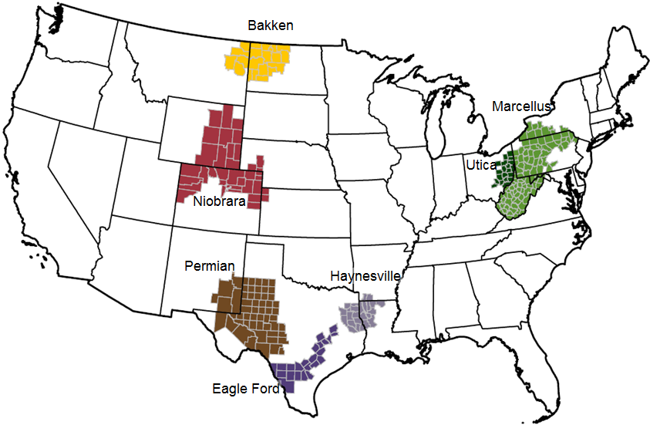
These seven regions accounted for 95% of U.S. oil production growth and all U.S. natural gas production growth from 2011-2013
Source: EIA, Drilling Productivity Report

Slide 4
The U.S. has experienced a rapid increase in natural gas and oil production from shale and other tight resources
Sources: EIA derived from state administrative data collected by DrillingInfo Inc. Data are through August 2014 and represent EIA’s official tight oil & shale gas estimates, but are not survey data. State abbreviations indicate primary state(s).

Slide 5
U.S. shale gas leads growth in total gas production through 2040, when production exceeds 100 billion cubic feet per day
U.S. dry natural gas production
trillion cubic feet
billion cubic feet per day
2012
history
projections
Shale gas
Non-associated onshore
Tight gas
Non-associated offshore
Alaska
Associated with oil
Coalbed methane
Source: EIA, Annual Energy Outlook 2014, Reference case
Notes:
5
5

Slide 6
Natural gas consumption growth is driven by electric power, industrial, and transportation use
U.S. dry gas consumption
trillion cubic feet
history
projections
11.0
electric
power
8.5
11.2
industrial*
9.1
0.7
1.7
transportation**
2.9
3.6
commercial
4.2
4.1
residential
*Includes combined heat-and-power and lease and plant fuel
**Includes pipeline fuel
Source: EIA, Annual Energy Outlook 2014, Reference case

Slide 7
U.S. becomes a net exporter of natural gas in the near future
U.S. dry natural gas
trillion cubic feet per year
billion cubic feet per day
history
2012
projections
100
75
Consumption
50
Domestic supply
Net exports
25
0
-25
Source: EIA, Annual Energy Outlook 2014 Reference case

Slide 8
Projected U.S. natural gas trade depends on assumptions regarding resources and future technology advances
Reference case
trillion cubic feet per year
High Oil and Gas Resource case
trillion cubic feet per year
billion cubic
feet per day
20
exports to Mexico
15
exports to Canada
10
5
lower 48
LNG exports
0
imports from Canada
-5
LNG imports
-10
Source: EIA, Annual Energy Outlook 2014, Reference case and High Oil and Gas Resource case

Slide 9
Key Takeaways from Updated EIA Study of added LNG exports
Prices: Projected average natural gas prices at the producer level average 4% to 11% above the Reference case projection across export scenarios over 2015-40, while residential natural gas prices in the export scenarios average 2% to 5% above their base projection
Natural gas production: With the exception of one baseline/scenario pairing, higher natural gas production satisfies 60% to 80% of the increase in natural gas demand from LNG exports over 2015-40
Natural gas consumption: The electric power sector accounts for most of the decrease in delivered natural gas. The electric generation mix shifts towards other generation sources, including coal and renewables, with some decrease in total generation as electricity prices rise
CO₂ emissions: Higher coal use leads to higher carbon dioxide output
Expenditures: On average, from 2015 to 2040, natural gas bills paid by end-use consumers in the residential, commercial and industrial sectors combined increase 1% to 8% across pairings of export scenarios and baselines. Increases in electricity bills paid by end-use customers range from 0% to 3%
Economic gains: Changes in the level of GDP relative to baseline range from 0.05% to 0.17% and generally increase with the amount of added LNG exports required to fulfill an export scenario; EIA’s NEMS model may understate the economic benefits

Slide 10
Resource and technology assumptions have major implications for projected U.S. crude oil production beyond the next few years
Reference case
million barrels per day
High Oil and Gas Resource case
million barrels per day
2012
2012
history
projections
history
projections
STEO October 2014 U.S. crude oil projection
tight oil
tight oil
other lower 48 states onshore
other lower 48 states onshore
lower 48 states offshore
lower 48 states offshore
Alaska
Alaska
Source: EIA, Annual Energy Outlook 2014; Short Term Energy Outlook, October 2014

Slide 11
U.S. oil production growth helping to offset unplanned outages
estimated unplanned crude oil production outages
million barrels per day
U.S. Production growth*
Non-
OPEC
OPEC
Source: EIA, Short-Term Energy Outlook, November 2014
*monthly production delta versus Jan. 2011 production level

Slide 12
U.S. rail carloads of crude oil and petroleum products exceed 1.5 million b/d in 2014
number of rail carloads per week
million barrels per day
Source: U.S. Energy Information Administration, based on Association of American Railroads

Slide 13
Growing U.S. oil production and rising demand in China have together made China the world’s largest net oil importer
net imports for China and the United States
million barrels per day
Aug-14
history
projections
Note: Net oil imports are defined as total liquid fuels consumption less domestic production
Source: EIA, Short-Term Energy Outlook, October 2014

Slide 14

U.S. is the largest producer of petroleum and natural gas in the world
estimated U.S., Russia, and Saudi Arabia petroleum and natural gas production
quadrillion Btu
million barrels per day of oil equivalent
United States
Russia
Saudi Arabia
natural
gas
petro-leum
2008
2009
2010
2011
2012
2013
2014e
Source: U.S. Energy Information Administration
Note: Petroleum production includes crude oil, natural gas liquids, condensates, refinery processing gain, and other liquids, including biofuels; barrels per day oil equivalent were calculated using a conversion factor of 1 barrel oil equivalent=5.55 million British thermal units (Btu)

Slide 15
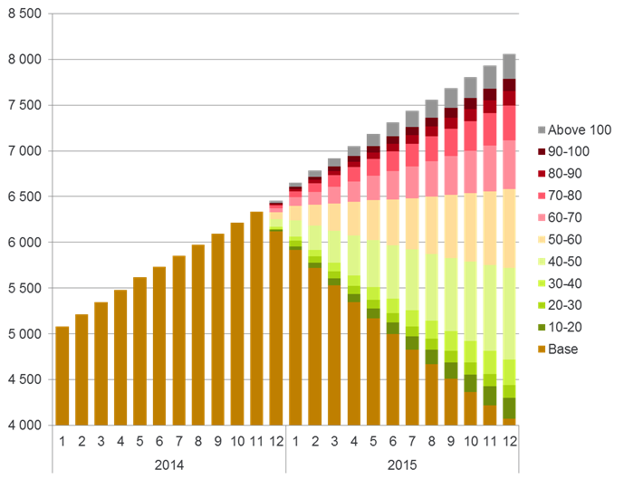
Effect of low oil prices on U.S. shale oil production
US+CA, oil+NGLs from tight plays (kbbld)
Brent-indexed
breakeven prices:
Source: Rystad Energy North America Quarterly Shale Report

Slide 16
U.S. is already a major net exporter of petroleum products
U.S. petroleum product net exports
million barrels per day
2015(e)
Source: EIA, Annual Energy Outlook 2014 Reference case and Short Term Energy Outlook
Notes:
16
16

Slide 17
Key observations from EIA’s analysis of the relationship between gasoline and crude oil prices
Prices of Brent crude oil, an international benchmark, are more important than the price of West Texas Intermediate (WTI), a domestic benchmark, for determining gasoline prices in all four U.S. regions studied
The effect that a relaxation of current limitations on U.S. crude oil exports would have on U.S. gasoline prices depends on its effect on international crude prices rather than its effect on domestic crude prices
Gasoline is a globally traded commodity, and prices are highly correlated across global spot markets
Gasoline supply, demand, and trade in various regions are changing; U.S. Gulf Coast and Chicago spot gasoline prices, which are closely linked, are now often the lowest in the world during fall and winter months

Slide 18
Most of the growth in production between 2011 and 2015 consists of sweet grades with API gravity of 40 or above
U.S. crude oil production by type
million barrels of oil per day
history
forecast
Source: EIA, DrillingInfo, Colorado DNR, Texas RRC. http://www.eia.gov/analysis/petroleum/crudetypes/

Slide 19
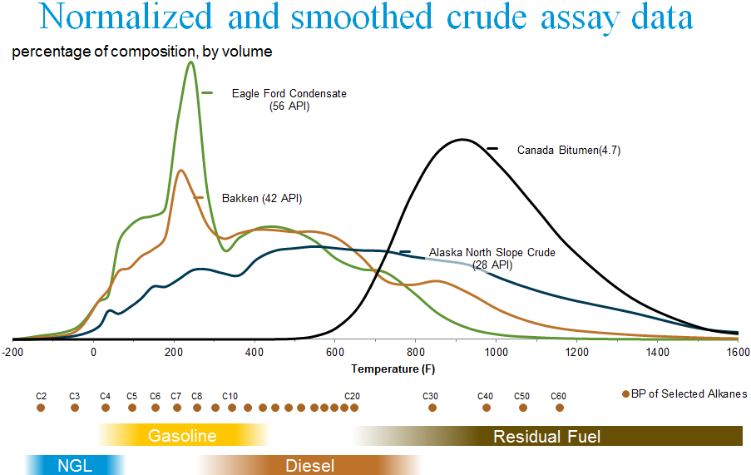
Crude oil and associated liquids contain a wide variety of hydrocarbons
Source: EIA via Harvey Crude Assay Management System

Slide 20
Distillation processes and resulting products
processed products for domestic use or exportable without license
processed
condensate
finished petroleum products and other processed hydrocarbon liquids
EIA Refinery Survey
other
processed
gas liquids
plant
condensate
splitter
complex
distillation
gas processing plant
stabilizer
finished product streams
dry gas
(exportable with
order/authorization)
fractionator
separator
separation via temperature gradients
wet gas
crude oil / lease condensate
(exportable under limited conditions)
flash drum
heater treater
water
field / lease separator
separation via pressure changes
mixed hydrocarbon wells
(gas, condensate, oil)

Slide 21
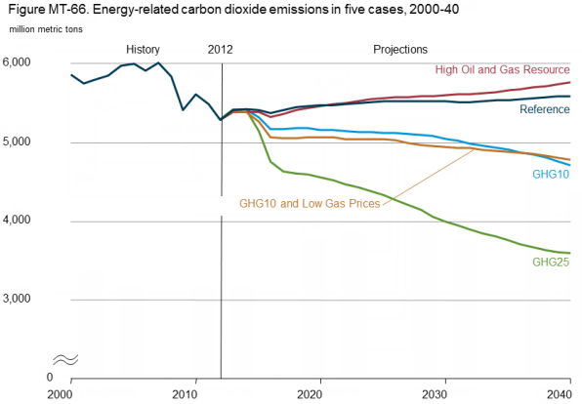
In the AEO reference case, annual carbon dioxide emissions rise slowly, but remain below levels reached in the 2000s
Source: EIA Annual Energy Outlook 2014

Slide 22
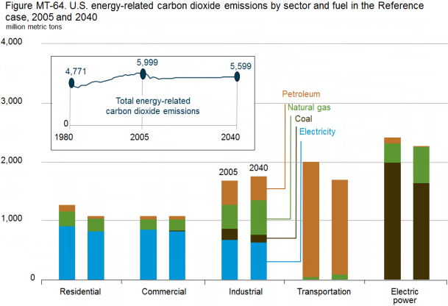
EIA projects declines in carbon dioxide emissions for all sectors except industrial relative to 2005
Source: EIA Annual Energy Outlook 2014

Slide 23
Coal continues to account for the largest share of global energy-related carbon dioxide emissions throughout the projection
world energy-related carbon dioxide emissions by fuel
billion metric tons
History
2010
Projections
Coal
Natural gas
Liquid fuels
Source: EIA, International Energy Outlook 2013

Slide 24
Areas of uncertainty in the outlook
Oil prices
China’s energy demand growth; particularly in transportation
Increasing global trade of natural gas and hydrocarbon gas liquids in addition to oil
Global development of tight oil and shale gas resources
Policy decisions on crude oil exports
Impact of geopolitical tensions on energy supply
Constraints on CO₂

Slide 25
For more information
U.S. Energy Information Administration home page | www.eia.gov
Annual Energy Outlook | www.eia.gov/aeo
Short-Term Energy Outlook | www.eia.gov/steo
International Energy Outlook | www.eia.gov/ieo
Monthly Energy Review | www.eia.gov/mer
Today in Energy | www.eia.gov/todayinenergy
State Energy Portal | www.eia.gov/state
Drilling Productivity Report | www.eia.gov/petroleum/drilling/

