Slide 1
Outlook for North American Natural Gas
For
LDC Natural Gas Forum
November 11, 2014 | Toronto, Ontario, Canada
By
Adam Sieminski, Administrator
U.S. Energy Information Administration

Slide 2
The Americas are the second largest region in natural gas reserves and resources
regional natural gas reserves and resources, 2012
trillion cubic feet
Source: U.S. Energy Information Administration, Oil and Gas Journal, U.S. Geological Survey, EIA/ARI World Shale Gas and Shale Oil Resource Assessment

Slide 3
The Americas hold an abundance of shale gas resources, undeveloped except in the U.S. and Canada
Americas natural gas reserves and resources, 2012
trillion cubic feet
Source: U.S. Energy Information Administration, Oil and Gas Journal, U.S. Geological Survey, EIA/ARI World Shale Gas and Shale Oil Resource Assessment.

Slide 4
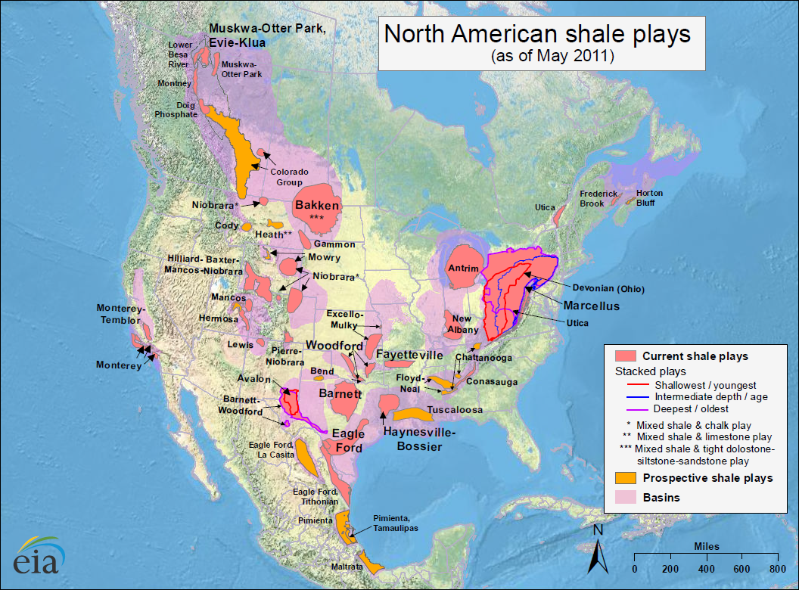
North American shale plays

Slide 5
Americas natural gas production is pulling away from other regions
dry natural gas production by region
trillion cubic feet
Source: EIA, International Energy Statistics

Slide 6
Total dry natural gas production in the Americas is outpacing consumption, largely driven by U.S. shale gas production
United States
Canada
Mexico
Trinidad & Tobago
Argentina
Venezuela
Brazil
Other Americas
Source: EIA, International Energy Statistics

Slide 7
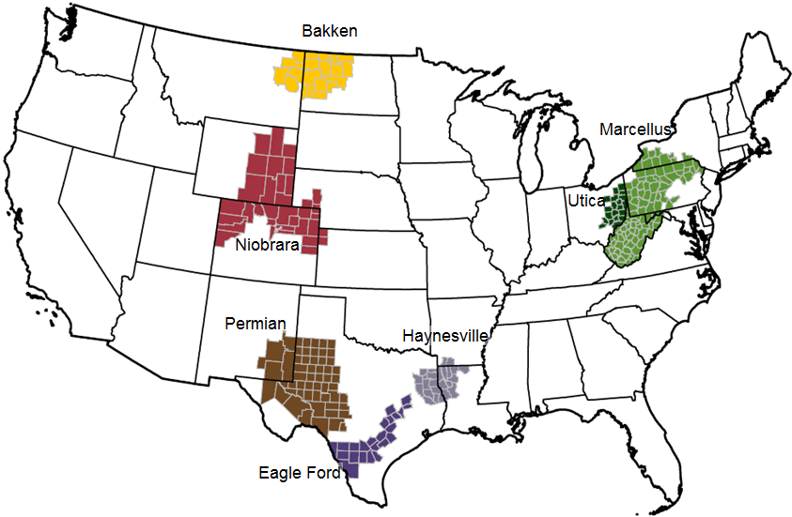
These seven regions accounted for 95% of U.S. oil production growth and all U.S. natural gas production growth from 2011-2013
Source: EIA, Drilling Productivity Report

Slide 8
The U.S. has experienced a rapid increase in natural gas and oil production from shale and other tight resources
Sources: EIA derived from state administrative data collected by DrillingInfo Inc. Data are through August 2014 and represent EIA’s official tight oil & shale gas estimates, but are not survey data. State abbreviations indicate primary state(s).

Slide 9
U.S. shale gas leads growth in total gas production through 2040, when production exceeds 100 billion cubic feet per day
U.S. dry natural gas production
trillion cubic feet
billion cubic feet per day
2012
history
projections
Shale gas
Non-associated onshore
Tight gas
Non-associated offshore
Alaska
Associated with oil
Coalbed methane
Source: EIA, Annual Energy Outlook 2014, Reference case
Notes:
9
9

Slide 10
Natural gas consumption growth is driven by electric power, industrial, and transportation use
U.S. dry gas consumption
trillion cubic feet
history
projections
11.0
electric
power
8.5
11.2
industrial*
9.1
0.7
1.7
transportation**
2.9
3.6
commercial
4.2
4.1
residential
*Includes combined heat-and-power and lease and plant fuel
**Includes pipeline fuel
Source: EIA, Annual Energy Outlook 2014, Reference case

Slide 11
U.S. becomes a net exporter of natural gas in the near future
U.S. dry natural gas
trillion cubic feet per year
billion cubic feet per day
history
2012
projections
100
75
Consumption
50
Domestic supply
Net exports
25
0
-25
Source: EIA, Annual Energy Outlook 2014 Reference case

Slide 12
Projected U.S. natural gas trade depends on assumptions regarding resources and future technology advances
Reference case
trillion cubic feet per year
High Oil and Gas Resource case
trillion cubic feet per year
billion cubic
feet per day
20
exports to Mexico
15
exports to Canada
10
5
lower 48
LNG exports
0
imports from Canada
-5
LNG imports
-10
Source: EIA, Annual Energy Outlook 2014, Reference case and High Oil and Gas Resource case

Slide 13
Currently, most of the US exports are via pipeline, but liquefied natural gas export projects have been proposed. Proposed non-FTA LNG export facilities as of March 2014 Potential export-oriented natural gas liquefaction facilities
Kitimat: 0.7 Bcf/d proposed
Douglas Island: 0.25 Bcf/d
Prince Rupert Island: 1.0 Bcf/d
Alaska
Kitimat: 2.0 Bcf/d potential
Canada
Kenai: 0.3 Bcf/d
Oregon LNG: 1.25 Bcf/d
Goldboro: 0.67 Bcf/d potential
LNG Facilities
Jordon Cove: 1.2 Bcf/d
Approved for exports
Proposed
Operating
Canadian Facilities
Texas
Louisiana
Melford: 1.8 Bcf/d potential
Golden Pass:
2.6 Bcf/d
Venture Global: 0.7 Bcf/d
Cameron: 1.7 Bcf/d
Freeport:
2.8 Bcf/d approved
Lake
Charles
2.0 Bcf/d
Cove Point:
1.0 Bcf/d
LNG Facility Capacity (Bcf/d)
Delfin
1.8 Bcf/d
Sabine Pass:
2.2 Bcf/d approved
0.9 Bcf/d proposed
2 to 3
1 to 2
0 to 1
Magnolia
1.08 Bcf/d
Elba Island: 0.5 Bcf/d
Corpus Christi: 2.1 Bcf/d
Gulf LNG Liquefaction Company:1.5 Bcf/d
Lavaca Bay, TX: 1.38 Bcf/d
CE FLNG: 1.07Bcf/d
Ingleside, TX: 1.09Bcf/d
Main Pass Energy Hub:3.2 Bcf/d
Mexico
Barca FLNG:
1.6 Bcf/d
Gulf Coast: 2.8 Bcf/d
EOS FLNG: 1.6 Bcf/d
Source: U.S. Energy Information Administration based on information from the Department of Energy (DOE), Office of Fossil Energy and the Canada’s National
Energy Board. Note: Capacity estimated from larger of FTA or non FTA capacity proposals.

Slide 14
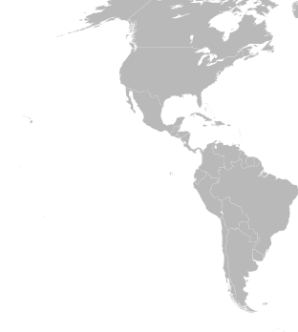
Most liquefaction projects are in North America and will increase the region’s total capacity 8-fold by 2019
Liquefaction (bcf/d)
Country | Operating | Construction | Engineering
Peru | 0.6
Trinidad and Tobago | 2.0
Colombia |  | 0.1
United States |  | 1.2 | 13.1
Brazil |  |  | 0.4
Canada |  |  | 3.3
Total | 2.6 | 1.3 | 16.8
Regasification (bcf/d)
Country | Operating | Construction | Engineering
Argentina | 0.9
Brazil | 1.2 | 0.8
Canada | 1.0
Chile | 0.6
Dominican Republic | 0.2
Mexico | 2.3
Puerto Rico | 0.4
United States | 10.2
Total | 16.8 | 0.8 | 0
Liquefaction, operating
Liquefaction, construction
Liquefaction, engineering
Regasification, operating
Regasification, construction
Source: IHS EDIN
Note: Displays larger import/export facilities only

Slide 15
Currently, the Panama Canal can accommodate only 9% of the world’s LNG carrier fleet; after the expansion, it will be able to accommodate 88% of currently active carriers
The Panama Canal and the Trans-Panama Pipeline are not currently used for significant volumes of petroleum trade and no LNG trade
The Panama Canal expansion project will open the canal route to Aframax tankers and 80% of the current global LNG carrier fleet, resulting in increased regional petroleum and LNG trade
By 2019, liquefaction capacity in the Americas is expected to increase eight-fold, with most of the projects in the United States
EIA anticipates increased LNG trade between countries in the Americas, but traffic from the Americas to Asia (the largest LNG import market) through the Panama Canal will also increase

Slide 16
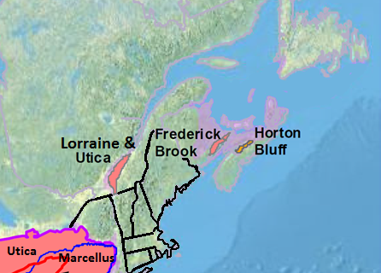
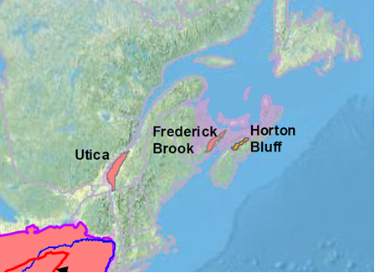
Shale gas in eastern Canada
Of the four shale plays in Eastern Canada, two have been assessed by ARI
Utica in Quebec has 31.1 Tcf of technically recoverable resources
Horton Bluff in Nova Scotia has 3.4 Tcf of technically recoverable resources
These shale resource volumes are not included in NEB’s 2013 estimates
Quebec enacted a hydraulic fracturing moratorium in 2012 pending further research
New Brunswick permits hydraulic fracturing, but has imposed strict rules surrounding it
Nova Scotia, similar to Quebec, will not permit hydraulic fracturing until the completion of a review, due mid-2014
Source: Advanced Resources International, “Technically Recoverable Shale Oil and Shale Gas Resources: An Assessment of 137 Shale Formations in 41 Countries Outside the United States”

Slide 17
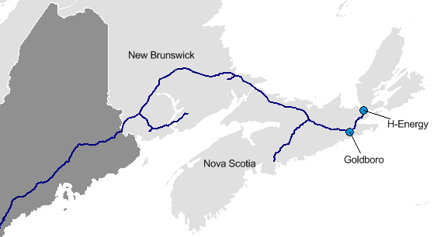
LNG export projects in eastern Canada
 | Goldboro LNG Terminal | H-Energy LNG Terminal
Planned year in service | 2019 | 2020
Liquefaction capacity | 1.3 Bcf/d | 0.6 Bcf/d
Storage capacity | 14.6 Bcf | N/A
Contract | 20 year supply deal with E. On AG | N/A
Supply sources | Marcellus, eastern Canada | N/A
NEB approval | Under review | N/A
Maine
Source: Company websites

Slide 18
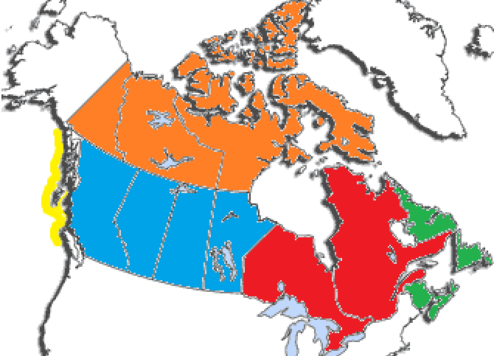
Resources in eastern Canada are modest compared with the Canada national total
Canada marketable resources in trillion cubic feet
as of 12/31/12
YK
NT
NU
BC
AB
SK
MB
NL
ON
QC
NB
NS
Note: WCSB stands for Western Canada Sedimentary Basin . All Territories are included under Northern Canada.
Source: National Energy Board, “Canada’s Energy Future 2013”

Slide 19
Key Takeaways from Updated EIA Study of added LNG exports
Prices: Projected average natural gas prices at the producer level average 4% to 11% above the Reference case projection across export scenarios over 2015-40, while residential natural gas prices in the export scenarios average 2% to 5% above their base projection
Natural gas production: With the exception of one baseline/scenario pairing, higher natural gas production satisfies 60% to 80% of the increase in natural gas demand from LNG exports over 2015-40
Natural gas consumption: The electric power sector accounts for most of the decrease in delivered natural gas. The electric generation mix shifts towards other generation sources, including coal and renewables, with some decrease in total generation as electricity prices rise
CO₂ emissions: Higher coal use leads to higher carbon dioxide output
Expenditures: On average, from 2015 to 2040, natural gas bills paid by end-use consumers in the residential, commercial and industrial sectors combined increase 1% to 8% across pairings of export scenarios and baselines. Increases in electricity bills paid by end-use customers range from 0% to 3%
Economic gains: Changes in the level of GDP relative to baseline range from 0.05% to 0.17% and generally increase with the amount of added LNG exports required to fulfill an export scenario; EIA’s NEMS model may understate the economic benefits

Slide 20
Areas of uncertainty in the outlook
Oil and natural gas prices
China’s energy demand growth; particularly in transportation
Increasing global trade of natural gas and hydrocarbon gas liquids in addition to oil
Global development of tight oil and shale gas resources
Policy decisions on crude oil exports and pipeline permits
Impact of geopolitical tensions on energy supply
Constraints on CO₂

Slide 21
For more information
U.S. Energy Information Administration home page | www.eia.gov
Annual Energy Outlook | www.eia.gov/aeo
Short-Term Energy Outlook | www.eia.gov/steo
International Energy Outlook | www.eia.gov/ieo
Monthly Energy Review | www.eia.gov/mer
Today in Energy | www.eia.gov/todayinenergy
State Energy Portal | www.eia.gov/state
Drilling Productivity Report | www.eia.gov/petroleum/drilling/

Slide 22
Supplemental Slides

Slide 23
A larger share of new wells produce both oil and natural gas
natural gas only
oil only
marketed gas production
oil and natural gas
non-marketed gas production
Note: 2014 figure represents averages from January to September 2014
Source: EIA based on DrillingInfo

Slide 24
Resource and technology assumptions have major implications for projected U.S. crude oil production beyond the next few years
Reference case
million barrels per day
High Oil and Gas Resource case
million barrels per day
2012
2012
history
projections
history
projections
STEO October 2014 U.S. crude oil projection
tight oil
tight oil
other lower 48 states onshore
other lower 48 states onshore
lower 48 states offshore
lower 48 states offshore
Alaska
Alaska
Source: EIA, Annual Energy Outlook 2014; Short Term Energy Outlook, October 2014

Slide 25
Most significant contributors to non-OPEC crude and lease condensate production: Canada, Brazil, U.S., Kazakhstan, Russia
non-OPEC crude and lease condensate production, Reference case
million barrels per day
Source: EIA, International Energy Outlook 2014

Slide 26
In the Americas, recent gains in oil production are concentrated in countries with open investment structures
crude oil production by select Americas country
million barrels per day
Source: EIA, International Energy Statistics

Slide 27
Tight oil production will spread to nations outside of the United States and Canada over the projection
tight oil production, Reference case
million barrels per day
AEO2014 High Resource case
5.0 MMbbl/d in 2015 (STEO)
3.9 MMbbl/d in 2014 (STEO)
2.9 MMbbl/d in 2013
Source: EIA, International Energy Outlook 2014

