Slide 1
Annual Energy Outlook 2021 (AEO2021)
For
Annual Energy Outlook 2021 Release at the Bipartisan Policy Center
February 3rd, 2021 | Washington, DC
By
Stephen Nalley, EIA Acting Administrator
Angelina LaRose, Assistant Administrator for Energy Analysis

Slide 2
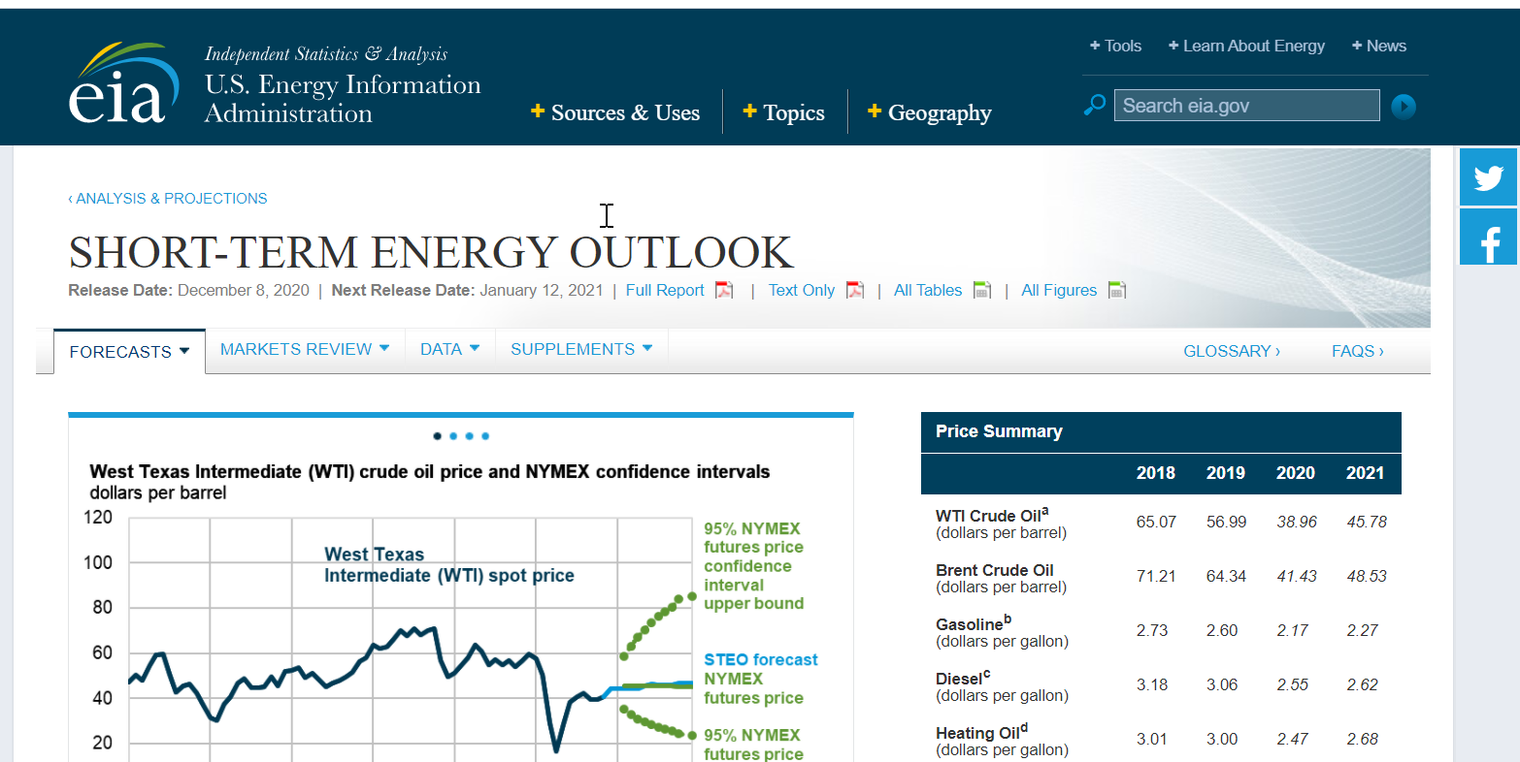
The U.S. Energy Information Administration (EIA) collects, analyzes, and disseminates independent and impartial energy information to promote sound policymaking, efficient markets, and public understanding of energy and its interaction with the economy and the environment.
EIA’s role is unique — by providing an unbiased view of energy markets, EIA increases transparency and promotes public understanding of important energy issues.
EIA has expanded its program in recent years to provide a growing customer base with coverage of increasingly complex and interrelated energy markets.

Slide 3
Because of responses to COVID-19, the near-term projections in AEO2021 are more uncertain than in previous AEOs
World liquid fuels consumption
million barrels per day
Components of annual change
million barrels per day
Source: U.S. Energy Information Administration, Short-Term Energy Outlook, January 2021

Slide 4
AEO2021 Highlights
A return to 2019 levels of U.S. energy consumption will take years; energy-related carbon dioxide emissions fall further before leveling off or rising.
Renewable energy incentives and falling technology costs support robust competition with natural gas as coal and nuclear power decrease in the electricity mix.
Continuing record-high domestic energy production supports natural gas exports but does not necessarily mean growth in the U.S. trade balance in petroleum products.

Slide 5
AEO2021 examines a range of conditions from 2020 to 2050
Assumptions
Current laws and regulations as of September 2020 remain unchanged
Current views on economic and demographic trends, and technology improvements
Compound annual growth rate for real U.S. gross domestic product (GDP) is 2.1% (Reference case)
High Economic Growth case (2.6%) and Low Economic Growth case (1.6%)
The Brent crude oil price by 2050 is $95 per barrel (b) in constant 2020 dollars (Reference case)
– High Oil Price case ($173/b) and Low Oil Price case ($48/b)
Oil and natural gas supply cases
High: more accessible resources and lower extraction technology costs than the Reference case
Low: fewer accessible resources and higher extraction technology costs than the Reference case
Renewables cost cases
High: no cost reductions in renewable technologies
Low: renewables achieve 40% lower overnight capital costs by 2050 compared to Reference case

Slide 6
AEO2021 cases vary technical and macroeconomic assumptions
Policy assumptions
Current laws and regulations
as of September 2020
Potential
new laws
High Economic Growth case
High Oil Price case
High Oil and Gas Supply case
High Renewables Cost case
Higher
Technical and macroeconomic assumptions
Reference case
Expected
Low Economic Growth case
Low Oil Price case
Low Oil and Gas Supply case
Low Renewables Cost case
Lower
Note: EPA’s Affordable Clean Energy (ACE) rule (84 FR 32520) was vacated after AEO2021 case were run. See AEO2021 Narrative for more discussion.

Slide 7
AEO2021 Highlights
A return to 2019 levels of U.S. energy consumption will take years; energy-related carbon dioxide emissions fall further before leveling off or rising.
Renewable energy incentives and falling technology costs support robust competition with natural gas as coal and nuclear power decrease in the electricity mix.
Continuing record-high domestic energy production supports natural gas exports but does not necessarily mean growth in the U.S. trade balance in petroleum products.

Slide 8
The pace of recovery for gross domestic product (GDP) and energy consumption remains highly uncertain
U.S. gross domestic product assumptions
AEO2021 economic growth cases
trillion 2012 dollars
U.S. delivered energy across end-use sectors
AEO2021 economic growth cases
quadrillion British thermal units

Slide 9
Industrial and electric power drive most of the increases in U.S. energy consumption in the Reference case
U.S. energy consumption by sector
AEO2021 Reference case
quadrillion British thermal units
U.S. energy consumption by fuel
AEO2021 Reference case
quadrillion British thermal units

Slide 10
The majority of petroleum consumption growth occurs in industrial sector use of liquefied petroleum gas
Petroleum and other liquids consumption by sector
AEO2021 Reference case
quadrillion British thermal units
Petroleum and other liquids consumption by fuel type
AEO2021 Reference case
million barrels per day
motor gasoline
liquefied petroleum gas
distillate fuel oil
jet fuel
other
residual fuel oil

Slide 11
U.S. energy-related carbon dioxide emissions continue to decrease, but they start growing after 2035 in the Reference case
U.S. energy-related carbon dioxide emissions by fuel
AEO2021 Reference case
billion metric tons
U.S. energy-related carbon dioxide emissions
AEO2021 economic growth cases
billion metric tons
High Economic
Growth
Reference
Low Economic
Growth
other cases

Slide 12
AEO2021 Highlights
A return to 2019 levels of U.S. energy consumption will take years; energy-related carbon dioxide emissions fall further before leveling off or rising.
Renewable energy incentives and falling technology costs support robust competition with natural gas as coal and nuclear power decrease in the electricity mix.
Continuing record-high domestic energy production supports natural gas exports but does not necessarily mean growth in the U.S. trade balance in petroleum products.

Slide 13
Electricity demand grows modestly throughout the projection period
U.S. electricity use growth rate,
three-year rolling average
AEO2021 economic growth cases
percentage growth
U.S. electricity use by end-use sector
AEO2021 Reference case
billion kilowatthours
Note: Onsite generation is electricity produced onsite for own use.

Slide 14
Electricity generating capacity increases 52% to 84% across AEO cases; additions come mostly from solar, wind, and natural gas
Cumulative electricity generating capacity additions and retirements (2021–2050)
AEO2021 selected cases
gigawatts

Slide 15
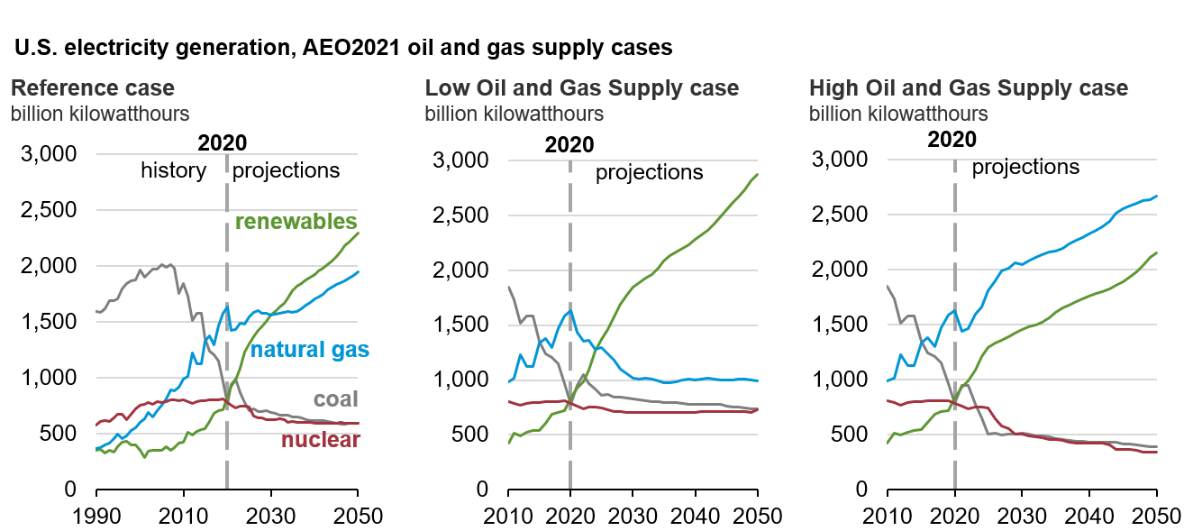
Electricity generation increases by a third; natural gas prices influence competition with renewables

Slide 16
AEO2021 Highlights
A return to 2019 levels of U.S. energy consumption will take years; energy-related carbon dioxide emissions fall further before leveling off or rising.
Renewable energy incentives and falling technology costs support robust competition with natural gas as coal and nuclear power decrease in the electricity mix.
Continuing record-high domestic energy production supports natural gas exports but does not necessarily mean growth in the U.S. trade balance in petroleum products.

Slide 17
Natural gas production grows significantly in most cases but with a wide range of outcomes
U.S. dry natural gas production
AEO2021 oil and gas supply and price cases
trillion cubic feet
U.S. liquefied natural gas exports
AEO2021 supply and price cases
trillion cubic feet
High Oil and
Gas Supply
High Oil Price
Reference
Low Oil Price
Low Oil and
Gas Supply
High Oil
Price
High Oil and Gas Supply
Reference
Low Oil and Gas Supply
Low Oil
Price

Slide 18
Natural gas consumption in the Reference case grows the most in the industrial sector; electric power and exports are the most sensitive to prices
U.S. natural gas consumption by sector and net exports, 2020 and 2050
AEO2021 selected cases
trillion cubic feet
net exports
industrial
electric power
commercial
residential
transportation

Slide 19
In all cases, the United States continues to be a globally significant producer of crude oil and refined liquids
U.S. crude oil and natural gas plant liquids production
AEO2021 oil and gas supply cases
million barrels per day
U.S. petroleum and other liquids net exports
AEO2021 oil and gas supply and price side cases
million barrels per day
High Oil and
Gas Supply
Reference
Low Oil and
Gas Supply
Reference (crude only)
High Oil Price
High Oil and Gas Supply
Reference
Low Oil and Gas Supply
Low Oil Price

Slide 20
AEO2021 Highlights
A return to 2019 levels of U.S. energy consumption will take years; energy-related carbon dioxide emissions fall further before leveling off or rising.
Renewable energy incentives and falling technology costs support robust competition with natural gas as coal and nuclear power decrease in the electricity mix.
Continuing record-high domestic energy production supports natural gas exports but does not necessarily mean growth in the U.S. trade balance in petroleum products.

