Slide 1
U.S. Energy Information Administration’s International Energy Outlook 2020 (IEO2020)
Center for Strategic and International Studies
October 14, 2020 | Washington, DC
Dr. Linda Capuano, Administrator
U.S. Energy Information Administration

Slide 2
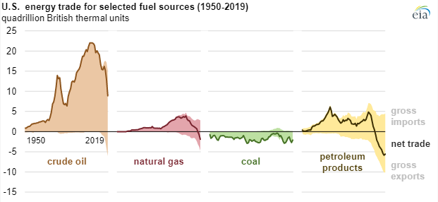
United States milestones in meeting global energy consumption
2011
Becomes petroleum products net exporter
2017
Becomes natural gas net exporter
2019
Becomes total energy exporter - total annual energy exports exceed imports
2020
Pandemic leads to market transitions
Source: EIA, Today in Energy, April 20, 2020 (https://www.eia.gov/todayinenergy/detail.php?id=43395)

Slide 3
The IEO2019 is the foundation for the IE2020
IEO2019 Reference case
World energy consumption rises nearly 50% by 2050
3.0% global GDP growth per year (Oxford Economics)
0.7% global population growth per year
Brent $100 per barrel crude price in 2018 dollars by 2050
Implementation of current laws and regulations
Current views of economic and demographic trends, and improvements in known technology
High and Low Economic Growth cases
3.7% and 2.4% per year GDP growth
High and Low Oil Price cases
Brent $185 and $45 per barrel in 2018 dollars by 2050

Slide 4
IEO2019 projects renewables the most used energy source by 2050
Primary energy consumption by fuel, world
quadrillion British thermal units
History Projections
renewables
petroleum
and other
liquids¹
natural gas
coal
nuclear
Note: 1 = Includes biofuels
Source: U.S. Energy Information Administration, International Energy Outlook 2019

Slide 5
IEO2020 focuses on electric power generation fuel-mix
Primary energy consumption, world
quadrillion Btu
Consumption by fuel for power generation, world
quadrillion Btu
Source: U.S. Energy Information Administration, International Energy Outlook 2019

Slide 6
China and India are the largest projected electricity users
Power generation energy consumption by region
quadrillion Btu
Source: U.S. Energy Information Administration, International Energy Outlook 2019

Slide 7
IEO2020 Issues in Focus:
Electricity generation fuel-mix trends and uncertainties
Asia: Impact of natural gas prices and renewables capital costs
India: Impact of interregional electricity trade
Africa: Impact of off-grid electricity development

