Slide 1
International Energy Outlook 2021 (IEO2021)
For
Center for Strategic and International Studies
October 6, 2021 | Washington, DC
By
Stephen Nalley, Acting Administrator
Angelina LaRose, Assistant Administrator for Energy Analysis
U.S. Energy Information Administration

Slide 2
IEO2021 Highlights
If current policy and technology trends continue, global energy consumption and energy-related carbon dioxide emissions will increase through 2050 as a result of population and economic growth.
Renewables will be the primary source for new electricity generation, but natural gas, coal, and increasingly batteries will be used to help meet load and support grid reliability.
Oil and natural gas production will continue to grow, mainly to support increasing energy consumption in developing Asian economies.

Slide 3
Energy use is projected to return to pre-pandemic levels quickly in non-OECD regions
Energy consumption by sector
quadrillion British thermal units
Energy consumption by sector
quadrillion British thermal units
OECD
non-OECD
history projections
history projections
industrial
transportation
transportation
commercial
commercial
residential

Slide 4

IEO2021 includes COVID-19 impacts; Side cases include alternative assumptions and newly expanded results
IEO2021 Reference case
  Incorporates global COVID-19 impacts on the energy sector
  Uses the U.S. projections published in the Annual Energy Outlook 2021, which assumes U.S. laws and regulations as of September 2020
  Assumes implementation of current laws and regulations as of May 2021, including existing climate law; Climate Considerations in the International Energy Outlook (IEO2021)¹ provides more details
  Uses Oxford Economics’ GDP projections, with a global growth rate of 2.8% per year
  Assumes 2050 world oil price reaches $95 per barrel (2020 dollars)
Side cases explore alternative economic growth and oil price assumptions
  High and Low Economic Growth cases: 3.7% per year and 2.0% per year global GDP growth rate
  High and Low Oil Price cases: $176 per barrel and $45 per barrel 2050 world oil prices (2020 dollars)
¹ EIA, Climate Considerations in the International Energy Outlook (IEO2021), https://www.eia.gov/outlooks/ieo/climate.php

Slide 5

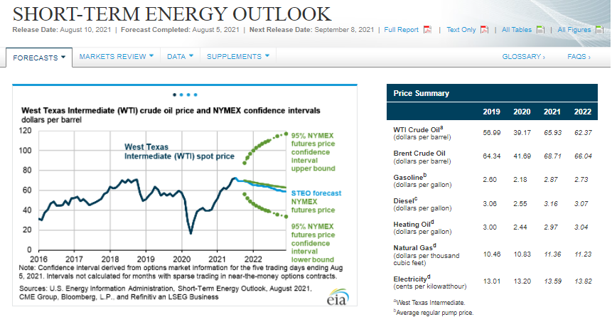


The U.S. Energy Information Administration (EIA) collects, analyzes, and disseminates independent and impartial energy information to promote sound policymaking, efficient markets, and public understanding of energy and its interaction with the economy and the environment.
EIA’s role is unique. By providing an unbiased view of energy markets, EIA increases transparency and promotes public understanding of important energy issues.
EIA has expanded its program in recent years to provide a growing customer base with coverage of increasingly complex and interrelated energy markets.

Slide 6
EIA assumes a range of GDP and oil prices, which affect projected energy consumption
Gross domestic product
trillion 2015 dollars
World oil prices
2020 dollars per barrel
Global energy consumption
quadrillion British thermal units
history projections
High Oil Price
Reference
Low Oil Price

Slide 7
IEO2021 Highlights
If current policy and technology trends continue, global energy consumption and energy-related carbon dioxide emissions will increase through 2050 as a result of population and economic growth.
Renewables will be the primary source for new electricity generation, but natural gas, coal, and increasingly batteries will be used to help meet load and support grid reliability.
Oil and natural gas production will continue to grow, mainly to support increasing energy consumption in developing Asian economies.

Slide 8
By 2050, global energy use increases nearly 50%, driven by non-OECD economic growth and population
World energy consumption
quadrillion British thermal units
World gross domestic product (GDP)
trillion 2015 dollars, purchasing power parity (PPP)
Population
billion people
history projections
history projections
non-OECD
OECD
non-OECD
OECD

Slide 9
Liquid fuels remain the largest source of primary energy in the Reference case, but renewables use grows to nearly the same level
Primary energy consumption by energy source, world
quadrillion British thermal units
Share of primary energy consumption by source, world
percentage
history projections
history projections
petroleum
and other
liquids
renewables
natural gas
coal
nuclear
¹
²
¹
¹ Includes biofuels
² Electricity generation from renewable sources is converted to Btu at a rate of 8,124 Btu/kWh

Slide 10
Liquid fuels consumption rises from 2020 in all IEO cases
World liquid fuels consumption
million barrels per day

Slide 11
Electric vehicle stock contributes to reduced emissions and represents 31% of total passenger vehicle stock by 2050
Light-duty passenger vehicle stock
billions of passenger vehicles
conventional stock
electric stock¹
history projections
history projections
history projections
non-OECD
OECD
non-OECD
OECD
non-OECD
OECD
¹ Electric stock includes full battery electric vehicles (BEVs) or all-electric vehicles and plug-in hybrid electric vehicles (PHEVs) that run on liquid fuels when batteries become depleted

Slide 12
Energy related carbon dioxide (CO₂) emissions rise, even as carbon and energy intensity fall
Energy-related CO₂ emissions
billion metric tons
Carbon intensity
metric tons CO₂ per billion British thermal units
Energy intensity
thousand British thermal units per 2015 dollar of GDP
history projections

Slide 13
IEO2021 Highlights
If current policy and technology trends continue, global energy consumption and energy-related carbon dioxide emissions will increase through 2050 as a result of population and economic growth.
Renewables will be the primary source for new electricity generation, but natural gas, coal, and increasingly batteries will be used to help meet load and support grid reliability.
Oil and natural gas production will continue to grow, mainly to support increasing energy consumption in developing Asian economies.

Slide 14
In the electric power sector, renewable energy generation grows significantly, with support from non-intermittent sources
World net electricity generation by source
trillion kilowatthours
OECD electricity generation change from 2020
trillion kilowatthours
Non-OECD electricity generation change from 2020
trillion kilowatthours
history projections
solar
coal
natural
gas
wind
hydro-electric
nuclear
other
non-renewables
renewables

Slide 15
Growing intermittent generating capacity is supported by different technologies, depending on each region’s respective resources
Installed electricity generating capacity, India
gigawatts
Installed electricity generating capacity, Canada
gigawatts
history projections
battery
storage
other
solar
wind
hydroelectric
nuclear
natural gas
coal

Slide 16
IEO2021 Highlights
As a result of population and economic growth, if current policy and technology trends continue, global energy consumption and energy-related carbon dioxide emissions will increase through 2050.
Renewables will be the primary source for new electricity demand, but natural gas and coal, and increased use of batteries will be used to help meet load and support grid reliability.
Oil and natural gas production will continue to grow, mainly to support increasing energy consumption in developing Asian economies.

Slide 17
Nearly all energy consumption growth occurs in non-OECD Asia, driven by economic growth
Average annual percentage change in GDP, 2020–2050, select regions
percentage
Non-OECD energy consumption by region
quadrillion British thermal units
OECD energy consumption by region
quadrillion British thermal units
history projections
Asia
Middle East
Africa
Americas
Europe and
Eurasia
Asia
Americas
Europe

Slide 18
Non-OECD Asia leads growth in liquid fuels consumption but has limited increases in crude oil production
Total liquid fuels consumption by select regions
million barrels per day
Crude oil production by select regions
million barrels per day
China
Other non-OECD Asia
India
China
Other non-OECD Asia
India

Slide 19
IEO2021 Highlights
If current policy and technology trends continue, global energy consumption and energy-related carbon dioxide emissions will increase through 2050 as a result of population and economic growth.
Renewables will be the primary source for new electricity generation, but natural gas, coal, and increasingly batteries will be used to help meet load and support grid reliability.
Oil and natural gas production will continue to grow, mainly to support increasing energy consumption in developing Asian economies.

Slide 20
Upcoming IEO2021 Issues in Focus
Energy implications of potential iron- and steel-sector decarbonization pathways
Effects of changes in coal supply and demand on international trade and electricity generation in India and Other non-OECD Asia
Changes in composition of economic growth in China

Slide 21


