Slide 1
References

Slide 2
Acronyms and abbreviations
b/d = barrels per day
Btu = British thermal unit
CO₂ = carbon dioxide
EIA = U.S. Energy Information Administration
GDP = gross domestic product
GTL = gas-to-liquids
GW = gigawatts
IEO = International Energy Outlook
LNG = liquefied natural gas
PPP = purchasing power parity

Slide 3
Acronyms and abbreviations
OECD = Organization for Economic Cooperation and Development
OPEC = Organization of the Petroleum Exporting Countries = Algeria, Angola, Congo, Ecuador, Equatorial Guinea, Gabon, Iran, Iraq, Kuwait, Libya, Nigeria, Saudi Arabia, United Arab Emirates, and Venezuela.
Petroleum and other liquids = crude oil and lease condensate (including tight oil, shale oil, extra-heavy oil, field condensate, and bitumen) and other liquid fuels (natural gas plant liquids, liquids from renewable sources [biofuels, including ethanol, biodiesel, and biomass-to-liquids], liquids from natural gas [gas-to-liquids], liquids from coal [coal-to-liquids], and liquids from kerogen [oil shale]).
Tcf = trillion cubic feet

Slide 4
IEO regional definitions: OECD Regions
OECD Americas = United States, Canada, Chile, Colombia, Puerto Rico, U.S. Virgin Islands and Mexico.
OECD Europe = Austria, Belgium, Czech Republic, Denmark, Estonia, Finland, France, Germany, Greece, Hungary, Iceland, Ireland, Italy, Latvia, Lithuania Luxembourg, Netherlands, Norway, Poland, Portugal, Slovakia, Slovenia, Spain, Sweden, Switzerland, Turkey, and United Kingdom. (Note: Israel is included in OECD Europe for statistical reporting purposes.)
OECD Asia = Australia, American Samoa, Guam, Japan, New Zealand, and South Korea.

Slide 5
IEO regional definitions: non-OECD Regions
Other non-OECD Europe and Eurasia = Albania, Armenia, Azerbaijan, Belarus, Bosnia and Herzegovina, Bulgaria, Croatia, Cyprus, Faroe Islands, Georgia, Gibraltar, Kazakhstan, Kosovo, Macedonia, Malta, Moldova, Montenegro, Romania, Russia, Serbia, Tajikistan, Turkmenistan, Ukraine, and Uzbekistan.
Other non-OECD Asia = Afghanistan, Bangladesh, Bhutan, Brunei, Burma (Myanmar), Cambodia (Kampuchea), Cook Islands, Fiji, French Polynesia, Hong Kong, Indonesia, Kiribati, Laos, Macau, Malaysia, Maldives, Mongolia, Nauru, Nepal, New Caledonia, Niue, Northern Mariana Islands North Korea, Pakistan, Papua New Guinea, Philippines, Samoa, Singapore, Solomon Islands, Sri Lanka, Taiwan, Thailand, Timor-Leste (East Timor), Tonga, Vanuatu, Vietnam, and Wake Islands.
Middle East = Bahrain, Iran, Iraq, Jordan, Kuwait, Lebanon, Oman, Palestinian Territories, Qatar, Saudi Arabia, Syria, United Arab Emirates, and Yemen.

Slide 6
IEO regional definitions: non-OECD Regions
Africa = Algeria, Angola, Benin, Botswana, Burkina Faso, Burundi, Cameroon, Cape Verde, Central African Republic, Chad, Comoros, Congo (Brazzaville), Congo (Kinshasa), Côte d’Ivoire, Djibouti, Egypt, Equatorial Guinea, Eritrea, Eswatini, Ethiopia, Gabon, The Gambia, Ghana, Kenya, Lesotho, Liberia, Libya, Madagascar, Malawi, Mali, Mauritania, Mauritius, Morocco, Mozambique, Namibia, Niger, Nigeria, Reunion, Rwanda, Sao Tome and Principe, Senegal, Seychelles, Sierra Leone, Somalia, South Africa, South Sudan, St. Helena, Sudan, Tanzania, Togo, Tunisia, Uganda, Western Sahara, Zambia, and Zimbabwe.
Other non-OECD Americas = Antarctica, Antigua and Barbuda, Argentina, Aruba, The Bahamas, Barbados, Belize, Bermuda, Bolivia, British Virgin Islands, Cayman Islands, Costa Rica, Cuba, Dominica, Dominican Republic, Ecuador, El Salvador, Falkland Islands, French Guiana, Greenland, Grenada, Guadeloupe, Guatemala, Guyana, Haiti, Honduras, Jamaica, Martinique, Montserrat, Netherlands Antilles, Nicaragua, Panama, Paraguay, Peru, St. Kitts and Nevis, St. Lucia, St. Pierre and Miquelon, St. Vincent/Grenadines, Suriname, Trinidad and Tobago, Turks and Caicos Islands, Uruguay, and Venezuela.

Slide 7
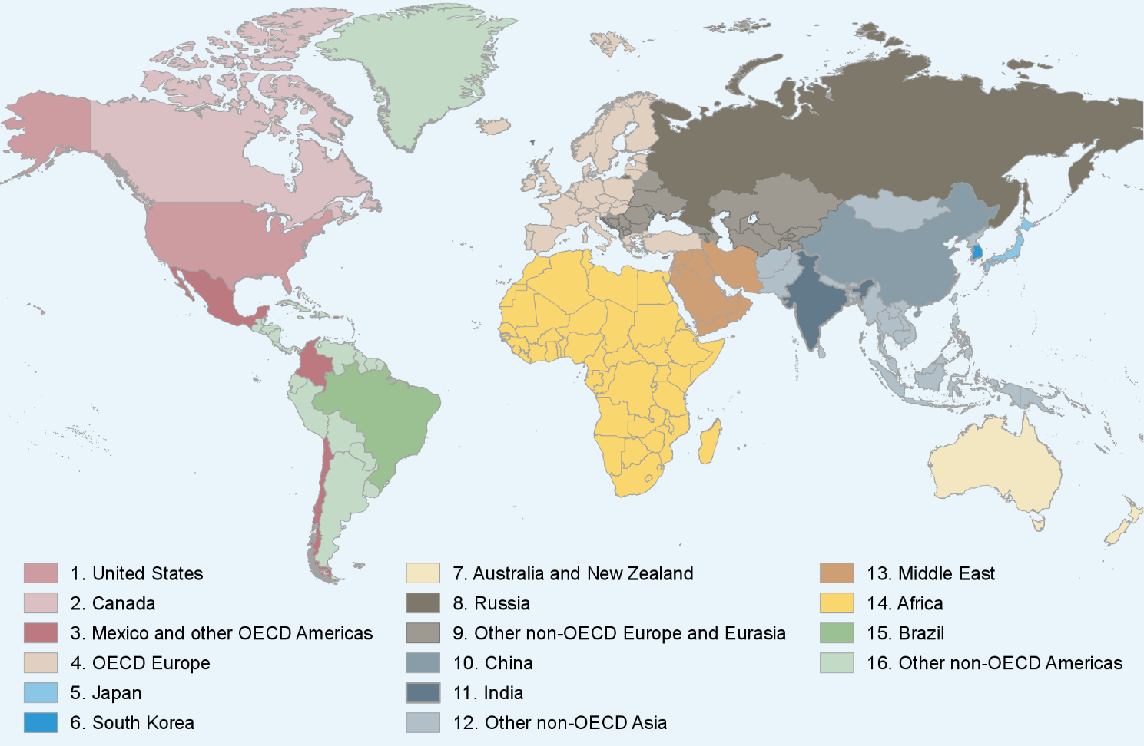
Map of IEO regions

Slide 8
For more information
U.S. Energy Information Administration home page | www.eia.gov
Short-Term Energy Outlook | www.eia.gov/outlooks/steo
Annual Energy Outlook | www.eia.gov/aeo
International Energy Outlook | www.eia.gov/ieo
Monthly Energy Review | www.eia.gov/mer
Today in Energy | www.eia.gov/todayinenergy
October 6, 2021
www.eia.gov/outlooks/ieo
#IEO2021

