Slide 1
Issues in Focus from International Energy Outlook 2020: Interregional Electricity Trade in India
Center for Strategic and International Studies
October 14, 2020 | Washington, DC
Manussawee Sukunta, Senior Renewable Electricity Analyst
U.S. Energy Information Administration

Slide 2

IEO2019 projected renewables to make up largest share of India’s electricity generation fuel mix in 2050
Share of net electricity generation, India
percent
India is the world’s third-largest energy consumer, with electricity demand projected to grow 4.7% per year on average (2018–50).
Wind plus solar generation share increases to more than 50% in 2050.
Coal-fired generation more than doubles, but its share of electricity generation falls to 38% in 2050.
other
solar
wind
hydroelectric
nuclear
natural gas
coal
Source: U.S. Energy Information Administration, International Energy Outlook 2019 (IEO2019)

Slide 3
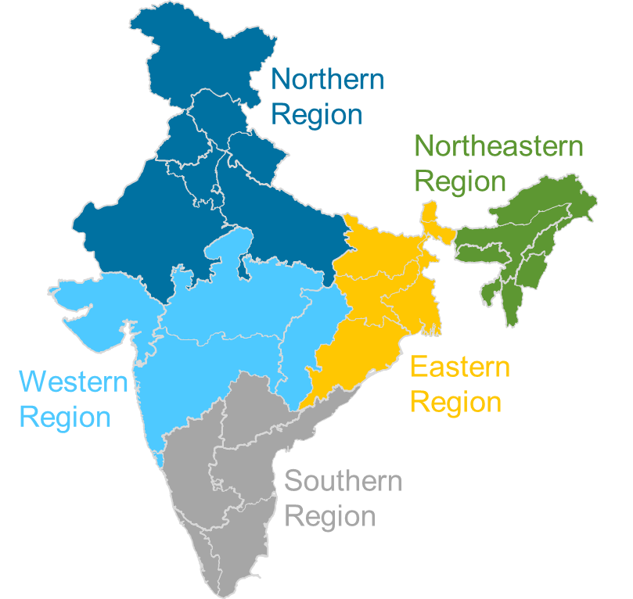
The analysis examines interregional electricity trade on generation mix
Increase geographical representation to five separated but connected power regions
IEO2019
IEO2020
Fuel costs
Renewable resources
Capital costs
Transmission capacity
Load shapes

Slide 4
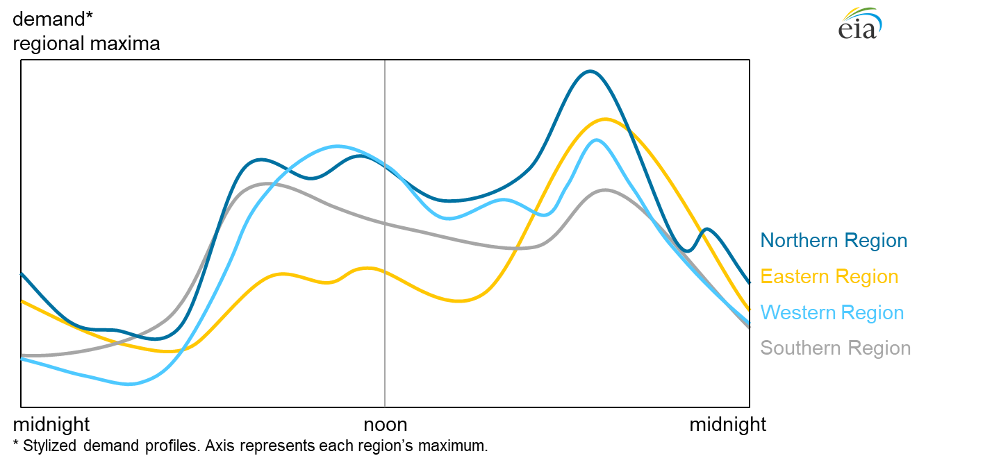
India’s electricity demand is reflected in varying demand patterns
India figurative hourly demand by region
Source: U.S. Energy Information Administration, based on Power System Operation Corporation Limited, Electricity Demand Pattern Analysis 2016.

Slide 5
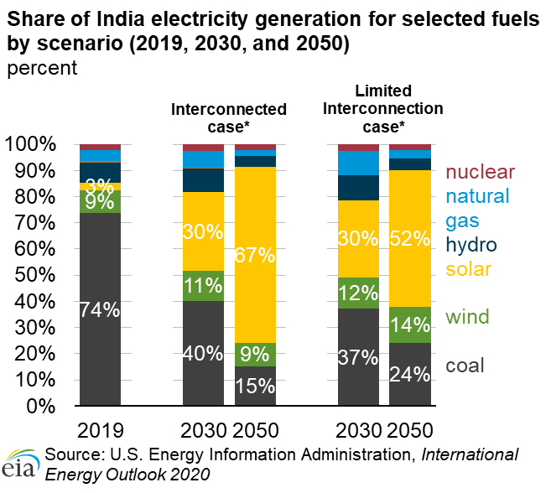
Generating fuel choices are affected by interregional electricity trading
Interregional trading allows regions to trade lower cost excess electricity to meet demand that would otherwise be met with higher cost generation.
Limited connectivity between regions typically causes existing fossil fuel generation to serve in-region demand.
The share of coal-fired generation declines as more cost competitive solar and wind meet incremental regional demand.
*Interconnected case and Restricted Trade case refer to Cases 4 and 5, respectively, that are detailed in the analysis.

Slide 6
The Interconnected and Limited Interconnection cases highlight the effect of grid coordination and trading between regions on fuel mix
Lower cost renewables, mostly solar and wind, are favored when a region is allowed to trade its lower cost excess electricity to regions that would otherwise need to meet demand with higher cost in-region generation.
Interregional electricity trade limitations between regions favor existing in-region generation which is often fossil fuel.
However, in both cases, the share of coal-fired generation is projected to decline as solar and storage, together, become more economically competitive in meeting incremental regional demand.

