Slide 1
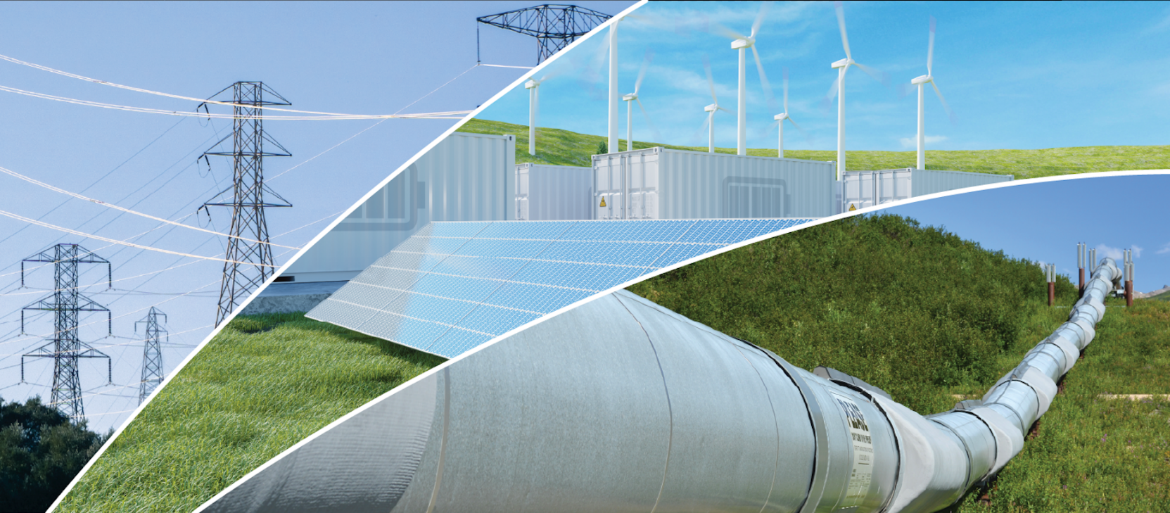

Annual Energy Outlook 2022
with projections to 2050
Narrative Figures
March 3, 2022
www.eia.gov/aeo
#AEO2022

Slide 2
You can access chart data by right-clicking the chart.

Slide 3

Electricity

Slide 4

Figure 10
Source: U.S. Energy Information Administration, Annual Energy Outlook 2022 (AEO2022)

Slide 5
Figure 11
Source: U.S. Energy Information Administration, Annual Energy Outlook 2022 (AEO2022) Reference case
Note: Onsite generation is electricity produced onsite for own use.

Slide 6
Figure 12
Source: U.S. Energy Information Administration, Annual Energy Outlook 2022 (AEO2022) Reference case
Note: Solar includes both utility-scale and end-use photovoltaic electricity generation.

Slide 7
Figure 13
Capacity factor for U.S. fossil fuel-fired plants
AEO2022 Reference case
percentage
Source: U.S. Energy Information Administration, Annual Energy Outlook 2022 (AEO2022) Reference case

Slide 8
Figure 14
Hourly U.S. electricity generation and load by fuel for selected cases and representative years
billion kilowatthours
AEO2022 Reference case, 2021 AEO2022 Reference case, 2050 AEO2022 Low Renewables Cost case, 2050
hour of the day
curtailment battery storage pumped storage solar wind hydroelectric natural gas combined-cycle natural gas and oil peakers nuclear coal
Source: U.S. Energy Information Administration, Annual Energy Outlook 2022 (AEO2022)
Note: Negative generation represents charging of energy storage technologies such as pumped hydro and battery storage. Hourly dispatch estimates are illustrative and are developed to determine curtailment and storage operations; final dispatch estimates are developed separately and may differ from total utilization as this figure shows. Solar includes both utility-scale and end-use photovoltaic electricity generation.

Slide 9
Figure 15
Hourly U.S. electricity generation and load by fuel type and season in 2050
AEO2022 Reference case
billion kilowatthours
winter summer spring and fall
load
load
hour of the day
curtailment battery storage pumped storage solar wind hydroelectric natural gas combined-cycle natural gas and oil peakers nuclear coal
Source: U.S. Energy Information Administration, Annual Energy Outlook 2022 (AEO2022) Reference case
Note: Negative generation represents charging of energy storage technologies such as pumped hydro and battery storage. Hourly dispatch estimates are illustrative and are developed to determine curtailment and storage operations; final dispatch estimates are developed separately and may differ from total utilization in Figure 15. Solar includes both utility-scale and end-use photovoltaic electricity generation.

Slide 10
Figure 16a
Hourly U.S. electricity generation and load by fuel type and region in 2050
AEO2022 Reference case
billion kilowatthours
hour of the day
curtailment battery storage pumped storage solar wind hydroelectric natural gas combined-cycle natural gas and oil peakers nuclear coal
Source: U.S. Energy Information Administration, Annual Energy Outlook 2022 (AEO2022) Reference case
Note: Negative generation represents charging of energy storage technologies such as pumped hydro and battery storage. Hourly dispatch estimates are illustrative and are developed to determine curtailment and storage operations; final dispatch estimates are developed separately and may differ from total utilization in Figure 16. Solar includes both utility-scale and end-use photovoltaic electricity generation.

Slide 11
Figure 16b
Hourly U.S. electricity generation and load by fuel type and region in 2050
AEO2022 Reference case
billion kilowatthours
Northeast PJM Southeast West
hour of the day
curtailment battery storage pumped storage solar wind hydroelectric natural gas combined-cycle natural gas and oil peakers nuclear coal
Source: U.S. Energy Information Administration, Annual Energy Outlook 2022 (AEO2022) Reference case
Note: Negative generation represents charging of energy storage technologies such as pumped hydro and battery storage. Hourly dispatch estimates are illustrative and are developed to determine curtailment and storage operations; final dispatch estimates are developed separately and may differ from total utilization in Figure 16. Solar includes both utility-scale and end-use photovoltaic electricity generation.

Slide 12
Figure 17a
Hourly U.S. electricity generation and load by fuel type and region in 2050
AEO2022 Low Renewables Cost case
billion kilowatthours
CAISO ERCOT Mid-Continent
load
hour of the day
curtailment battery storage pumped storage solar wind hydroelectric gas combined-cycle natural gas and oil peakers nuclear coal
Source: U.S. Energy Information Administration, Annual Energy Outlook 2022 (AEO2022) Low Renewables Cost case
Note: Negative generation represents charging of energy storage technologies such as pumped hydro and battery storage. Hourly dispatch estimates are illustrative and are developed to determine curtailment and storage operations; final dispatch estimates are developed separately and may differ from total utilization in Figure 17. Solar includes both utility-scale and end-use photovoltaic electricity generation.

Slide 13
Figure 17b
Hourly U.S. electricity generation and load by fuel type and region in 2050
AEO2022 Low Renewables Cost case
billion kilowatthours
Northeast PJM Southeast West
hour of the day
curtailment battery storage pumped storage solar wind hydroelectric natural gas combined-cycle natural gas and oil peakers nuclear coal
Source: U.S. Energy Information Administration, Annual Energy Outlook 2022 (AEO2022) Low Renewables Cost case
Note: Negative generation represents charging of energy storage technologies such as pumped hydro and battery storage. Hourly dispatch estimates are illustrative and are developed to determine curtailment and storage operations; final dispatch estimates are developed separately and may differ from total utilization in Figure 17. Solar includes both utility-scale and end-use photovoltaic electricity generation.

Slide 14
Figure 18
Annual electricity generating capacity additions and retirements
AEO2022 Reference case
gigawatts
Source: U.S. Energy Information Administration, Annual Energy Outlook 2022 (AEO2022) Reference case
Note: Solar includes both utility-scale and end-use photovoltaic power generation capacity.

Slide 15
Figure 19
additions
other
diurnal storage
solar
wind
nuclear
oil & gas
coal
retirements
CAISO ERCOT Mid-C Northeast PJM Southeast West
US
Source: U.S. Energy Information Administration, Annual Energy Outlook 2022 (AEO2022) Reference case
Note: Solar includes both utility-scale and end-use photovoltaic power generation capacity.

Slide 16
Figure 20
other diurnal storage solar wind nuclear oil and natural gas coal
Source: U.S. Energy Information Administration, Annual Energy Outlook 2022 (AEO2022) Reference case
Note: Solar includes both utility-scale and end-use photovoltaic power generation capacity.

