Slide 1


Annual Energy Outlook 2022
with projections to 2050
Chart library
March 3, 2022
www.eia.gov/aeo
#AEO2022

Slide 2
Annual Energy Outlook 2022 with projections to 2050
March 2022
Office of Energy Analysis
U.S. Energy Information Administration
U.S. Department of Energy
Washington, DC 20585
This publication is online at
www.eia.gov/aeo
  This report was prepared by the U.S. Energy Information Administration (EIA), the statistical and analytical agency within the U.S. Department of Energy. By law, EIA's data, analyses, and forecasts are independent of approval by any other officer or employee of the United States Government. The views in this report therefore should not be construed as representing those of the U.S. Department of Energy or other federal agencies.

Slide 3


Table of contents
Slide number
Overview of U.S. energy markets
Critical drivers
Petroleum and other liquids
Natural gas
Electricity generation
Transportation
Buildings
Industrial
Emissions
References
4
10
17
35
47
74
88
105
116
124

Slide 4
Overview of U.S. energy markets

Slide 5
Energy production and consumption
Energy production by source
AEO2022 Reference case
quadrillion British thermal units
Energy consumption by fuel
AEO2022 Reference case
quadrillion British thermal units
Note: Biofuels are shown separately and included in petroleum and other liquids.

Slide 6
Energy intensity and consumption
Indexed total energy intensity of the U.S. economy
AEO2022 Reference case
2021 = 1.0
Energy consumption by sector
AEO2022 Reference case
quadrillion British thermal units
2021
history projections
Note: Total energy intensity calculation reflects primary energy, which includes electricity losses.

Slide 7
Petroleum consumption by sector and fuel type
Petroleum and other liquids consumption by sector
AEO2022 Reference case
quadrillion British thermal units
Petroleum and other liquids consumption by fuel type
AEO2022 Reference case
million barrels per day
motor gasoline
hydrocarbon gas liquids
distillate fuel oil
jet fuel
other
residual fuel oil

Slide 8
Energy imports and exports
Gross energy trade
AEO2022 Reference case
quadrillion British thermal units
Net energy imports
AEO2022 Reference case
quadrillion British thermal units

Slide 9
Energy-related CO₂ emissions by sector and fuel source
Energy-related CO₂ emissions by sector AEO2022 Reference case
billion metric tons
Energy-related CO₂ emissions by fuel source
AEO2022 Reference case
billion metric tons
Note: Series does not include greenhouse gases other than CO₂. Industrial sector CO₂ emissions do not include process emissions, such as the emissions from cement clinker production.

Slide 10
Critical drivers

Slide 11
Crude oil price projections and natural gas price projections
North Sea Brent crude oil price
AEO2022 side cases
2021 dollars per barrel
Natural gas price at Henry Hub
AEO2022 side cases
2021 dollars per million British thermal units

Slide 12
GDP and population growth assumptions
U.S. gross domestic product assumptions
AEO2022 economic growth cases
trillion 2012 dollars
U.S. population assumptions
AEO2022 economic growth cases
millions
High Economic Growth
Reference
Low Economic Growth

Slide 13
Installation cost for solar photovoltaic (PV), wind, and natural gas capacity in renewable cost cases
Overnight installation cost, AEO2022 renewables cost cases
Reference case
2021 dollars per kilowatt
Low Renewables Cost case
2021 dollars per kilowatt
High Renewables Cost case
2021 dollars per kilowatt
wind
natural gas
solar PV
Note: Series begin in 2022.

Slide 14
Delivered energy
Delivered energy across end-use sectors
AEO2022 economic growth cases
quadrillion British thermal units
Indexed delivered energy across end-use sectors
AEO2022 economic growth cases
2021 = 1.0
High Economic Growth
Reference
Low Economic Growth

Slide 15
Delivered energy by end-use sector
Indexed delivered energy by end-use sector
AEO2022 Reference case
2021 = 1.0

Slide 16
Delivered energy intensity by sector
Indexed delivered energy intensity by sector
AEO2022 Reference case
Residential delivered energy intensity index
per household
2021 = 1.0
Commercial delivered energy intensity index
by square foot of floorspace
2021 = 1.0
Industrial delivered energy intensity index
by 2012 dollar of output
2021 = 1.0
Transportation on-road energy intensity index
by vehicle-mile
2021 = 1.0
Transportation passenger energy intensity index
by passenger-mile
2021 = 1.0
2000 2020 2050
2000 2020 2050
2000 2020 2050
2000 2020 2050
2000 2020 2050
Note: Energy intensity at the end-use sector level is typically measured as energy use relative to an indicator that most directly affects delivered energy consumption within the sector (for example, energy use per household is a key energy intensity indicator for the residential sector).

Slide 17
Petroleum and other liquids

Slide 18
Production of U.S. crude oil and natural gas plant liquids
U.S. crude oil production
AEO2022 Reference case and side cases
million barrels per day
U.S. natural gas plant liquids production
AEO2022 Reference case and side cases
million barrels per day
High Oil Price
High Oil and Gas Supply
Reference
Low Oil Price
Low Oil and Gas Supply
High Oil and Gas Supply
High Oil Price
Reference
Low Oil Price
Low Oil and Gas Supply

Slide 19
U.S. crude oil and natural gas plant liquids production and consumption
Note: Petroleum liquids does not include biofuels.

Slide 20
U.S. petroleum, other liquids, and natural gas production and consumption
production
production
consumption
consumption

Slide 21
U.S. crude oil production
Crude oil production, AEO2022 oil price cases
Reference case
million barrels per day
High Oil Price case
million barrels per day
Low Oil Price case
million barrels per day
tight oil
Alaska
Gulf of Mexico
other
tight oil
Alaska
Gulf of Mexico
other
tight oil
Alaska
Gulf of Mexico
other

Slide 22
U.S. crude oil production
Crude oil production by play
AEO2022 Reference case
million barrels per day
tight oil
Wolfcamp
Bone Springs/
Avalon
Spraberry
Eagle Ford
Bakken
Niobrara
other tight oil
Alaska
Gulf of Mexico
other

Slide 23
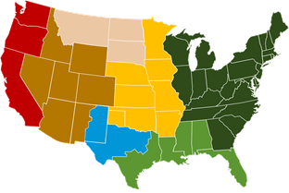
Onshore crude oil production in the Lower 48 states
Onshore crude oil production in the Lower 48 states
AEO2022 Reference case
million barrels per day

Slide 24
U.S. natural gas plant liquids production by region and type

Slide 25
U.S. refinery capacity
Refinery capacity
AEO2022 Reference case
million barrels per day
2021
history projections

Slide 26
U.S. crude oil supply and refinery utilization
Crude oil supply to domestic refineries
AEO2022 Reference case
million barrels per day
Refinery utilization
AEO2022 Reference case
percentage
2021
history projections
2021
history projections

Slide 27
U.S. crude and petroleum and other liquids trade
Total petroleum and other liquids trade
AEO2022 Reference case
million barrels per day
Crude oil trade
AEO2022 Reference case
million barrels per day

Slide 28
U.S. petroleum and other liquids trade
Petroleum and other liquids net exports
AEO2022 side cases
million barrels per day

Slide 29
U.S. motor gasoline and diesel prices
Retail prices of motor gasoline
AEO2022 oil price cases
2021 dollars per gallon
Retail prices of diesel
AEO2022 oil price cases
2021 dollars per gallon

Slide 30
U.S. biofuels production
Biofuels production, AEO2022 oil price cases
Reference case
million barrels per day
Low Oil Price case
million barrels per day
High Oil Price case
million barrels per day
biomass-based diesel
total ethanol
biomass-based diesel
total ethanol
biomass-based diesel
total ethanol
Note: Other biofuels make up less than 0.2% of biofuel production and are therefore not visible.

Slide 31
U.S. biomass-based diesel production
Biomass-based diesel production
AEO2022 Reference case
million barrels per day
Biomass-based diesel production as a percentage of petroleum diesel production
AEO2022 Reference case
percentage
2021
history projections
2021
history projections

Slide 32
U.S. biofuels consumption
Energy-related biofuels consumptionAEO2022 Reference case
million barrels per day
biomass-based diesel
total ethanol

Slide 33
U.S. ethanol and motor gasoline consumption

Slide 34
Biofuels as a percentage of U.S. motor gasoline and diesel consumption
Biofuels percentage of gasoline and diesel consumption
AEO2022 oil price cases
percentage

Slide 35
Natural gas

Slide 36
U.S. natural gas production and consumption
Dry natural gas production
AEO2022 side cases
trillion cubic feet
Natural gas consumption
AEO2022 side cases
trillion cubic feet
2021
history projections
2021
history projections
High Oil and
Gas Supply
High Oil Price
Reference
Low Oil Price
Low Oil and
Gas Supply

Slide 37
U.S. natural gas production and prices
U.S. dry natural gas production
AEO2022 oil and gas supply cases
trillion cubic feet
Natural gas spot price at Henry Hub
AEO2022 side cases
2021 dollars per million British thermal unit
2021
history projections
High Oil and
Gas Supply
Reference
Low Oil and
Gas Supply

Slide 38
U.S. dry natural gas production
Dry natural gas production, AEO2022 oil and natural gas supply cases
Reference case
trillion cubic feet
Low Oil and Gas Supply case
trillion cubic feet
High Oil and Gas Supply case
trillion cubic feet
tight &
shale gas
other Lower
48 states
onshore
Lower 48
states
offshore
other
Note: Tight and shale gas includes tight gas, shale gas, and natural gas from tight oil formations.

Slide 39
U.S. production of natural gas from shale resources by region
Dry natural gas production from shale resources, AEO2022 oil price cases
Reference case
trillion cubic feet
Low Oil Price case
trillion cubic feet
High Oil Price case
trillion cubic feet
2021
history projections
Southwest
East
Gulf Coast
Southwest
East
Gulf Coast
rest of United States
rest of United States
rest of United States
Note: Shale resources includes natural gas production from tight oil formations and excludes natural gas from tight gas formations.

Slide 40
U.S. production of natural gas from oil formations
Dry natural gas production from oil formations, AEO2022 oil and gas supply cases
Reference case
trillion cubic feet
Low Oil and Gas Supply case
trillion cubic feet
High Oil and Gas Supply case
trillion cubic feet

Slide 41
U.S. natural gas production from shale resources
Dry natural gas production by selected shale play
trillion cubic feet
2021
history projections
Note: Other includes natural gas production from other tight oil formations.

Slide 42
U.S. natural gas consumption by sector
Natural gas consumption
AEO2022 Reference case
trillion cubic feet
2021
history projections
electric power
commercial
residential
transportation
industrial
liquefaction
lease and plant
other

Slide 43
U.S. natural gas disposition by sector
Natural gas disposition and net exports
AEO2022 Reference case
trillion cubic feet
Change in natural gas disposition and net exports
AEO2022 Reference case
relative to 2021 in trillion cubic feet
net exports
electric power
commercial
residential
transportation
industrial
net exports
electric power
commercial
transportation
industrial
residential

Slide 44
U.S. natural gas and liquefied natural gas (LNG) trade
Natural gas trade, AEO2022 oil and natural gas supply cases
Reference case
trillion cubic feet
Low Oil and Gas Supply case
trillion cubic feet
High Oil and Gas Supply case
trillion cubic feet billion cubic feet per day
LNG exports
net exports
pipeline exports
to Mexico
pipeline exports
to Canada
pipeline imports
from Canada
LNG imports

Slide 45
U.S. liquefied natural gas (LNG) exports and oil and natural gas prices
LNG exports
AEO2022 supply and price cases
trillion cubic feet
Ratio of Brent crude oil price to natural gas price
at Henry Hub, AEO2022 supply and price cases
energy-equivalent terms
High Oil
Price
High Oil
and Gas Supply
Reference
Low Oil
Price
Low Oil
and Gas Supply
2021
history projections
High Oil
Price
High Oil
and Gas Supply
Reference
Low Oil
Price
Low Oil
and Gas Supply

Slide 46
U.S. liquefied natural gas exports and export capacity
Liquefied natural gas (LNG) exports and capacity
AEO2022 Reference case
trillion cubic feet
2021
history projections
current/under construction U.S. LNG export capacity as of 2021

Slide 47
Electricity

Slide 48
U.S. electricity generation and shares from selected fuels and renewable sources

Slide 49
U.S. electricity demand
Note: Onsite generation is electricity produced onsite for own use.

Slide 50
U.S. electricity generation levels from selected fuels and renewable sources
U.S. electricity generation, AEO2022 oil and gas supply cases
Note: Renewables category includes electricity generation from wind, solar, hydroelectric, geothermal, wood, and other biomass sources.

Slide 51
U.S. electricity generation levels from selected fuels and renewable sources
U.S. electricity generation, AEO2022 renewables cost cases
Note: Renewables category includes electricity generation from wind, solar, hydroelectric, geothermal, wood, and other biomass sources.

Slide 52
U.S. retiring and new generating capacity
Annual electricity generating capacity additions and retirements
AEO2022 Reference case
gigawatts
Source: Form EIA-860M, Monthly Update to the Annual Electric Generator Report, August 2021

Slide 53
U.S. cumulative retiring and new generating capacity
2

Slide 54
Regional cumulative capacity additions and retirements
additions
other
diurnal storage
solar
wind
nuclear
oil & gas
coal
retirements
CAISO ERCOT Mid-C Northeast PJM Southeast West
US

Slide 55
Electricity prices by components and long-term average electricity prices

Slide 56
Hybrid versus stand-alone solar PV and energy storage systems
U.S. solar photovoltaic (PV) generating capacity,
all sectors
AEO2022 Reference case
gigawatts
U.S. storage energy capacity, electric power sector
AEO2022 Reference case
billion kilowatthours
stand-alone solar PV, electric power sector

Slide 57
Renewable capacity by source and region
HC = High Renewable Cost; LC = Low Renewable Cost; HOGS = High Oil & Gas Supply; LOGS = Low Oil & Gas Supply; other = geothermal, biomass, municipal waste

Slide 58
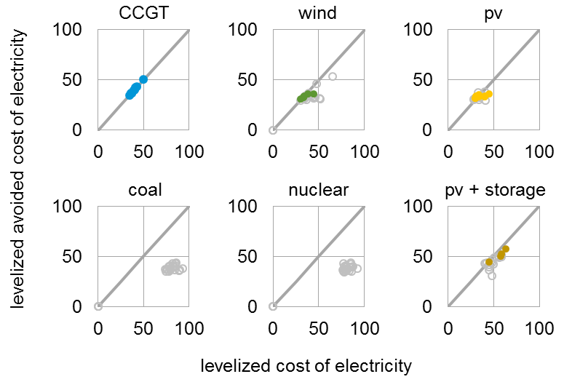
Economic cost competitiveness of generating technologies
Levelized avoided cost of electricity (LACE) and levelized cost of electricity (LCOE) by technology,
2027 online year, AEO2022 Reference case
2021 dollars per megawatthour
regions with built capacity
regions with no built capacity
Economically attractive builds are shown above the diagonal breakeven line for each technology.
The solid, colored circles on the figure indicate that projects tend to be built in regions where revenue (LACE) exceeds costs (LCOE).
CCGT = natural gas combined cycle, PV = solar photovoltaic

Slide 59
U.S. renewable portfolio standards
solar
wind
hydroelectric
other renewables
nuclear
required compliant generation

Slide 60
U.S. nuclear capacity and annual capacity changes
U.S. nuclear electricity generating capacity
AEO2022 oil and natural gas supply cases
gigawatts
Year-over-year nuclear capacity changes
AEO2022 Reference case
gigawatts

Slide 61
U.S. coal-fired generation, capacity, and capacity factors

Slide 62
U.S. coal-fired generating capacity relative to natural gas prices
U.S. electric generating capacity
AEO2022 oil and gas supply cases
gigawatts
Average delivered natural gas prices to the electric power sector
2021 dollars per million British thermal units

Slide 63
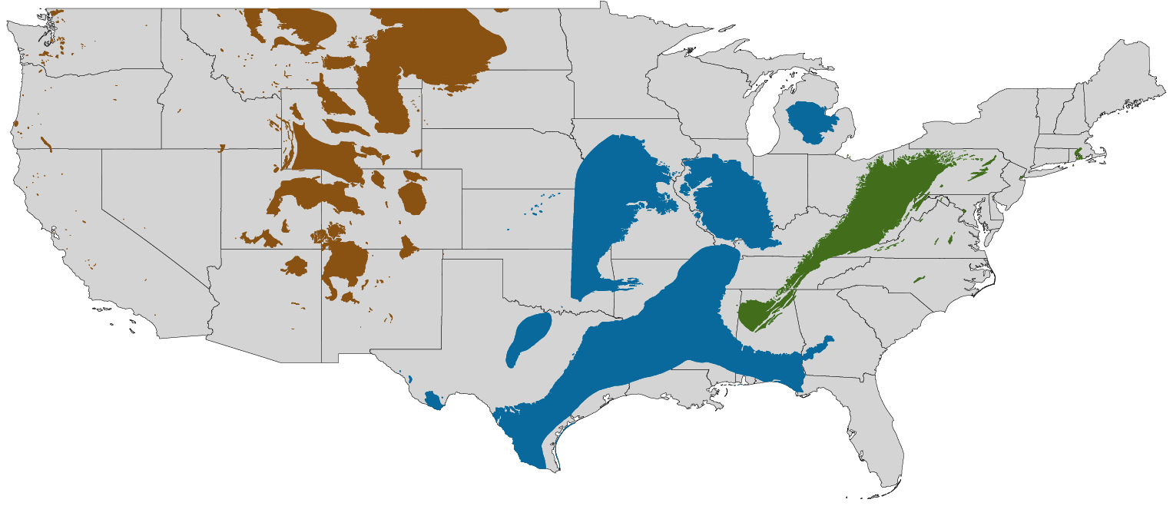
Coal production by U.S. region
U.S. coal production by region, AEO2022 oil and gas supply cases
Reference case
million short tons
Low Oil and Gas Supply case
million short tons
High Oil and Gas Supply case
million short tons
2021
projections
2021
projections
total
West
Appalachia
Interior

Slide 64
U.S. fossil fuel-fired plant capacity factors
Capacity factor for U.S. fossil fuel-fired plants
AEO2022 Reference case
percentage
Note: New combined-cycle (natural gas) plants are assumed to come online in 2023. New builds as shown are multi-shaft combined-cycle units. Existing combined cycle units include both multi-shaft and single-shaft; 12 gigawatts of new single-shaft combined-cycle units are included in existing.

Slide 65
U.S. electricity generation by source
Hourly U.S. electricity generation and load by fuel for selected cases and representative years
billion kilowatthours
AEO2022 Reference case, 2021 AEO2022 Reference case, 2050 AEO2022 Low Renewables Cost case, 2050
hour of the day
curtailment battery storage pumped storage solar wind hydroelectric natural gas combined-cycle natural gas and oil peakers nuclear coal
Note: Negative generation represents charging of energy storage technologies such as pumped hydro and battery storage. Hourly dispatch estimates are illustrative and are developed to determine curtailment and storage operations; final dispatch estimates are developed separately and may differ from total utilization as this figure shows. Solar includes both utility-scale and end-use photovoltaic electricity generation

Slide 66
Seasonal U.S. electricity generation by source
Hourly U.S. electricity generation and load by fuel type and season in 2050
AEO2022 Reference case
billion kilowatthours
winter summer spring and fall
load
load
hour of the day
curtailment battery storage pumped storage solar wind hydroelectric natural gas combined-cycle natural gas and oil peakers nuclear coal

Slide 67
Regional U.S. electricity generation by source
Hourly U.S. electricity generation and load by fuel type and region in 2050
AEO2022 Reference case
billion kilowatthours
CAISO ERCOT Mid-Continent
load
load
load
hour of the day
curtailment battery storage pumped storage solar wind hydroelectric natural gas combined-cycle natural gas and oil peakers nuclear coal

Slide 68
Regional U.S. electricity generation by source
Hourly U.S. electricity generation and load by fuel type and region in 2050
AEO2022 Reference case
billion kilowatthours
Northeast PJM Southeast West
load
load
load
load
hour of the day
curtailment battery storage pumped storage solar wind hydroelectric natural gas combined-cycle natural gas and oil peakers nuclear coal

Slide 69
Regional U.S. electricity generation by source
Hourly U.S. electricity generation and load by fuel type and region in 2050
AEO2022 Low Renewables Cost case
billion kilowatthours
CAISO ERCOT Mid-Continent
load
load
load
hour of the day
curtailment battery storage pumped storage solar wind hydroelectric gas combined-cycle natural gas and oil peakers nuclear coal

Slide 70
Regional U.S. electricity generation by source
Hourly U.S. electricity generation and load by fuel type and region in 2050
AEO2022 Low Renewables Cost case
billion kilowatthours
Northeast PJM Southeast West
load
load
load
load
hour of the day
curtailment battery storage pumped storage solar wind hydroelectric natural gas combined-cycle natural gas and oil peakers nuclear coal

Slide 71
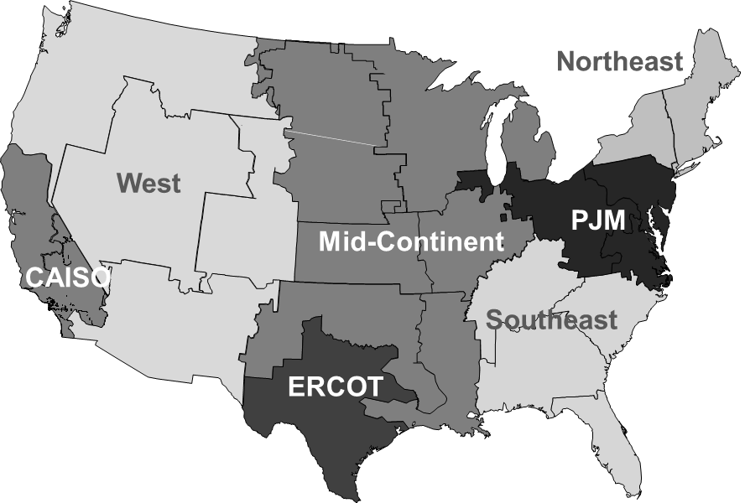
All-sector solar and wind penetration by region
All-sector solar penetration by region, AEO2022 Reference case (2010–2050)
All-sector wind penetration by region,
AEO2022 Reference case (2010–2050)
71

Slide 72
Solar and wind penetration and curtailment by selected regions
Solar and wind penetration by regions in AEO2022 Reference case, 2021-2050
Solar and wind curtailment by regions in AEO2022 Reference case, 2021-2050

Slide 73
Installed electric generating capacity by source
other diurnal storage solar wind nuclear oil and natural gas coal

Slide 74
Transportation

Slide 75
Transportation sector energy consumption
Transportation sector consumption by mode
AEO2022 Reference case
quadrillion British thermal units
Transportation sector consumption by fuel
AEO2022 Reference case
quadrillion British thermal units
light-duty
vehicles
medium- and
heavy-duty
vehicles
air
commercial
light trucks
rail
marine
other

Slide 76
Transportation sector consumption of minor petroleum and alternative fuels
Transportation sector consumption of minor petroleum and alternative fuels
AEO2022 Reference case
quadrillion British thermal units

Slide 77
Transportation sector delivered electricity and natural gas
Delivered electricity by mode
AEO2022 Reference case
quadrillion British thermal units
Delivered compressed and liquefied natural gas by mode
AEO2022 Reference case
quadrillion British thermal units

Slide 78
Passenger and freight travel by mode

Slide 79
Energy intensity by transportation mode
Passenger travel energy intensity by mode
AEO2022 Reference case
thousand British thermal units per passenger-mile
Freight travel energy intensity by mode
AEO2022 Reference case
thousand British thermal units per ton-mile

Slide 80
Indexed travel indicators and energy use by mode
Indexed light-duty vehicle travel
and energy use
AEO2022 Reference case
2019 = 1.0
Indexed freight and commercial truck travel and energy use
AEO2022 Reference case
2019 = 1.0
Indexed aircraft travel and energy use
AEO2022 Reference case
2019 = 1.0
energy efficiency
travel demand
energy consumption
travel demand
energy efficiency
energy consumption
Note: Indexed freight and commercial truck energy efficiency is weighted by each vehicle type’s relative share of energy consumption.

Slide 81
New light-duty vehicle sales by type
2020 2030 2040 2050
2020 2030 2040 2050

Slide 82
Light-duty vehicle sales by technology or fuel type

Slide 83
On-road vehicle fuel economy
Note: Combined represents the average of light-duty vehicles.

Slide 84
Light-duty vehicle fuel economy and per capita travel
new light-duty vehicles
total light-duty vehicle stock

Slide 85
Air travel energy use by travel type
Energy use by air mode
AEO2022 Reference case
quadrillion British thermal units
cargo
passenger domestic flights
passenger international flights
general aviation

Slide 86
Passenger aircraft sales and jet fuel efficiency
U.S. passenger jet sales by body type
AEO2022 Reference case
individual aircraft sold
U.S. passenger jet fuel efficiency index
AEO2022 Reference case
2019 = 1.0
revenue passenger-miles
revenue passenger-miles per gallon
energy consumption
narrow body aircraft
wide body aircraft
regional aircraft

Slide 87
Passenger travel demand and aircraft stock
Active versus parked passenger and cargo stock
AEO2022 Reference case
thousand aircraft
Revenue passenger-miles Average passenger
AEO2022 Reference case load factors
trillion passenger-miles percentage
passenger load factors
revenue-passenger miles
active passenger aircraft
active cargo aircraft
parked passenger aircraft
Note: Load factors are weighted by domestic and U.S.-originating or U.S.-bound flights’ relative share of revenue passenger-miles.

Slide 88
Buildings

Slide 89
Total buildings sector delivered energy consumption
Buildings delivered energy consumption
AEO2022 Reference case
quadrillion British thermal units
residential buildings
commercial buildings

Slide 90
Residential and commercial buildings energy consumption
electricity
natural gas
petroleum and other liquids
other
electricity
natural gas
petroleum and other liquids
other

Slide 91
Change in population and residential housing stocks
population
millions, U.S. population
Residential housing unit and population changes by region and type in 2021 and 2050
AEO2022 Reference case
millions, residential housing units
census divisions
New
England
West
North
Central
East
North
Central
Middle Atlantic
Mountain
population
mobile
multifamily
single-family
West
South
Central
East
South
Central
South
Atlantic
Pacific

Slide 92
Commercial buildings floorspace growth
Commercial floorspace in 2021 and growth in floorspace from 2021 to 2050
AEO2022 Reference case
percentage growth
compound annual growth rate (CAGR) (2021 to 2050)
total floorspace in 2021
(billion square feet)
CAGR
billion square feet

Slide 93
Population-weighted heating and cooling degree days

Slide 94
Residential and commercial electricity and natural gas prices

Slide 95
Residential and commercial energy intensity
Indexed residential delivered energy intensity
AEO2022 Reference case
indexed annual energy use per household
2021 = 1.0
Indexed commercial delivered energy intensity
AEO2022 Reference case
indexed annual energy use per square foot
2021 = 1.0
2021
history projections
purchased electricity
total delivered energy
natural gas
purchased electricity
total delivered energy
natural gas

Slide 96
Residential and commercial overall energy intensity by end use
Commercial energy intensity by end use
AEO2022 Reference case
Residential energy intensity by end use
AEO2022 Reference case
million British thermal units per household
thousand British thermal units per square foot
Note: Intensities reflect all energy sources consumed, including both purchased electricity and electricity produced onsite for own use.

Slide 97
Residential and commercial electricity intensity by end use
Commercial electricity intensity by end use
AEO2022 Reference case
Residential electricity intensity by end use
AEO2022 Reference case
thousand kilowatthours per household
kilowatthours per square foot
Note: Intensities reflect both purchased electricity and electricity produced onsite for own use.

Slide 98
Commercial building end-use intensities
Indexed commercial service provided per square foot of floorspace
AEO2022 Reference case
2021 = 1.0
ventilation
cooking
lighting
space cooling
space heating

Slide 99
Residential and commercial onsite generation versus purchased electricity
Residential sector electricity consumption
AEO2022 Reference case
quadrillion British thermal units
Commercial sector electricity consumption
AEO2022 Reference case
quadrillion British thermal units
onsite generation for own use
purchased electricity
onsite generation for own use
purchased electricity

Slide 100
Residential electricity use and miscellaneous electrical loads
cooking
lighting
laundry and dishwashing
refrigeration
and freezing
water heating
space heating
space cooling
characterized miscellaneous electric loads
(MELS)
other MELs
security systems
tablets, phones, smart speakers and rechargeable devices
small kitchen appliances
PCs and related equipment
pool pumps, heaters, and spas
ceiling fans and dehumidifiers
televisions and related equipment
Note: The other MELs category includes aggregated energy use for end uses not explicitly characterized in the right-hand chart, as well as unspecified electricity consumption.

Slide 101
Commercial electricity use and miscellaneous electrical loads
water heating,
cooking, and
space heating
lighting
ventilation
space cooling
refrigeration and freezing
characterized miscellaneous electric loads
(MELs)
other MELs
lab and diagnostic equipment
transformers
water services, parking lot lighting, and other non-building uses
IT and office equipment
Note: The other MELs category includes aggregated energy use for end uses not explicitly characterized in the right-hand chart, as well as unspecified electricity consumption.

Slide 102
Residential and commercial solar photovoltaic generation capacity
Residential solar distributed generation capacity
AEO2022 Reference and side cases
gigawatts direct current
Commercial solar distributed generation capacity
AEO2022 Reference and side cases
gigawatts direct current
Low Renewables Cost
Low Oil and Gas Supply
Reference
High Oil and Gas Supply
High Renewables Cost
Low Oil and Gas Supply
Low Renewables Cost
High Renewables Cost
Reference
High Oil and Gas Supply
2020 2030 2040 2050
2020 2030 2040 2050

Slide 103
Commercial distributed generation capacity
Commercial distributed generation capacity
AEO2022 Reference case
gigawatts direct current
Commercial non-solar distributed generation capacity
AEO2022 Reference case
gigawatts direct current
natural gas-fired combined heat and power
municipal solid waste/other
wind
solar
microturbines
natural gas-fired engines
fuel cells
natural gas-fired turbines
municipal solid waste/other
wind

Slide 104
Residential and commercial lighting consumption and lighting shares
residential sector
percentage
commercial sector
percentage
other linear fluorescent
incandescent/halogen light-emitting diode (LED) A-line/reflector
compact fluorescent lamp (CFL) LED integrated luminaire
Note: Includes both purchased electricity and onsite generation for own use.

Slide 105
Industrial

Slide 106
Industrial sector energy consumption
Industrial energy consumption by fuel
AEO2022 Reference case
quadrillion British thermal units
Industrial energy consumption by subsector
AEO2022 Reference case
quadrillion British thermal units

Slide 107
Industrial sector delivered energy consumption across cases
Industrial delivered energy consumption
AEO2022 selected side cases
quadrillion British thermal units
High Economic Growth
High Oil Price
High Oil and Gas Supply
Reference
Low Oil Price
Low Economic Growth
Low Oil and Gas Supply

Slide 108
Industrial sector energy intensity
Energy intensity by subsector
AEO2022 Reference case
trillion British thermal units per billion 2012 dollar shipments
Energy-intensive manufacturing by industry
AEO2022 Reference case
trillion British thermal units per billion 2012 dollar shipments
total industry
manufacturing
energy-intensive
manufacturing
non-energy intensive
manufacturing
non-manufacturing

Slide 109
Iron and steel industry energy consumption by source
Iron and steel industry energy consumption by source
AEO2022 Reference case
quadrillion British thermal units
petroleum and other liquids
purchased electricity
natural gas
coal

Slide 110
Cement and lime industry energy consumption by source
Cement and lime industry energy consumption by source
AEO2022 Reference case
quadrillion British thermal units
petroleum and other liquids
purchased electricity
natural gas
renewables
coal

Slide 111
Pulp and paper industry energy consumption by source
Pulp and paper industry energy consumption by source
AEO2022 Reference case
quadrillion British thermal units
petroleum and other liquids
coal
purchased electricity
natural gas
renewables

Slide 112
Bulk chemicals industry energy consumption by source
Bulk chemicals industry energy consumption by source
AEO2022 Reference case
quadrillion British thermal units
other
purchased electricity
natural gas feedstock
natural gas heat and power
petrochemical feedstock
hydrocarbon gas liquids feedstock
Note: Other includes coal, renewables, and other petroleum.

Slide 113
Hydrocarbon gas liquid and naphtha feedstocks consumed for chemical production
Hydrocarbon gas liquid (HGL) and naphtha chemical feedstocks
AEO2022 Reference case
quadrillion British thermal units
natural gasoline
butanes
propane
ethane
naphtha
Note: Excludes propylene.

Slide 114
Industrial sector combined-heat-and-power (CHP) generation
CHP generation by industry
AEO2022 Reference case
billion kilowatthours
CHP generation by fuel
AEO2022 Reference case
billion kilowatthours
coal
other fuels
natural gas
other
bulk chemicals
refining
paper
Note: Other fuels includes renewables and other petroleum.

Slide 115
Industrial sector CO₂ emissions and CO₂ intensity
Industrial sector CO₂ emissions
AEO2022 economic growth cases
billion metric tons of CO₂
Industrial sector CO₂ intensity
AEO2022 Reference case
metric tons of CO₂ per billion British thermal units
2021
history projections
High Economic Growth
Reference
Low Economic Growth
Low Economic Growth
Reference
High Economic Growth
Note: Series does not include greenhouse gases other than CO₂. Industrial sector CO₂ emissions do not include process emissions, such as the emissions from cement clinker production. Series excludes power sector emissions.

Slide 116
CO₂
Emissions

Slide 117

CO₂ emissions based on macroeconomic growth assumptions
U.S. energy-related CO₂ emissions
AEO2022 economic growth cases
billion metric tons

Slide 118
Energy-related CO₂ emissions by sector and fuel
Energy-related CO₂ emissions by sector
AEO2022 Reference case
billion metric tons
Energy-related CO₂ emissions by fuel
AEO2022 Reference case
billion metric tons
Note: Series does not include greenhouse gases other than CO₂. Industrial sector CO₂ emissions do not include process emissions, such as the emissions from cement clinker production.

Slide 119
Energy-related CO₂ emissions based on oil price assumptions
U.S. energy-related CO₂ emissions
AEO2022 oil price cases
billion metric tons

Slide 120
Energy-related CO₂ emissions by sector based on oil price assumptions
CO₂ emissions by sector, AEO2022 oil price cases
Reference case
billion metric tons
Low Oil Price case
billion metric tons
High Oil Price case
billion metric tons
transportation
industrial
electric power
residential
commercial
Note: Industrial sector CO₂ emissions do not include process emissions, such as the emissions from cement clinker production.

Slide 121
Electric power generation and energy-related CO₂ emissions based on oil and natural gas supply assumptions
CO₂ emissions and electric power generation, AEO2022 oil and natural gas supply cases
U.S. energy-related CO₂ emissions
billion metric tons
Fossil fuel-fired electric power generation
trillion kilowatthours
Renewable electric power generation
trillion kilowatthours

Slide 122
Electric power generation and energy-related CO₂ emissions based on renewable cost assumptions
CO₂ emissions and electric power generation, AEO2022 renewables cost cases
U.S. energy-related CO₂ emissions
billion metric tons
Fossil fuel-fired electric power generation
trillion kilowatthours
Renewable electric power generation
trillion kilowatthours

Slide 123
CO₂ intensity by sector
CO₂ intensity by end-use sector
AEO2022 Reference case
metric tons of CO₂ per billion British thermal unit
Note: Each end-use sector takes into account the carbon intensity of electric power. Industrial sector CO₂ emissions do not include process emissions, such as the emissions from cement clinker production.

Slide 124
References

Slide 125
Abbreviations
AEO = Annual Energy Outlook
Bcf/d = billion cubic feet per day
CAGR = compound annual growth rate
CAISO = California Independent System Operator
CCGT = natural gas combined cycle
CFL = compact fluorescent lamp
CHP = combined heat and power
CO2 = carbon dioxide
EIA = U.S. Energy Information Administration
ERCOT = Electric Reliability Council of Texas
GDP = gross domestic product
HC = High Renewable Cost case
HOGS = High Oil and Gas Supply case
LC = Low Renewable Cost case
LED = light-emitting diode
LNG = liquefied natural gas
LOGS = Low Oil and Gas Supply case
PJM = Pennsylvania-New Jersey-Maryland Interconnection
PV = photovoltaic
Tcf = trillion cubic feet
EIA Glossary | www.eia.gov/tools/glossary

Slide 126
Graph sources
Projected values are sourced from
  Projections: EIA, AEO2022 National Energy Modeling System (runs: ref2021.d011222a, highprice.d011222a, lowprice.d011222a, highmacro.d011622a, lowmacro.d011222a, highogs.d011222a, lowogs.d011222a, hirencst.d011322a, lorencst.d011222a)
EIA historical data are sourced from
  Monthly Energy Review (and supporting databases), October 2021
  Form EIA-860M, Preliminary Monthly Electric Generator Inventory, August 2021
For source information for specific graphs published in this document, contact annualenergyoutlook@eia.gov.

Slide 127
For more information
AEO Working Groups | https://www.eia.gov/outlooks/aeo/workinggroup/
AEO Analysis and Forecasting Experts | https://www.eia.gov/about/contact/forecasting.php#longterm
U.S. Energy Information Administration homepage | www.eia.gov
Short-Term Energy Outlook | www.eia.gov/steo
Annual Energy Outlook | www.eia.gov/aeo
International Energy Outlook | www.eia.gov/ieo
Monthly Energy Review | www.eia.gov/mer
Today in Energy | www.eia.gov/todayinenergy
EIA’s Application Programming Interface (API) | www.eia.gov/opendata

