Slide 1
Electricity

Slide 2
U.S. electricity generation and shares from selected fuels and renewable sources

Slide 3
U.S. electricity demand
Note: Onsite generation is electricity produced onsite for own use.

Slide 4
U.S. electricity generation levels from selected fuels and renewable sources
U.S. electricity generation, AEO2022 oil and gas supply cases
Note: Renewables category includes electricity generation from wind, solar, hydroelectric, geothermal, wood, and other biomass sources.

Slide 5
U.S. electricity generation levels from selected fuels and renewable sources
U.S. electricity generation, AEO2022 renewables cost cases
Note: Renewables category includes electricity generation from wind, solar, hydroelectric, geothermal, wood, and other biomass sources.

Slide 6
U.S. retiring and new generating capacity
Annual electricity generating capacity additions and retirements
AEO2022 Reference case
gigawatts
Source: Form EIA-860M, Monthly Update to the Annual Electric Generator Report, August 2021

Slide 7
U.S. cumulative retiring and new generating capacity
2

Slide 8
Regional cumulative capacity additions and retirements
additions
other
diurnal storage
solar
wind
nuclear
oil & gas
coal
retirements
CAISO ERCOT Mid-C Northeast PJM Southeast West
US

Slide 9
Electricity prices by components and long-term average electricity prices

Slide 10
Hybrid versus stand-alone solar PV and energy storage systems
U.S. solar photovoltaic (PV) generating capacity,
all sectors
AEO2022 Reference case
gigawatts
U.S. storage energy capacity, electric power sector
AEO2022 Reference case
billion kilowatthours
stand-alone solar PV, electric power sector

Slide 11
Renewable capacity by source and region
HC = High Renewable Cost; LC = Low Renewable Cost; HOGS = High Oil & Gas Supply; LOGS = Low Oil & Gas Supply; other = geothermal, biomass, municipal waste

Slide 12
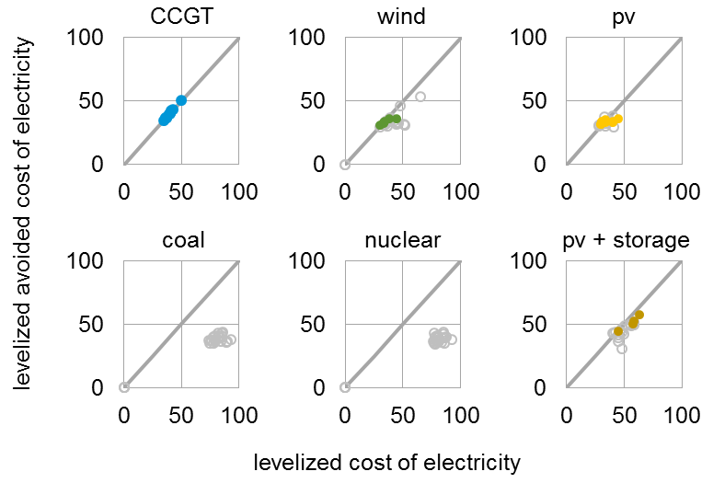
Economic cost competitiveness of generating technologies
Levelized avoided cost of electricity (LACE) and levelized cost of electricity (LCOE) by technology,
2027 online year, AEO2022 Reference case
2021 dollars per megawatthour
regions with built capacity
regions with no built capacity
Economically attractive builds are shown above the diagonal breakeven line for each technology.
The solid, colored circles on the figure indicate that projects tend to be built in regions where revenue (LACE) exceeds costs (LCOE).
CCGT = natural gas combined cycle, PV = solar photovoltaic

Slide 13
U.S. renewable portfolio standards
solar
wind
hydroelectric
other renewables
nuclear
required compliant generation

Slide 14
U.S. nuclear capacity and annual capacity changes
U.S. nuclear electricity generating capacity
AEO2022 oil and natural gas supply cases
gigawatts
Year-over-year nuclear capacity changes
AEO2022 Reference case
gigawatts

Slide 15
U.S. coal-fired generation, capacity, and capacity factors

Slide 16
U.S. coal-fired generating capacity relative to natural gas prices
U.S. electric generating capacity
AEO2022 oil and gas supply cases
gigawatts
Average delivered natural gas prices to the electric power sector
2021 dollars per million British thermal units

Slide 17
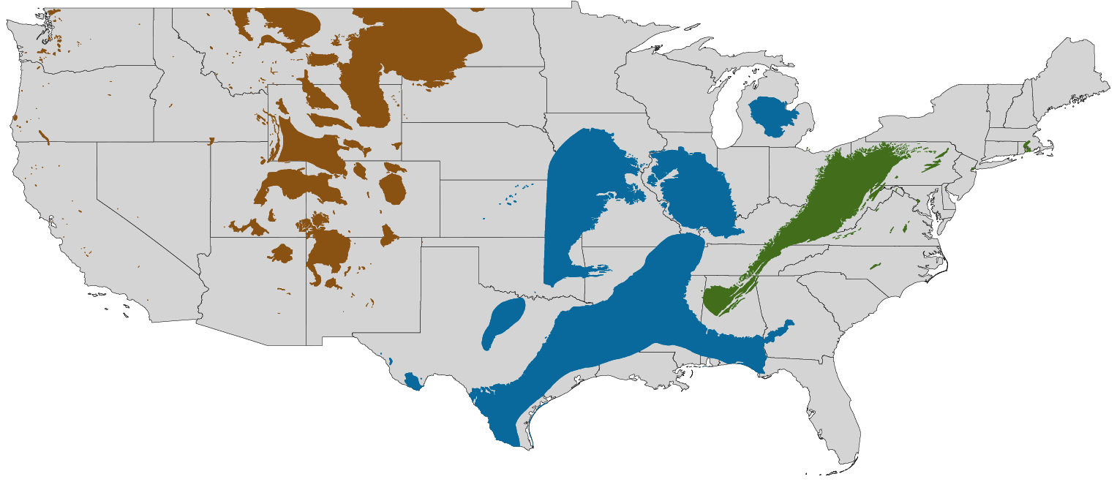
Coal production by U.S. region
U.S. coal production by region, AEO2022 oil and gas supply cases
Reference case
million short tons
Low Oil and Gas Supply case
million short tons
High Oil and Gas Supply case
million short tons
2021
projections
2021
projections
total
West
Appalachia
Interior

Slide 18
U.S. fossil fuel-fired plant capacity factors
Capacity factor for U.S. fossil fuel-fired plants
AEO2022 Reference case
percentage
Note: New combined-cycle (natural gas) plants are assumed to come online in 2023. New builds as shown are multi-shaft combined-cycle units. Existing combined cycle units include both multi-shaft and single-shaft; 12 gigawatts of new single-shaft combined-cycle units are included in existing.

Slide 19
U.S. electricity generation by source
Hourly U.S. electricity generation and load by fuel for selected cases and representative years
billion kilowatthours
AEO2022 Reference case, 2021 AEO2022 Reference case, 2050 AEO2022 Low Renewables Cost case, 2050
hour of the day
curtailment battery storage pumped storage solar wind hydroelectric natural gas combined-cycle natural gas and oil peakers nuclear coal
Note: Negative generation represents charging of energy storage technologies such as pumped hydro and battery storage. Hourly dispatch estimates are illustrative and are developed to determine curtailment and storage operations; final dispatch estimates are developed separately and may differ from total utilization as this figure shows. Solar includes both utility-scale and end-use photovoltaic electricity generation

Slide 20
Seasonal U.S. electricity generation by source
Hourly U.S. electricity generation and load by fuel type and season in 2050
AEO2022 Reference case
billion kilowatthours
winter summer spring and fall
load
load
hour of the day
curtailment battery storage pumped storage solar wind hydroelectric natural gas combined-cycle natural gas and oil peakers nuclear coal

Slide 21
Regional U.S. electricity generation by source
Hourly U.S. electricity generation and load by fuel type and region in 2050
AEO2022 Reference case
billion kilowatthours
CAISO ERCOT Mid-Continent
load
load
load
hour of the day
curtailment battery storage pumped storage solar wind hydroelectric natural gas combined-cycle natural gas and oil peakers nuclear coal

Slide 22
Regional U.S. electricity generation by source
Hourly U.S. electricity generation and load by fuel type and region in 2050
AEO2022 Reference case
billion kilowatthours
Northeast PJM Southeast West
load
load
load
load
hour of the day
curtailment battery storage pumped storage solar wind hydroelectric natural gas combined-cycle natural gas and oil peakers nuclear coal

Slide 23
Regional U.S. electricity generation by source
Hourly U.S. electricity generation and load by fuel type and region in 2050
AEO2022 Low Renewables Cost case
billion kilowatthours
CAISO ERCOT Mid-Continent
load
load
load
hour of the day
curtailment battery storage pumped storage solar wind hydroelectric gas combined-cycle natural gas and oil peakers nuclear coal

Slide 24
Regional U.S. electricity generation by source
Hourly U.S. electricity generation and load by fuel type and region in 2050
AEO2022 Low Renewables Cost case
billion kilowatthours
Northeast PJM Southeast West
load
load
load
load
hour of the day
curtailment battery storage pumped storage solar wind hydroelectric natural gas combined-cycle natural gas and oil peakers nuclear coal

Slide 25
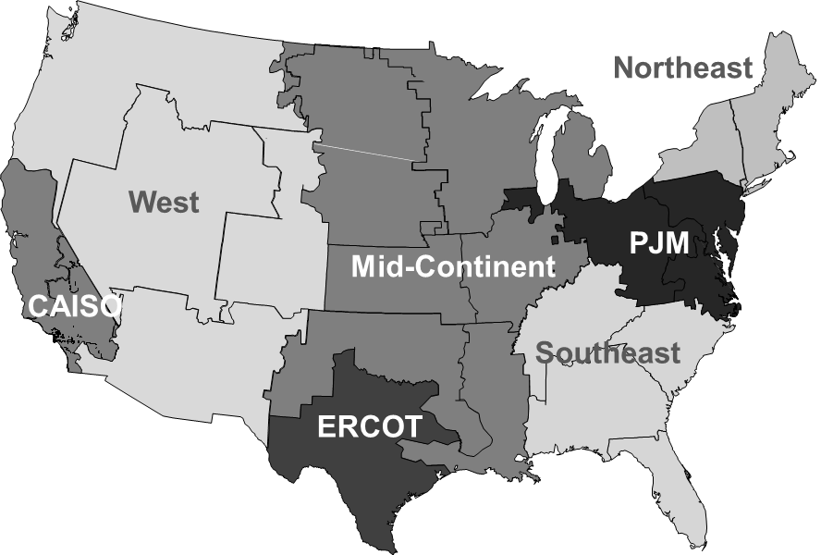
All-sector solar and wind penetration by region
All-sector solar penetration by region, AEO2022 Reference case (2010–2050)
All-sector wind penetration by region,
AEO2022 Reference case (2010–2050)
25

Slide 26
Solar and wind penetration and curtailment by selected regions
Solar and wind penetration by regions in AEO2022 Reference case, 2021-2050
Solar and wind curtailment by regions in AEO2022 Reference case, 2021-2050

Slide 27
Installed electric generating capacity by source
other diurnal storage solar wind nuclear oil and natural gas coal

