Slide 1
Annual Energy Outlook 2023 with projections to 2050
Annual Energy Outlook 2023 Release at Resources for the Future Joseph DeCarolis, EIA Administrator Angelina LaRose, Assistant Administrator for Energy Analysis
March 16, 2023
www.eia.gov/aeo
#AEO2023

Slide 2
What does EIA do?
The U.S. Energy Information Administration (EIA) is the statistical and analytical agency within the U.S. Department of Energy.
EIA is the nation's premier source of energy information.
By law, our data, analyses, and forecasts are independent of approval by any other officer or employee of the U.S. government.
Our Annual Energy Outlook 2023 explores long-term energy trends in the United States.

Slide 3
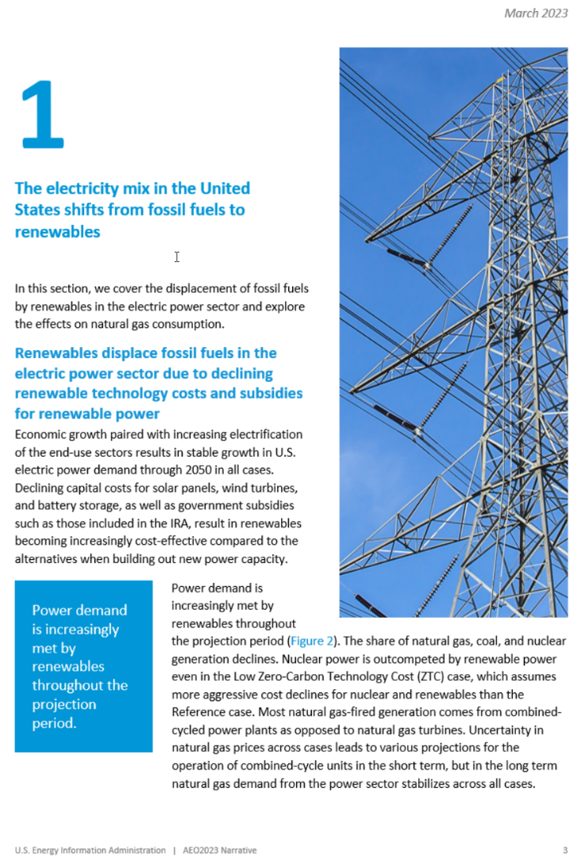
What’s new in the 2023 Annual Energy Outlook?
A focus on the narrative
Technical notes
Emphasis on the range of results
New combination cases

Slide 4
The AEO2023 includes cases that vary technical and economic assumptions, including combination cases that extend the bounds of uncertainty
All cases reflect current laws and regulations as of November 2022, including the Inflation Reduction Act.
Reference | 1.9% annual GDP growth; Brent = $101 per barrel (b) in 2050
Economic Growth | Low: 1.4% annual GDP growth High: 2.3%
Oil Price | Low: Brent = $51/b in 2050 High: Brent = $190/b in 2050
Oil and Gas Supply | Low: 50% lower oil and gas resource recovery and 50% higher drilling costs relative to the Reference case High: 50% higher oil and gas resource recovery and 50% lower drilling costs relative to the Reference case
Zero-Carbon Technology Cost (electric power sector) | Low: About 40% reduction in cost by 2050 High: No reduction in costs
Combination | Combinations of Economic Growth and Zero-Carbon Technology Cost cases

Slide 5
AEO2023 Issues in Focus: Inflation Reduction Act
Inflation Reduction Act Issues in Focus released today
No IRA case
High Uptake case
Low Uptake case
Detailed IRA assumptions available on the AEO website

Slide 6
IRA-related caveats to keep in mind
The IRA contains a complex package of incentives, many of which are challenging to model.
We do not explicitly include certain IRA provisions in AEO2023 for three general reasons:
Guidance is not yet available on how a provision will be enacted or how agencies will implement it.
Provisions requiring significant model modifications that were not possible to implement this year.
Provisions that do not align with our analytic resolution, for example “energy communities.”
As a result, all energy system impacts of the IRA are not represented in AEO2023.
We have documented our modeling assumptions related to all IRA provisions, which are available with today’s AEO2023 release.
We will refine our estimates over time as IRA implementation details become available and we update our modeling capability.

Slide 7
AEO2023 Highlights
Energy-related CO₂ emissions fall across all AEO2023 cases because of increased electrification, higher equipment efficiencies, and more zero-carbon electricity generation.
Renewable generating capacity grows in all regions of the United States in all AEO2023 cases, supported by growth in installed battery capacity.
Technological advancements and electrification drive projected decreases in demand-side energy intensity.
The United States remains a net exporter of petroleum products and of natural gas through 2050 in all AEO2023 cases.

Slide 8
AEO2023 Highlights
Energy-related CO₂ emissions fall across all AEO2023 cases because of increased electrification, higher equipment efficiencies, and more zero-carbon electricity generation.
Renewable generating capacity grows in all regions of the United States in all AEO2023 cases, supported by growth in installed battery capacity.
Technological advancements and electrification drive projected decreases in demand-side energy intensity.
The United States remains a net exporter of petroleum products and of natural gas through 2050 in all AEO2023 cases.

Slide 9
By 2030, energy-related CO₂ emissions fall 25% to 38% below 2005 levels
Data source: U.S. Energy Information Administration, Annual Energy Outlook 2023 (AEO2023)
Note: Shaded regions represent maximum and minimum values for each projection year across the AEO2023 Reference case and side cases. ZTC=Zero-Carbon Technology Cost; IRA=Inflation Reduction Act.

Slide 10
In the No IRA and Low Uptake cases, U.S. CO₂ emissions fall 26% and 27%, respectively, by 2030 from 2005. The Reference and High Uptake cases go further and reach reductions of about 33% and 34%, respectively.
Energy-related CO₂ emissions
billion metric tons
Data source: U.S. Energy Information Administration, Annual Energy Outlook 2023 (AEO2023)
Note: Charts include CO₂ emissions from fossil fuel and industrial feedstock uses. This scope excludes industrial process emissions, agriculture, waste, land use, and other greenhouse gases such as methane and hydrofluorocarbons. Industrial emissions include combined-heat-and-power plants that have a non-regulatory status and small on-site generating systems.

Slide 11
AEO2023 Highlights
Energy-related CO₂ emissions fall across all AEO2023 cases because of increased electrification, higher equipment efficiencies, and more zero-carbon electricity generation.
Renewable generating capacity grows in all regions of the United States in all AEO2023 cases, supported by growth in installed battery capacity.
Technological advancements and electrification drive projected decreases in demand-side energy intensity.
The United States remains a net exporter of petroleum products and of natural gas through 2050 in all AEO2023 cases.

Slide 12
Total installed generating capacity more than doubles across most scenarios
stand-alone storage
solar
wind
oil and natural gas
nuclear
other
coal
Data source: U.S. Energy Information Administration, Annual Energy Outlook 2023 (AEO2023)
Note: ZTC=Zero-Carbon Technology Cost; other=geothermal, biomass, municipal waste, fuel cells, hydroelectric, pumped hydro storage

Slide 13
Power demand is increasingly met by renewables
U.S. electricity generation by select technologies for all cases
billion kilowatthours
Ref
Ref
Ref
Ref
Ref
Data source: U.S. Energy Information Administration, Annual Energy Outlook 2023 (AEO2023)
Note: Shaded regions represent maximum and minimum values for each projection year across the AEO2023 Reference case and side cases. Ref=Reference case

Slide 14
Solar and wind generate a majority of U.S. electricity by 2050 in the Reference and High Uptake cases
U.S. net electricity generation by fuel
billion kilowatthours
No IRA
Low Uptake
Reference
High Uptake
2022
history projections
2022
history projections
Data source: U.S. Energy Information Administration, Annual Energy Outlook 2023 (AEO2023) Note: IRA=Inflation Reduction Act
*Includes utility-scale and end-use photovoltaic generation and excludes off-grid photovoltaics.
**Includes petroleum, conventional hydroelectric power, geothermal, wood and other biomass, pumped storage, non-biogenic municipal waste in the electric power sector, refinery gas, still gas, batteries, chemicals, hydrogen, pitch, purchased steam, sulfur, and miscellaneous technologies.

Slide 15
More intermittent renewables lead to more curtailment and usage of battery storage
Hourly U.S. electricity generation and load by fuel for selected cases and representative years
billion kilowatthours
Reference case, 2050
Reference case, 2022
Low Oil and Gas Supply case, 2050
Low Zero-Carbon Technology Cost case, 2050
load, excluding storage
curtailment
stand-alone storage
pumped storage
hybrid solar PV stand-alone solar PV
wind
hydroelectric
natural gas combined-cycle
natural gas and oil peakers
nuclear
coal
hour of the day
Data source: U.S. Energy Information Administration, Annual Energy Outlook 2023 (AEO2023)
Note: Negative generation represents charging of energy storage technologies such as pumped hydro and battery storage. Hourly dispatch estimates are illustrative and are developed to determine curtailment and storage operations; final dispatch estimates are developed separately and may differ from total utilization as this figure shows. Standalone solar photovoltaic (PV) includes both utility-scale and end-use PV electricity generation.
AEO2023 Release, RFF
March 16, 2023

Slide 16
AEO2023 Highlights
Energy-related CO₂ emissions fall across all AEO2023 cases because of increased electrification, higher equipment efficiencies, and more zero-carbon electricity generation.
Renewable generating capacity grows in all regions of the United States in all AEO2023 cases, supported by growth in installed battery capacity.
Technological advancements and electrification drive projected decreases in demand-side energy intensity.
The United States remains a net exporter of petroleum products and of natural gas through 2050 in all AEO2023 cases.

Slide 17
U.S. energy consumption increases to 2050, and electricity plays an increasingly larger role
Total energy consumption by end-use sector
quadrillion British thermal units
2022
history projections
Data source: U.S. Energy Information Administration, Annual Energy Outlook 2023 (AEO2023)
Note: Total consumption in end-use sectors includes purchased electricity and electricity-related losses. Each line represents AEO2023 Reference case projections. Shaded regions represent maximum and minimum values for each projection year across the AEO2023 Reference case and side cases.

Slide 18
Average energy intensity declines through 2050 across all cases
Data source: U.S. Energy Information Administration, Annual Energy Outlook 2023 (AEO2023)
Note: Shaded regions represent maximum and minimum values for each projection year across the AEO2023 Reference case and side cases. ZTC=Zero-Carbon Technology Cost

Slide 19
Light-duty vehicle fuel economy and electric vehicle market share increase through 2050 due to rising CAFE Standards and other incentives
Data source: U.S. Energy Information Administration, Annual Energy Outlook 2023 (AEO2023)
Note: *Includes battery electric and plug-in hybrid electric vehicles. Shaded regions represent maximum and minimum values for each projection year across the AEO2023 Reference case and side cases.

Slide 20
IRA incentives speed growth in sales of electric vehicles
Data source: U.S. Energy Information Administration, Annual Energy Outlook 2023 (AEO2023)
Note: *Includes battery electric and plug-in hybrid electric vehicles. IRA=Inflation Reduction Act

Slide 21
AEO2023 Highlights
Energy-related CO₂ emissions fall across all AEO2023 cases because of increased electrification, higher equipment efficiencies, and more zero-carbon electricity generation.
Renewable generating capacity grows in all regions of the United States in all AEO2023 cases, supported by growth in installed battery capacity.
Technological advancements and electrification drive projected decreases in demand-side energy intensity.
The United States remains a net exporter of petroleum products and of natural gas through 2050 in all AEO2023 cases.

Slide 22
In all cases, we project that the United States will remain a net exporter of petroleum products through 2050
Data source: U.S. Energy Information Administration, Annual Energy Outlook 2023 (AEO2023)
Note: Biofuels are not included in petroleum and other liquids production or consumption. Shaded regions represent maximum and minimum values for each projection year across the AEO2023 Reference case and side cases. ZTC=Zero-Carbon Technology Cost

Slide 23
Liquefied natural gas exports drive production; domestic consumption remains stable
Liquefied natural gas exports
trillion cubic feet
Data source: U.S. Energy Information Administration, Annual Energy Outlook 2023 (AEO2023)
Note: Shaded regions represent maximum and minimum values for each projection year across the AEO2023 Reference case and side cases. ZTC=Zero-Carbon Technology Cost

Slide 24
Upcoming AEO2023 Issues in Focus
Liquefied Natural Gas (LNG) Issues in Focus coming next month
High LNG Price case
Low LNG Price case
Fast Builds + High LNG Price case

Slide 25
View the full report at eia.gov/aeo
Contact us at AnnualEnergyOutlook@eia.gov

