Slide 1
International Energy Outlook
For
Deloitte Oil and Gas Conference
November 18, 2014 | Houston, TX
By
Adam Sieminski, Administrator
U.S. Energy Information Administration

Slide 2
Renewable energy and nuclear power are the fastest growing sources of energy consumption; oil still dominates
world energy consumption by fuel
quadrillion Btu
History
2010
Projections
28%
27%
34%
23%
28%
Share of world total
15%
22%
11%
7%
5%
Source: EIA, International Energy Outlook 2013

Slide 3
World energy consumption growth is concentrated in non-OECD countries
world energy consumption, 1990-2040
quadrillion Btu
History
Projections
1,000
800
600
Non-OECD
400
200
OECD
0
1990
2000
2010
2020
2030
2040
Source: EIA, International Energy Outlook 2013

Slide 4
Results from the IEO2014 Reference case
World petroleum and other liquid fuels use increases by 38% between 2010 and 2040, all in the non-OECD
Developing Asia (including China and India) and the Middle East account for 85% of the increase
Increased demand requires 33 MMbbl/d of additional liquid fuels supplies to reach 119 MMb/d by 2040
OPEC crude and lease condensate increases by 14 MMbbl/d
Non-OPEC crude and lease condensate increases by 10 MMbbl/d
Other liquid supplies (from NGPL, biofuels, CTL, GTL, and refinery gain) grow in importance, supplying 17% of total liquids production by 2040

Slide 5
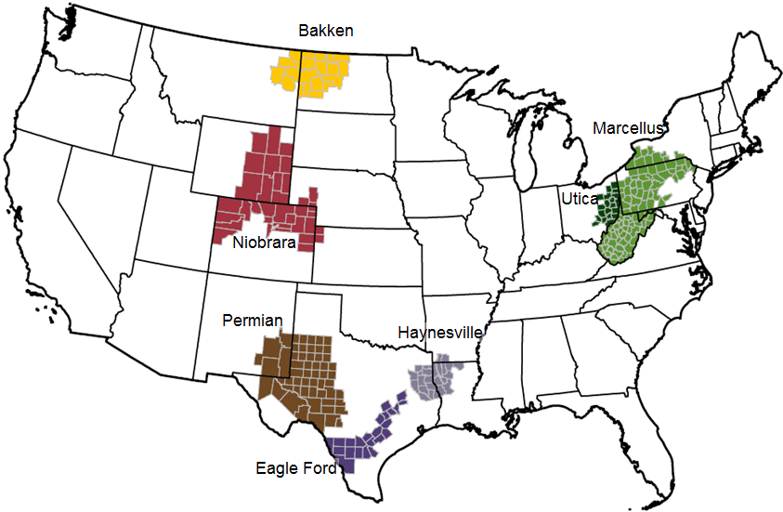
These seven regions accounted for 95% of U.S. oil production growth and all U.S. natural gas production growth from 2011-2013
Source: EIA, Drilling Productivity Report

Slide 6
The U.S. has experienced a rapid increase in natural gas and oil production from shale and other tight resources
Sources: EIA derived from state administrative data collected by DrillingInfo Inc. Data are through August 2014 and represent EIA’s official tight oil & shale gas estimates, but are not survey data. State abbreviations indicate primary state(s).

Slide 7
Resource and technology assumptions have major implications for projected U.S. crude oil production beyond the next few years
Reference case
million barrels per day
High Oil and Gas Resource case
million barrels per day
2012
2012
history
projections
history
projections
STEO November 2014 U.S. crude oil projection
tight oil
tight oil
other lower 48 states onshore
other lower 48 states onshore
lower 48 states offshore
lower 48 states offshore
Alaska
Alaska
Source: EIA, Annual Energy Outlook 2014; Short Term Energy Outlook, November 2014

Slide 8
EIA Reference scenario shows world tight oil production increasing to almost 8 million b/d in 2025
tight oil production
million barrels per day
history
projections
2012
World (IEO2014 Reference case)
U.S. (AEO2014 & IEO2014 Reference case)
Source: EIA, Annual Energy Outlook 2014 and International Energy Outlook 2014

Slide 9
Tight oil production will spread to nations outside of the United States and Canada over the projection
tight oil production, Reference case
million barrels per day
AEO2014 High Resource case
5.0 MMbbl/d in 2015 (STEO)
3.9 MMbbl/d in 2014 (STEO)
2.9 MMbbl/d in 2013
Source: EIA, International Energy Outlook 2014

Slide 10
U.S. is the largest producer of petroleum and natural gas in the world
estimated U.S., Russia, and Saudi Arabia petroleum and natural gas production
quadrillion Btu
million barrels per day of oil equivalent
United States
Russia
Saudi Arabia
natural
gas
petro-leum
2008
2009
2010
2011
2012
2013
2014e
Source: U.S. Energy Information Administration
Note: Petroleum production includes crude oil, natural gas liquids, condensates, refinery processing gain, and other liquids, including biofuels; barrels per day oil equivalent were calculated using a conversion factor of 1 barrel oil equivalent=5.55 million British thermal units (Btu)

Slide 11
U.S. oil production growth helping to offset unplanned outages
estimated unplanned crude oil production outages
million barrels per day
U.S. Production growth*
Non-
OPEC
OPEC
Source: EIA, Short-Term Energy Outlook, November 2014
*monthly production delta versus Jan. 2011 production level

Slide 12
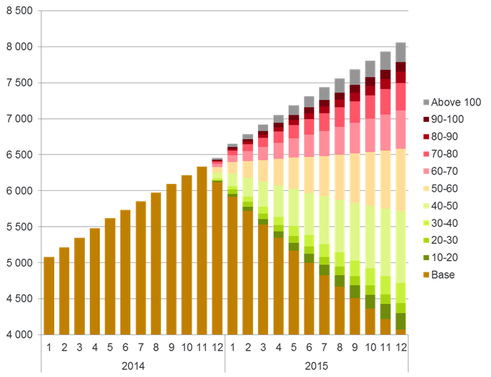
Effect of low oil prices on U.S. shale oil production
US+CA, oil+NGLs from tight plays (kbbld)
Brent-indexed
breakeven prices:
Source: Rystad Energy North America Quarterly Shale Report

Slide 13
U.S. shale gas leads growth in total gas production through 2040, when production exceeds 100 billion cubic feet per day
U.S. dry natural gas production
trillion cubic feet
billion cubic feet per day
2012
history
projections
Shale gas
Non-associated onshore
Tight gas
Non-associated offshore
Alaska
Associated with oil
Coalbed methane
Source: EIA, Annual Energy Outlook 2014, Reference case
Notes:
13
13

Slide 14
Natural gas consumption growth is driven by electric power, industrial, and transportation use
U.S. dry gas consumption
trillion cubic feet
history
projections
11.0
electric
power
8.5
11.2
industrial*
9.1
0.7
1.7
transportation**
2.9
3.6
commercial
4.2
4.1
residential
*Includes combined heat-and-power and lease and plant fuel
**Includes pipeline fuel
Source: EIA, Annual Energy Outlook 2014, Reference case

Slide 15
U.S. becomes a net exporter of natural gas in the near future
U.S. dry natural gas
trillion cubic feet per year
billion cubic feet per day
history
2012
projections
100
75
Consumption
50
Domestic supply
Net exports
25
0
-25
Source: EIA, Annual Energy Outlook 2014 Reference case

Slide 16
Projected U.S. natural gas trade depends on assumptions regarding resources and future technology advances
Reference case
trillion cubic feet per year
High Oil and Gas Resource case
trillion cubic feet per year
billion cubic
feet per day
20
exports to Mexico
15
exports to Canada
10
5
lower 48
LNG exports
0
imports from Canada
-5
LNG imports
-10
Source: EIA, Annual Energy Outlook 2014, Reference case and High Oil and Gas Resource case

Slide 17
Most of the growth in production between 2011 and 2015 consists of sweet grades with API gravity of 40 or above
U.S. crude oil production by type
million barrels of oil per day
history
forecast
Source: EIA, DrillingInfo, Colorado DNR, Texas RRC. http://www.eia.gov/analysis/petroleum/crudetypes/

Slide 18
Crude oil and associated liquids contain a wide variety of hydrocarbons
Source: EIA via Harvey Crude Assay Management System

Slide 19
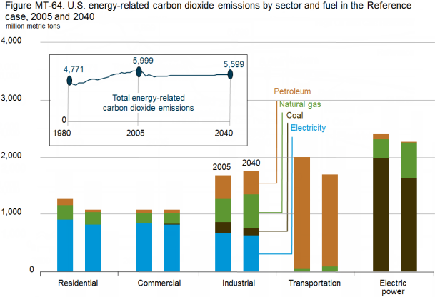
EIA projects declines in carbon dioxide emissions for all sectors except industrial relative to 2005
Source: EIA Annual Energy Outlook 2014

Slide 20
Coal continues to account for the largest share of global energy-related carbon dioxide emissions throughout the projection
world energy-related carbon dioxide emissions by fuel
billion metric tons
History
2010
Projections
Coal
Natural gas
Liquid fuels
Source: EIA, International Energy Outlook 2013

Slide 21
Areas of uncertainty in the outlook
Oil prices
China’s energy demand growth; particularly in transportation
Increasing global trade of natural gas and hydrocarbon gas liquids in addition to oil
Global development of tight oil and shale gas resources
Policy decisions on crude oil exports
Impact of geopolitical tensions on energy supply
Constraints on CO₂

Slide 22
EIA natural gas production forecasts were revised up significantly between 2013 and 2014
forecasted dry natural gas production
billion cubic feet per day
Source: EIA Annual Energy Outlook; EIA Monthly Natural Gas Production Report

Slide 23
EIA crude oil production forecasts were also revised up substantially between 2013 and 2014
forecasted crude oil production
million barrels per day
Source: EIA Annual Energy Outlook; EIA via state agencies

Slide 24
For more information
U.S. Energy Information Administration home page | www.eia.gov
Annual Energy Outlook | www.eia.gov/aeo
Short-Term Energy Outlook | www.eia.gov/steo
International Energy Outlook | www.eia.gov/ieo
Monthly Energy Review | www.eia.gov/mer
Today in Energy | www.eia.gov/todayinenergy
State Energy Portal | www.eia.gov/state
Drilling Productivity Report | www.eia.gov/petroleum/drilling/

