Slide 1
EIA’s Energy Outlook 2016
for
9th Annual Kosciuszko Chair Conference
November 12, 2016 | Washington, D.C.
by
Adam Sieminski, Administrator

Slide 2
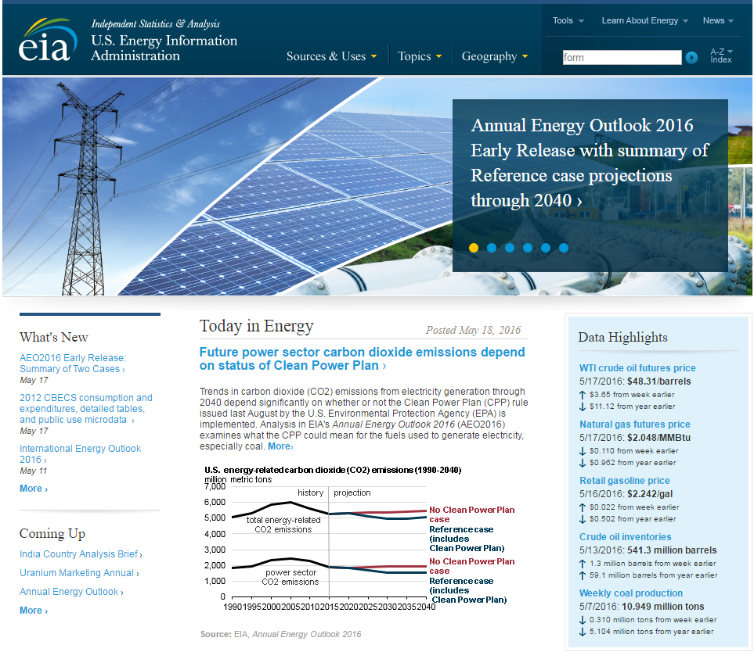
Mission: EIA collects, analyzes, and disseminates independent and impartial energy information to promote sound policymaking, efficient markets, and public understanding of energy and its interaction with the economy and the environment.
EIA is the Nation’s official source of energy information and, by law, its data, analyses, and forecasts are independent of approval by any other officer or employee of the United States Government.
Notes:
The Department of Energy Organization Act of 1977 established EIA as the primary federal government authority on energy statistics and analysis, building upon systems and organizations first established in 1974 following the oil market disruption of 1973. Located in Washington, DC, EIA is an organization of about 370 federal employees, with an annual budget in Fiscal Year 2016 of $122 million.
The cornerstone of EIA’s mission was, and still is, its impartiality and independence, which promotes sound policymaking and efficient markets. Overall, EIA helps support a public understanding of energy and its interaction with the economy and the environment.

Slide 3
Selected recurring products
Weekly | Weekly Natural Gas Storage Report (principal Federal economic indicator)
 | Weekly Petroleum Status Report
 | Gasoline and Diesel Fuel Update
Monthly | Short-Term Energy Outlook
 | Natural Gas Monthly
 | Drilling Productivity Report
 | Electric Power Monthly
 | Petroleum Supply Monthly
 | Monthly Energy Review
Annual | Annual Energy Outlook
 | International Energy Outlook
 | U.S. Crude Oil and Natural Gas Proved Reserves
 | U.S. Energy-Related Carbon Dioxide Emissions

Slide 4
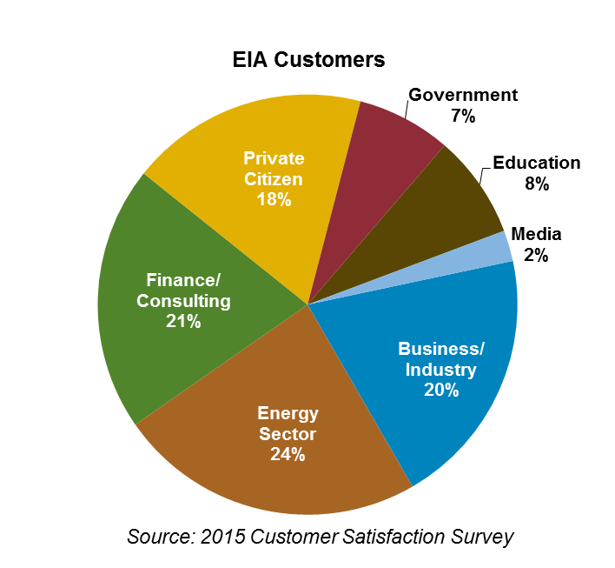
EIA information is used by a range of stakeholders
Examples of Activities
Government
Executive Agencies – WH, DOE, & EPA use EIA data to track energy markets and program performance and to analyze policy proposals
Congress – policy development and agency funding
State Governments – planning and program development
Energy Sector
Consumers – monitor price forecasts
Producers – track inventory statistics
Business/Industry
Manufacturers – market research
Finance/Consulting
Commodities Analysts – market response to supply data
Media/Education
Journalists – cite energy statistics
Teachers – use Energy Kids materials
Researchers – energy forecasting and modeling
Private Citizens
Public – research gasoline prices
Customer-focused Performance Results
Quality: 90% of customers are satisfied or very satisfied with the quality of EIA information
Timeliness: 95% of selected EIA recurring products meet their release date target
Notes:
EIA’s data and analyses reaches a range of stakeholders, both inside and outside the government.
The majority of our stakeholders are outside the government, with people involved in the energy sector, the financial and consulting business, general business and industry, and private citizens accounting for over 80% of our website visitors, according to recent survey results.

Slide 5
Poland’s Energy Situation

Slide 6
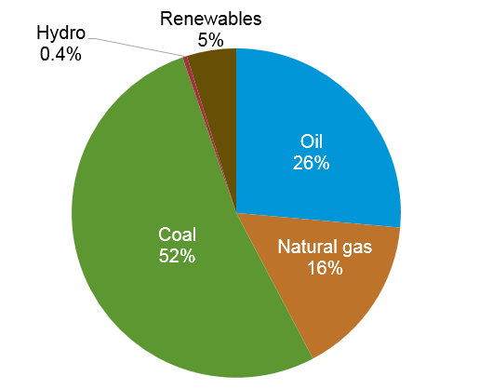
Poland’s total primary energy consumption was 3.8 quadrillion Btu in 2015 with Coal accounting for about half of consumption
Poland energy consumption by fuel type
Source: BP Statistical Review of World Energy

Slide 7
Poland is the second largest coal producer in Europe with a majority Poland’s electricity generation coming from coal
Poland produced and consumed about 150 million short tons of coal in 2014, accounting for 22% of total coal production in Europe and 16% of total coal consumption in Europe
Poland’s electricity sector is heavily reliant on coal, as coal-fired power plants accounted for 75% of installed capacity in 2014
Poland’s government has announced the goal of sourcing 15.5% of domestic energy supply from renewable energy sources, with renewables accounting for 19.3% of electricity generation
Source: U.S. Energy Information Administration

Slide 8
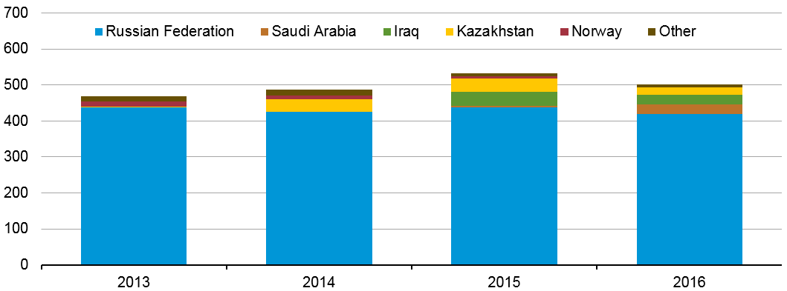
Poland’s largest source of crude imports is Russia
crude oil imports to Poland by country of origin
thousand barrels per day
Source: U.S. Energy Information Administration, based on customs data from Poland and partner countries, from Global Trade Tracker
Note: 2016 includes data through August

Slide 9
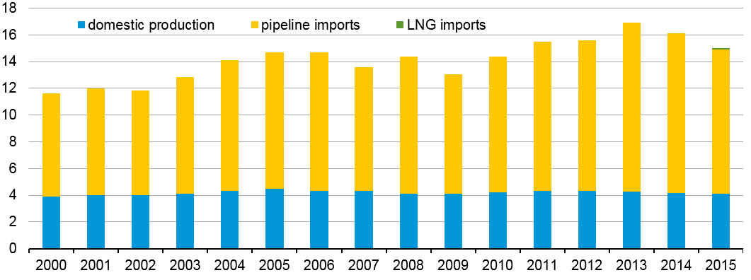
The majority of Poland’s natural gas supply is imported
domestic production and imports of natural gas
billion cubic meters
Source: Cedigaz statistical database

Slide 10
Poland’s energy statistics
 |  | world rank
Total Primary Energy Consumption | 4.284 | 24
2013 | Quadrillion Btu
Total Primary Energy Production | 2.329 | 39
2013 | Quadrillion Btu
Primary Coal Production | 150,374 | 9
2014 | Thousand Short Tons
Primary Coal Consumption | 151,044 | 8
2014 | Thousand Short Tons
Total Primary Coal Reserves | 23,845 | 10
2014 | Million Short Tons
Imports of Dry Natural Gas | 440 | 22
2013 | Billion Cubic Feet
Total Renewable Electricity Net Generation | 22 | 32
2013 | Billion Kilowatt-hours
Total Carbon Dioxide Emissions from the Consumption of Energy | 322 | 19
2013 | Millions Metric Tons
Source: U.S. Energy Information Administration

Slide 11
International short term energy outlook

Slide 12
World liquid fuels production and consumption balance
world production and consumption
million barrels per day (MMb/d)
implied stock change and balance
million barrels per day (MMb/d)
Source: Short-Term Energy Outlook, November 2016.

Slide 13
OECD commercial stocks of crude oil and other liquids
days of supply
Note: Colored band around days of supply of crude oil and other liquids stocks represents the range between the minimum and maximum from Jan. 2011 - Dec. 2015.
Source: Short-Term Energy Outlook, November 2016.

Slide 14
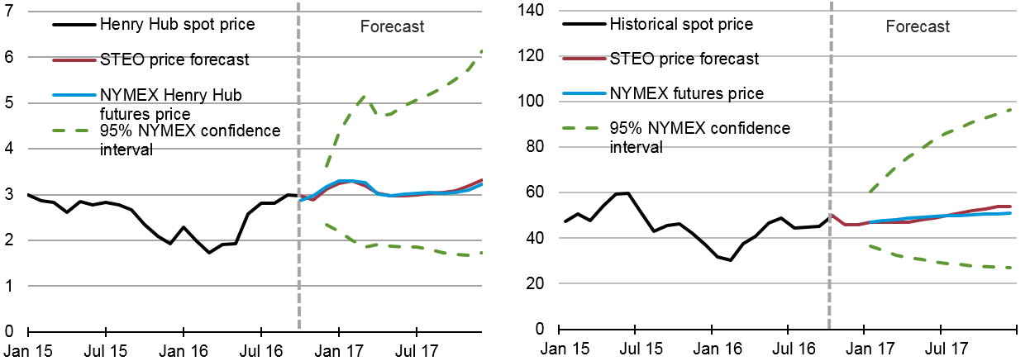
EIA forecasts Henry Hub spot prices to average $3.12/MMBtu and West Texas intermediate crude oil to average $47/b this winter.
Henry Hub natural gas price
dollars per million Btu
West Texas intermediate (WTI) crude oil price
dollars per barrel
Forecast
Note: Confidence interval derived from options market information for the 5 trading days ending October 6, 2016 Intervals not calculated for months with sparse trading in near-the-money options contracts.
Source: Short-Term Energy Outlook, November 2016, and CME Group.

Slide 15
International long-term energy outlook

Slide 16
Key findings in EIA’s long-term global outlook (IEO2016)
World energy consumption increases from 549 quadrillion Btu in 2012 to 629 quadrillion Btu in 2020 and then to 815 quadrillion Btu in 2040, a 48% increase (1.4%/year). Non-OECD Asia (including China and India) account for more than half of the increase. Population grows 0.9%/year.
The industrial sector continues to account for the largest share of delivered energy consumption; the world industrial sector still consumes over half of global delivered energy in 2040.
Renewable energy is the world’s fastest-growing energy source, increasing by 2.6%/year; nuclear energy grows by 2.3%/year, from 4% of the global total in 2012 to 6% in 2040.
Fossil fuels continue to supply more than three-fourths of world energy use in 2040.

Slide 17
Economic activity and population drive increases in energy use; energy intensity (E/GDP) improvements moderate this trend
average annual percent change (2012–40)
percent per year
Source: EIA, International Energy Outlook 2016

Slide 18
Global energy shares: renewables grow fastest, coal use plateaus, natural gas surpasses coal by 2030, and oil maintains its leading share
world energy consumption
quadrillion Btu
Source: EIA, International Energy Outlook 2016 and EIA, Analysis of the Impacts of the Clean Power Plan (May 2015)

Slide 19
Key findings in the IEO2016 (continued)
Among the fossil fuels, natural gas grows the fastest. Coal use plateaus in the mid-term as China shifts from energy-intensive industries to services and worldwide policies to limit coal use intensify. By 2030, natural gas surpasses coal as the world’s second largest energy source.
In 2012, coal provided 40% of the world’s total net electricity generation. By 2040, coal, natural gas, and renewable energy sources provide roughly equal shares (28-29%) of world generation.
With current policies and regulations, worldwide energy-related carbon dioxide emissions rise from about 32 billion metric tons in 2012 to 36 billion metric tons in 2020 and then to 43 billion metric tons in 2040, a 34% increase.

Slide 20
Oil and natural gas markets

Slide 21
Liquid fuels supplies from both OPEC and non-OPEC producers increase through 2040
world production of petroleum and other liquid fuels
million barrels per day
Source: EIA, International Energy Outlook 2016

Slide 22
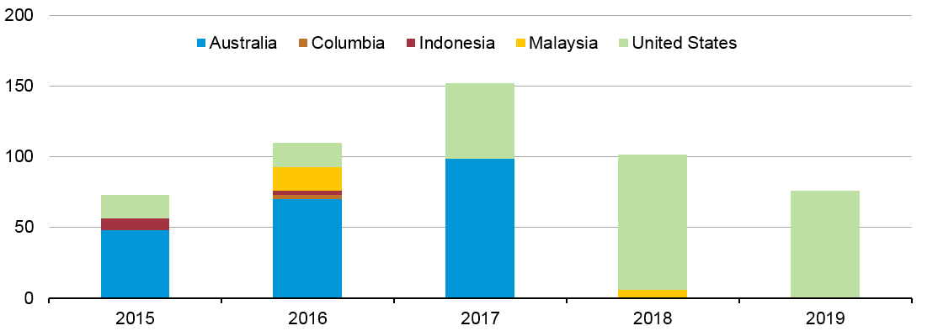
Liquefaction capacity additions over the 2015-19 time period will increase global capacity by over 30%
LNG capacity additions
million cubic meters per day
Note: Capacity additions in 2015-19 include projects currently under construction, and represent nameplate capacity,
not adjusted for ramp-up
Source: U.S. Energy Information Administration estimates based on trade press

Slide 23
Electricity markets

Slide 24
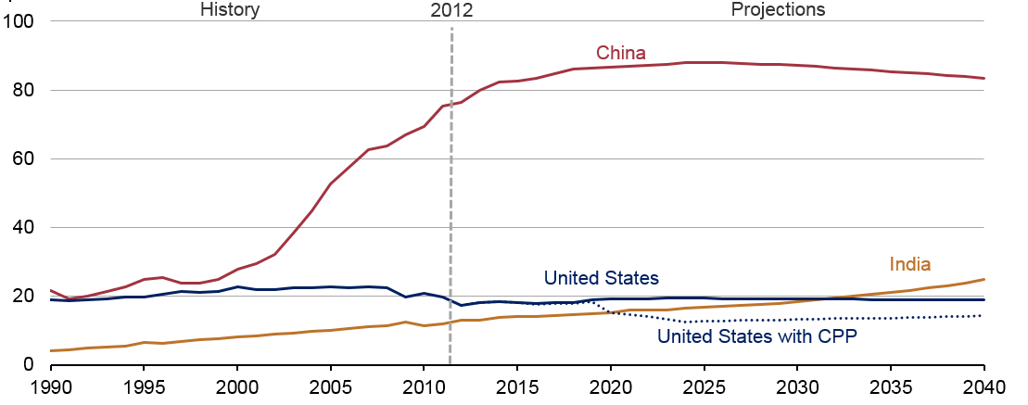
Of the world’s three largest coal consumers, only India is projected to continue to increase throughout the projection
coal consumption in the US, China, and India
quadrillion Btu
Source: EIA, International Energy Outlook 2016 and EIA, Analysis of the Impacts of the Clean Power Plan (May 2015)

Slide 25
Renewables, natural gas, and coal all contribute roughly the same amount of global net electricity generation in 2040
world net electricity generation by source
trillion kilowatthours
Source: EIA, International Energy Outlook 2016

Slide 26
For more information
U.S. Energy Information Administration home page | www.eia.gov
Short-Term Energy Outlook | www.eia.gov/steo
U.S. Annual Energy Outlook | www.eia.gov/aeo
International Energy Outlook | www.eia.gov/ieo
Monthly Energy Review | www.eia.gov/mer
Today in Energy | www.eia.gov/todayinenergy
State Energy Profiles | www.eia.gov/state
Drilling Productivity Report | www.eia.gov/petroleum/drilling/
International Energy Portal | www.eia.gov/beta/international/?src=home-b1

