Slide 1
EIA’s Energy Outlook 2016
for
U.S. EIA China Visit
November 2016 | China
by
Adam Sieminski, Administrator

Slide 2
Mission: EIA collects, analyzes, and disseminates independent and impartial energy information to promote sound policymaking, efficient markets, and public understanding of energy and its interaction with the economy and the environment.
EIA is the Nation’s official source of energy information and, by law, its data, analyses, and forecasts are independent of approval by any other officer or employee of the United States Government.
Notes:
The Department of Energy Organization Act of 1977 established EIA as the primary federal government authority on energy statistics and analysis, building upon systems and organizations first established in 1974 following the oil market disruption of 1973. Located in Washington, DC, EIA is an organization of about 370 federal employees, with an annual budget in Fiscal Year 2016 of $122 million.
The cornerstone of EIA’s mission was, and still is, its impartiality and independence, which promotes sound policymaking and efficient markets. Overall, EIA helps support a public understanding of energy and its interaction with the economy and the environment.

Slide 3
U.S. short term oil and natural gas outlook

Slide 4
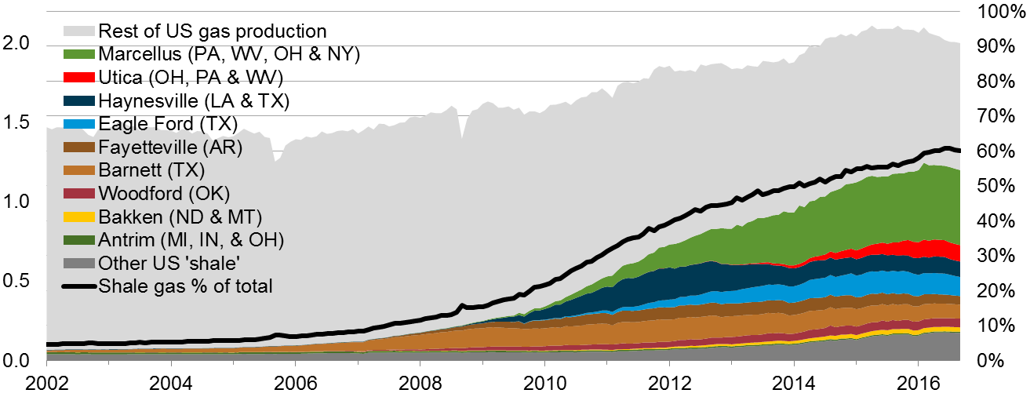
Estimated U.S. shale gas production was 1.2 Bcm/d in September 2016 about 60% of total U.S. dry production (2.0 Bcm/d)
natural gas production (dry)
billion cubic meters per day
Shale gas production as a
percent of total gas production
Sources: EIA Natural Gas Monthly, STEO through September 2016 and DrillingInfo.
Notes:
The production data provided in this chart is EIA’s official shale gas estimate based on state administrative data collected by DrillingInfo Inc., drilling rig activity, and EIA’s analysis of data reporting trends. This is not survey data. Estimates are through March 2016. State abbreviations indicate primary state(s).
Rest of US 'shale‘ include:
Baxter (WY) (minor shale play)
Huron (WV) (minor shale play)
Mancos (CO &NM) (minor shale play)
Monterey (CA) (shale oil play)
Pearsall (TX) (minor shale play)
Pierre (ND) (minor shale play)
Wolfcamp (NM & TX) (tight oil play)
Yeso-Glorieta (NM & TX) (tight oil play)
Bonespring (NM & TX) (tight oil play)
Spraberry (NM & TX) (tight oil play)
Niobrara-Codell (CO & WY) (shale-sand oil play)

Slide 5
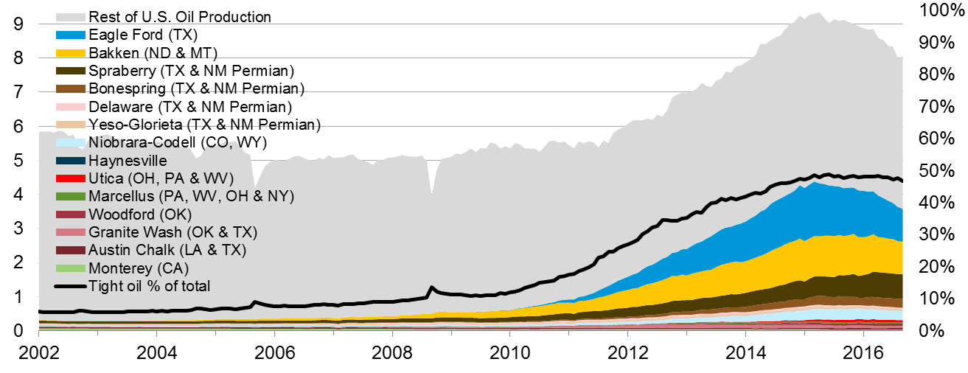
Estimated U.S. tight oil production was 3.9 MMbbl/d in September 2016 about 47% of total U.S. oil production (8.4 MMbbl/d)
tight oil production
million barrels of oil per day
tight oil production as a
percent of total oil production
Sources: EIA derived from state administrative data collected by DrillingInfo Inc. Data are through September 2016 and represent EIA’s
official tight oil estimates, but are not survey data. State abbreviations indicate primary state(s).
Notes:
Sources: DrillingInfo Inc. and EIA’s Drilling Productivity Report (DPR), through September 2016. Note: Information in the chart is estimated not surveyed. State abbreviations indicate primary state(s).

Slide 6
EIA forecasts Henry Hub spot prices to average $3.15/MMBtu and West Texas intermediate crude oil to average $47/b this winter.
Henry Hub natural gas price
dollars per million Btu
West Texas intermediate (WTI) crude oil price
dollars per barrel
Forecast
Note: Confidence interval derived from options market information for the 5 trading days ending October 6, 2016 Intervals not calculated for months with sparse trading in near-the-money options contracts.
Source: EIA Short-Term Energy Outlook, October 2016, and CME Group.

Slide 7
Both natural gas and renewable generation surpass coal by 2030 in the Reference case, but only natural gas does so in the No CPP case
net electricity generation
billion kilowatthours
AEO2016 Reference
No CPP
2015
2015
History
Projections
Projections
Coal
Natural gas
Nuclear
Petroleum
Renewables
Source: EIA, Annual Energy Outlook 2016

Slide 8
International short term energy outlook

Slide 9
World liquid fuels consumption
total world consumption
million barrels per day (MMb/d)
change in consumption
annual change (MMb/d)
Source: Short-Term Energy Outlook, October 2016.

Slide 10
World liquid fuels consumption growth
million barrels per day
* Countries belonging to the Organization for Economic Cooperation and Development
Source: Short-Term Energy Outlook, October 2016.

Slide 11
World liquid fuels production and consumption balance
world production and consumption
million barrels per day (MMb/d)
implied stock change and balance
million barrels per day (MMb/d)
Source: Short-Term Energy Outlook, October 2016.

Slide 12
OECD commercial stocks of crude oil and other liquids
days of supply
Note: Colored band around days of supply of crude oil and other liquids stocks represents the range between the minimum and maximum from Jan. 2011 - Dec. 2015.
Source: Short-Term Energy Outlook, October 2016.

Slide 13
International long-term energy outlook

Slide 14
Key findings in EIA’s long-term global outlook (IEO2016)
World energy consumption increases from 549 quadrillion Btu in 2012 to 629 quadrillion Btu in 2020 and then to 815 quadrillion Btu in 2040, a 48% increase (1.4%/year). Non-OECD Asia (including China and India) account for more than half of the increase. Population grows 0.9%/year.
The industrial sector continues to account for the largest share of delivered energy consumption; the world industrial sector still consumes over half of global delivered energy in 2040.
Renewable energy is the world’s fastest-growing energy source, increasing by 2.6%/year; nuclear energy grows by 2.3%/year, from 4% of the global total in 2012 to 6% in 2040.
Fossil fuels continue to supply more than three-fourths of world energy use in 2040.

Slide 15
Key findings in the IEO2016 (continued)
Among the fossil fuels, natural gas grows the fastest. Coal use plateaus in the mid-term as China shifts from energy-intensive industries to services and worldwide policies to limit coal use intensify. By 2030, natural gas surpasses coal as the world’s second largest energy source.
In 2012, coal provided 40% of the world’s total net electricity generation. By 2040, coal, natural gas, and renewable energy sources provide roughly equal shares (28-29%) of world generation.
With current policies and regulations, worldwide energy-related carbon dioxide emissions rise from about 32 billion metric tons in 2012 to 36 billion metric tons in 2020 and then to 43 billion metric tons in 2040, a 34% increase.

Slide 16
Economic activity and population drive increases in energy use; energy intensity (E/GDP) improvements moderate this trend
average annual percent change (2012–40)
percent per year
Source: EIA, International Energy Outlook 2016
Notes:
This chart examines the major drivers of world energy demand.
Prosperity in China and India is rising faster than energy intensity falls
Population growth in the Middle East and Africa
Economic activity and population growth are major drivers to increases in energy use. Improvements in energy use per unit of economic output, which result from both efficiency improvements and structural shifts in economies, work in the opposite direction. World GDP = 3.3% p.a.; OECD = 2.0% p.a.; non-OECD 4.2% p.a.
For all drivers, there is a significant differences across key countries and regions
Per capita economic output grows at a similar rate in the U.S.(1/7%/year) and OECD Europe (1.5%/year), about 40% of the projected growth rate of 4.6%/year in China and India.
There are also significant differences in projected population growth, where China , South Korea, and OCED Europe have significantly lower growth rates than the U.S. and India. Moving to the bounding cases, population grows fastest in the Middle East and Africa, and is expected to decline in Russia and Japan
So per capita income growth—as measured by gross domestic product (GDP) in purchasing power parity terms per person—and population growth indicate the amount of increased demand over the projection. In contrast, energy intensity improvements (declines) over time offset the demand created by income and population. In the Reference case, world GDP per capita increases by an average annual 2.4% from 2010 through 2040.
In the non-OECD (which includes China and India), GDP per capita is projected to increase by 3.2%/year over the projection period. In the OECD, however, GDP increases at half the rate of the non-OECD, at 1.6%/year. The large expected productivity gains in China and India (difference between GDP and population growth rates) are a good news story for well-being in those countries, but one that will have very large impacts on international energy markets for next several decades.

Slide 17
Global energy shares: renewables grow fastest, coal use plateaus, natural gas surpasses coal by 2030, and oil maintains its leading share
world energy consumption
quadrillion Btu
Source: EIA, International Energy Outlook 2016 and EIA, Analysis of the Impacts of the Clean Power Plan (May 2015)

Slide 18
As total world energy consumption grows, shares by end-use sector remain relatively unchanged
world delivered energy consumption by end-use sector
quadrillion Btu
Source: EIA, International Energy Outlook 2016

Slide 19
Liquid fuels markets
Notes:
Like everyone else, EIA is paying considerable attention to world oil markets.
The Short-Term Energy Outlook, updated each month, presents a forecast of energy markets over the next 12 to 24 months along with quantitative measures of price uncertainty based on the market value of energy futures and options contracts. That outlook, rather than the IEO we are discussing today, reflects EIA’s perspective on current and near-term oil market conditions.

Slide 20
Near-term crude oil price scenario is lower in AEO2016
Brent crude oil spot price
2015 dollars per barrel
History
2015
Projections
High Oil Price
AEO2015 Reference
AEO2016 Reference
Low Oil Price
Source: EIA, Annual Energy Outlook 2016 Reference case and Annual Energy Outlook 2015 Reference case

Slide 21
Passenger-miles per person will rise as GDP per capita grows; travel growth is largely outside the OECD
passenger-miles per capita (left-axis) and GDP per capita (horizontal-axis) for
selected country groupings 2010–40
Source: EIA, International Energy Outlook 2016
Notes:
Rising global incomes increase the demand for personal mobility, measured as passenger-miles per capita, in all the world regions, with different rates of increase depending on current income levels and travel patterns, as well as the unique nature of regional geographies. Consequently, the rates of increase in travel demand per capita vary across the OECD and non-OECD regions.
OECD regions are, for the most part, economically developed and thus have higher levels of personal mobility than the non-OECD countries. In the IEO2016 Reference case, OECD passenger travel per capita (including light-duty and 2- and 3-wheel vehicles, buses, and passenger rail but excluding aircraft) increases from 9.1 thousand passenger-miles/person in 2012 to 10.3 thousand passenger-miles/person in 2040, while average GDP per capita rises from about $36,000/person to $56,500/person (in inflation-adjusted real 2010 U.S. dollars). In comparison, average non-OECD GDP per capita rises from an average of $8,500/person in 2012 to $20,800/person in 2040, and passenger travel per capita rises from 2.1 thousand passenger-miles/person in 2012 to 4.9 thousand passenger-miles/person in 2040.
In China, GDP per capita increases from about $10,400/person in 2012 to $36,100/person in 2040—a level comparable to the OECD average per capita income in 2012. But, passenger travel per capita in China only rise to 6.4 thousand passenger-miles/person by 2040—higher than the non-OECD average in 2040, but still 30% lower than the OECD passenger travel per capita in 2012.

Slide 22
Natural gas markets
Notes:
Turning to natural gas markets, in the IEO2016 Reference case, natural gas is the world’s fastest-growing fossil fuel, with consumption increasing at an average rate of 1.7 percent per year from 2010 to 2040.
Although the global recession resulted in an estimated decline of 3.6 trillion cubic feet in natural gas use in 2009, robust demand returned in 2010 with an increase of 7.7 trillion cubic feet, or 4 percent higher than demand in 2008, before the downturn.
Natural gas consumption grows robustly in the IEO2016 Reference case, from 113 trillion cubic feet in 2010 to 185 trillion cubic feet in 2040.
Contributing to the strong competitive position of natural gas among other energy sources is a strong growth outlook for reserves and supplies. Significant changes in natural gas supplies and global markets continue through the projection helping to keep markets well-supplied and prices competitive.

Slide 23
Shale gas, tight gas, and coalbed methane will become increasingly important to gas supplies, not only for the U.S., but also China and Canada
natural gas production by type
trillion cubic meters
China
Canada
United States
Shale gas
Tight gas
Coalbed methane
Other gas
Note: Other natural gas includes natural gas produced from structural and stratigraphic traps (e.g. reservoirs), historically referred to as ‘conventional’ production.
Source: EIA, International Energy Outlook 2016
Notes:
Although there is more to learn about the extent of the world’s tight gas, shale gas, and coalbed methane resource base, the IEO2016 Reference case projects a substantial increase in those supplies—especially in China, the United States, and Canada. The application of horizontal drilling and hydraulic fracturing technologies has made it possible to develop the U.S. shale gas resource, contributing to a near doubling of estimates for total U.S. technically recoverable natural gas resources over the past decade.
Shale gas accounts for more than half of U.S. natural gas production in the IEO2016 Reference case, and tight gas, shale gas, and coalbed methane resources in Canada and China account for about 80% of total domestic production in 2040 in those countries.

Slide 24
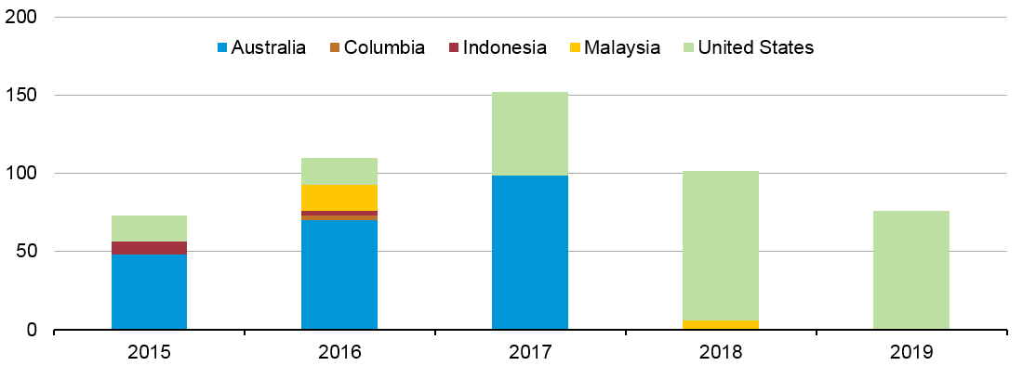
Liquefaction capacity additions over the 2015-19 time period will increase global capacity by over 30%
LNG capacity additions
million cubic meters per day
Note: Capacity additions in 2015-19 include projects currently under construction, and represent nameplate capacity,
not adjusted for ramp-up
Source: U.S. Energy Information Administration estimates based on trade press
Notes:
Column1 2012 Low Oil Price Reference High Oil Price
OPEC crude and lease condensate 32.0 57.0 46.4 34.1
Non-OPEC crude and lease conde 42.6 45.1 53.0 58.0
Other Liquid Fuels 14.2 20.8 21.2 25.3

Slide 25
Electricity markets
Notes:
Another important area to consider for future world energy markets is electric power. Electricity is the world’s fastest-growing form of end-use energy consumption in the Reference case, as it has been for the past several decades. World net electricity generation increases by between 2010 and 2040 in the IEO2016 Reference case.
In general, in OECD countries, where electricity markets are well established and consumption patterns are mature, the growth of electricity demand is slower than in non-OECD countries, where a large amount of potential demand remains unmet.
Total net electricity generation in non-OECD countries increases by an average of 3.1 percent per year in the Reference case, led by non-OECD Asia (including China and India), where annual increases average 3.6 percent from 2010 to 2040. In contrast, net generation among OECD nations grows by an average of 1.1 percent per year from 2010 to 2040.

Slide 26
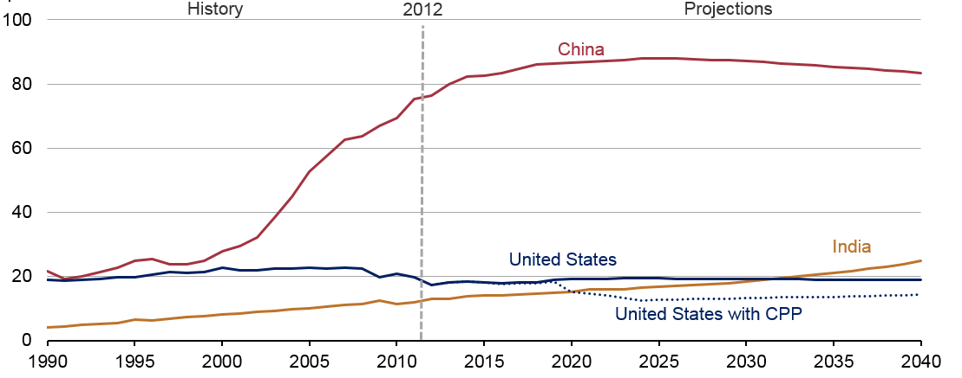
Of the world’s three largest coal consumers, only India is projected to continue to increase throughout the projection
coal consumption in the US, China, and India
quadrillion Btu
Source: EIA, International Energy Outlook 2016 and EIA, Analysis of the Impacts of the Clean Power Plan (May 2015)
Notes:
China currently accounts for almost half of the world’s total coal consumption, but a slowing economy and plans to implement policies to address air pollution and climate change contribute to declining coal use in China in the later years of the projection China’s recent moves to reduce coal as a means of addressing air pollution in major urban areas, and the government’s announcement in November 2015 that the country’s carbon dioxide emissions would peak by 2030, result in lower coal demand for China in the IEO2016 Reference case than in previous IEOs. Only 2 years ago, in the IEO2013 Reference case projections, coal use in China totaled 121 quadrillion Btu in 2040. In IEO2016, China’s coal use reaches 88 quadrillion Btu in 2025 before declining to 83 quadrillion Btu in 2040.
Coal is the world’s slowest-growing energy source in the IEO2016 Reference case, rising by an average 0.6%/year, from 153 quadrillion Btu in 2012 to 180 quadrillion Btu in 2040. Throughout the projection, the top three coal-consuming countries are China, the United States, and India, which together account for more than 70% of world coal use. China currently accounts for almost half of the world’s total coal consumption, but a slowing economy and plans to implement policies to address air pollution and climate change contribute to declining coal use in China in the later years of the projection.
Coal consumption projections in the IEO2016 Reference case do not include the impact of the finalized Clean Power Plan regulations in the United States. Including the CPP would reduce world coal consumption to 165 quadrillion Btu in 2020 and to 176 quadrillion Btu in 2040, based on EIA’s analysis of the CPP proposed rule. EIA’s analysis of the final rule, which will be released in EIA’s Annual Energy Outlook 2016, is expected to show a roughly similar impact on projections of U.S. coal use.

Slide 27
Renewables, natural gas, and coal all contribute roughly the same amount of global net electricity generation in 2040
world net electricity generation by source
trillion kilowatthours
Source: EIA, International Energy Outlook 2016

Slide 28
For more information
U.S. Energy Information Administration home page | www.eia.gov
Short-Term Energy Outlook | www.eia.gov/steo
U.S. Annual Energy Outlook | www.eia.gov/aeo
International Energy Outlook | www.eia.gov/ieo
Monthly Energy Review | www.eia.gov/mer
Today in Energy | www.eia.gov/todayinenergy
State Energy Profiles | www.eia.gov/state
Drilling Productivity Report | www.eia.gov/petroleum/drilling/
International Energy Portal | www.eia.gov/beta/international/?src=home-b1

