Slide 1
Energy Markets
for
The Payne Institute for Earth Resources at the Colorado School of Mines
October 29, 2015 | Golden, Colorado
by
Adam Sieminski, Administrator
U.S. Energy Information Administration

Slide 2

Mandate: EIA collects, analyzes, and disseminates independent and impartial energy information to promote sound policymaking, efficient markets, and public understanding of energy and its interaction with the economy and the environment
Independence: EIA, an element of the Department of Energy, is one of 14 federal statistical agencies; by law, its data, analyses, and forecasts are independent of approval by any other officer or employee of the United States Government
Mission: EIA provides data and analysis to help stakeholders understand the rapidly changing energy landscape across all fuels and all sectors

Slide 3

EIA information is used by a range of stakeholders
Examples of Activities
Government
Executive Agencies use EIA data to track energy markets, and program performance, and to analyze policy proposals
Congress – policy development and agency funding
State Governments – planning and program development
Energy Sector
Consumers – monitor price forecasts
Producers – track inventory statistics
Business/Industry
Manufacturers – market research
Finance/Consulting
Commodities Analysts – market response to supply data
Media/Education
Journalists – cite energy statistics
Teachers – use Energy Kids materials
Researchers – energy forecasting and modeling
Private Citizens
Public – research gasoline prices
Source: 2015 EIA Web Customer Survey

Slide 4
2014 U.S. primary energy use by source and sector
quadrillion British thermal units
Source: EIA, Monthly Energy Review

Slide 5
U.S. energy use grows slowly over the projection reflecting both economic recovery and energy efficiency improvement
U.S. primary energy consumption
quadrillion Btu
History
2013
Projections
1990
27%
Natural gas
28%
23%
8%
Renewables (excluding biofuels)
14%
7%
1%
7%
8%
2%
Liquid biofuels
Nuclear
8%
23%
18%
Coal
15%
36%
Petroleum and other liquids
33%
40%
Share of total U.S. energy use
Source: EIA, Analysis of the Impacts of the Clean Power Plan (May 2015), Base Policy case
Notes:
COMPLETED: Jim D and team – please provide an updated slide that depicts AEO2015 CPP base case ** updated using AEO2015 slide (slightly different colors, orders of fuels)

Slide 6
Key results from the 2015 Annual Energy Outlook (current laws and policies + proposed Clean Power Plan)
Growing domestic production of natural gas and oil continues to reshape the U.S. energy economy
Light-duty vehicle energy use declines sharply reflecting slowing growth in vehicle miles traveled and accelerated improvement in vehicle efficiency
With continued growth in shale gas production, natural gas becomes the largest source of U.S. electric power generation, surpassing coal within 5 to 10 years, and boosting production and natural gas consumption in manufacturing
Strong growth in domestic natural gas production supports increased exports of both pipeline and liquefied natural gas
With strong growth in domestic oil and gas production, U.S. dependence on imported fuels falls sharply
Improved efficiency of energy use and a shift away from carbon-intensive fuels keep U.S. energy-related carbon dioxide emissions below their 2005 level through 2040, even before consideration of the recently finalized Clean Power Plan
Notes:
ACTION: Howard will update this slide.

Slide 7
Key questions regarding the U.S. energy outlook
Which path best characterizes U.S. hydrocarbon production growth over the next 5 to 10 years? How is the path influenced by prices, resources, and technology?
What is the impact of possible relaxation of limitations on oil and natural gas exports for production growth and markets ?
Will EPA’s final rules for existing coal fired power plants be delayed by political or legal challenges, and how will states implement them?
Notes:
ACTION: Howard will update this slide.

Slide 8
Shale oil and gas

Slide 9
The U.S. has experienced a rapid increase in natural gas and oil production from shale and other tight resources
U.S. tight oil production
million barrels of oil per day
U.S. dry shale gas production
billion cubic feet per day
Sources: EIA derived from state administrative data collected by DrillingInfo Inc. Data are through September 2015 and represent EIA’s official tight oil & shale gas estimates, but are not survey data. State abbreviations indicate primary state(s).
Notes:
The production data provided in this chart is EIA’s official shale gas estimate based on state administrative data collected by DrillingInfo Inc., drilling rig activity, and EIA’s analysis of data reporting trends. This is not survey data. Estimates are through August 2015. State abbreviations indicate primary state(s).
Rest of US 'shale‘ include:
Baxter (WY) (minor shale play)
Huron (WV) (minor shale play)
Mancos (CO &NM) (minor shale play)
Monterey (CA) (shale oil play)
Pearsall (TX) (minor shale play)
Pierre (ND) (minor shale play)
Yeso-Glorieta (NM & TX) (tight oil play)
Delaware (NM & TX) (tight oil play)
Wolfcamp (NM & TX) (tight oil play)
Bonespring (NM & TX) (tight oil play)
Spraberry (NM & TX) (tight oil play)
Niobrara-Codell (CO & WY) (shale-sand oil play)

Slide 10
Estimated U.S. tight oil production was 4.5 MMbbl/d in September 2015 about 50% of total U.S. oil production (9.0 MMbbl/d)
tight oil production
million barrels of oil per day
tight oil production as a
percent of total oil production
Sources: EIA derived from state administrative data collected by DrillingInfo Inc. Data are through September 2015 and represent EIA’s official tight oil estimates, but are not survey data. State abbreviations indicate primary state(s).
Notes:
Sources: DrillingInfo Inc. and EIA’s Drilling Productivity Report (DPR), through September 2015. Note: Information in the chart is estimated not surveyed. State abbreviations indicate primary state(s).

Slide 11
Estimated U.S. shale gas production was 42.3 Bcf/d in September 2015 about 56% of total U.S. dry production (74.9 Bcf/d)
Shale gas production as a
percent of total gas production
Natural gas production (dry)
billion cubic feet per day
Sources: EIA Natural Gas Monthly data through December, STEO through September 2015 and Drilling Info.
Notes:
The production data provided in this chart is EIA’s official shale gas estimate based on state administrative data collected by DrillingInfo Inc., drilling rig activity, and EIA’s analysis of data reporting trends. This is not survey data. Estimates are through September 2015. State abbreviations indicate primary state(s).
Rest of US 'shale‘ include:
Baxter (WY) (minor shale play)
Huron (WV) (minor shale play)
Mancos (CO &NM) (minor shale play)
Monterey (CA) (shale oil play)
Pearsall (TX) (minor shale play)
Pierre (ND) (minor shale play)
Wolfcamp (NM & TX) (tight oil play)
Yeso-Glorieta (NM & TX) (tight oil play)
Bonespring (NM & TX) (tight oil play)
Spraberry (NM & TX) (tight oil play)
Niobrara-Codell (CO & WY) (shale-sand oil play)

Slide 12
Production growth in top crude producing regions (Permian, Bakken, Niobrara, and Eagle Ford) reverses in early 2015
monthly percent change
three month rolling average
Source: EIA, Drilling Productivity Report, October 2015 (chart extends to November 2015)

Slide 13
Oil markets

Slide 14
Oil supply and demand begin to rebalance in 2016
world supply and demand
million barrels per day (MMb/d)
implied stock change
million barrels per day
Source: EIA, Short-Term Energy Outlook (October 2015)

Slide 15
The market-implied confidence band for oil prices is very wide
WTI price
dollars per barrel
2013
Source: EIA, Short-Term Energy Outlook (October 2015)

Slide 16
Oil demand: Prices and economic growth are important, but policy, preferences, and technology may have a bigger long-term impact
What types of consumption and pricing policies will be enacted across the world?
  Fuel subsidies
  Environmental policies
  Domestic security policies
What will light-duty vehicle trends look like?
  Ownership rates
  Efficiency and emissions standards
  Technology/alternative fuels
Where will goods be produced and how will they be moved?
Will there be major industrial sector efficiency improvements or fuel switching?

Slide 17
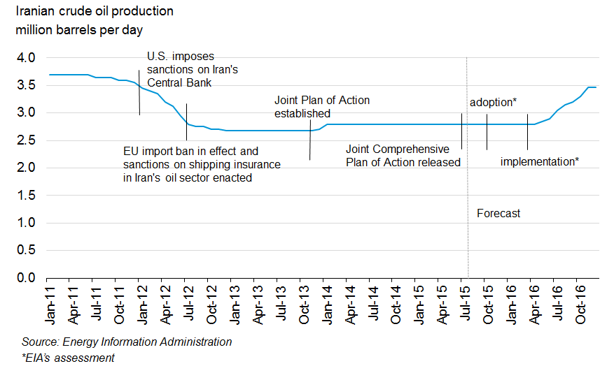
Iranian crude oil production is expected to begin increasing in the 2Q 2016, inventory sales could be sooner

Slide 18
Natural gas markets

Slide 19
Shale resources remain the dominant source of U.S. natural gas production growth
U.S. dry natural gas production
trillion cubic feet
billion cubic feet per day
History
Projections
2013
Shale gas and tight oil plays
Other lower 48 onshore
Tight gas
Coalbed methane
Lower 48 offshore
Alaska
Source: EIA, Annual Energy Outlook 2015 Reference case
Notes:
19
19
Three sources of future natural gas production growth (in order of importance):
1) shale gas, 2) tight gas, and 3) Alaska gas.
Shale gas production grows throughout the projections.
The six largest shale gas plays in relative order of cumulative production from 2013 through 2040:
Marcellus (150 Tcf, 2013-2040),
Haynesville (81 Tcf, 2013-2040),
Eagle Ford (53 Tcf, 2013-2040),
Barnett (39 Tcf, 2013-2040),
Utica (27 Tcf, 2013-2040),
Fayetteville (27 Tcf, 2013-2040)
Tight gas production growth occurs in the sedimentary basins located in the Rocky Mountains an Gulf Coast regions.
Alaska gas production grows during the projections due to the construction and operation of an LNG export facility, which goes into operation in 2027, eventually shipping 800 Bcf per year.

Slide 20
U.S. becomes a net exporter of natural gas in the near future
U.S. dry natural gas
trillion cubic feet per year
billion cubic feet per day
History
2013
Projections
100
75
Consumption
50
Production
25
0
Net exports
-25
Source: EIA, Annual Energy Outlook 2015
Notes:
This figure shows Reference case projections for consumption, domestic supply, and net imports of natural gas. In the AEO2015 Reference case, the U.S. becomes a net exporter of natural gas in 2018.
Although domestic natural gas consumption grows by about 23% from 2013 through 2040 (reaching near 32 trillion cubic feet in 2040), the growth in natural gas production (55% from 2013 through 2040) out paces consumption leading to net exports, primarily to Mexico and overseas as liquefied natural gas.
The growth in natural gas production is largely determined by oil and natural gas prices and the cost of developing those resources. Current gas prices (April spot gas was trading under $3 per MMBtu range last week) are not yet reducing production because of a variety of short-term market dynamics.
Longer-term factors include the current industry’s capability to efficiently develop resources, the success of the technology to quickly produce shale gas resources, and the rising crude oil prices which incentivizes the development of “wet” shale gas plays where crude oil and natural gas liquids, which have a significantly higher market value than natural gas, can greatly increase the economic return to producers.

Slide 21
With the proposed Clean Power Plan, the electricity mix shifts to lower-carbon options, led initially by growth in natural gas and later by renewables generation
electricity net generation
trillion kilowatthours per year
History
Projections
1993
2013
2020
2040
29%
27%
32%
Natural gas
13%
13%
17%
27%
11%
Renewables
53%
39%
31%
Coal
26%
19%
Oil and other liquids
19%
19%
1%
1%
Nuclear
16%
<1%
4%
Source: EIA, Analysis of the Impacts of the Clean Power Plan (May 2015), Base Policy case
Notes:
21
21
COMPLETED: Jim D and team, updated this slide with proposed CPP base case.

Slide 22
Renewable energy

Slide 23
U.S. renewable energy consumption, 1990 – 2014 by source and by sector
U.S. renewable energy consumption by source
quadrillion British thermal units (Btu)
U.S. renewable energy consumption by sector
quadrillion British thermal units (Btu)
Source: U.S. Energy Information Administration, Monthly Energy Review (April, 2015)

Slide 24
Renewables share of U.S. energy consumption highest since 1930s
renewable share of U.S. energy consumption, total and by sector
percent
Source: U.S. Energy Information Administration, Monthly Energy Review (April 2015)

Slide 25
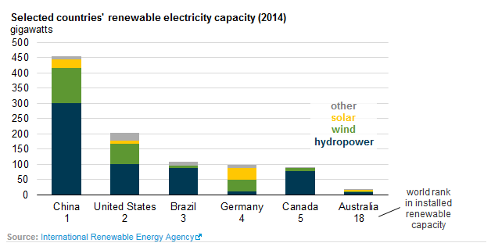
Leading producers of renewable electricity

Slide 26
Climate considerations

Slide 27
Renewable energy and nuclear power are the fastest growing source of energy consumption
world energy consumption by fuel
quadrillion Btu
History
2010
Projections
28%
27%
34%
23%
share of world total
28%
15%
22%
11%
7%
5%
Source: EIA, International Energy Outlook 2013
Notes:
This chart shows the distribution energy use by fuel.
Use of all fuels grows throughout the projection period. Although nuclear power and renewable energy are the world’s fastest growing forms of energy, fossil fuels are expected to continue supplying much of the energy used worldwide.
Oil remains the largest source of energy, but its share of world marketed energy consumption declines from 34 percent in 2010 to 28 percent in 2040. On a worldwide basis, liquids consumption increases only in the industrial and transportation sectors, while declining in the buildings and electric power sectors. The decline in the residential, commercial, and power sectors is a result of steadily rising world oil prices that encourage fuel switching whenever possible.
Natural gas is the world’s fastest growing fossil fuel, increasing by 1.7 percent per year, compared to liquid’s 0.9 percent per year and coal’s 1.3 percent per year. The growth in coal use slows markedly toward the end of the outlook, as gas, renewables, and nuclear power displace the use of coal in the power sector and demand for coal weakens for industrial processes. Coal, natural gas, nuclear. and renewables all compete as fuels for electric power generation, and the actual mix of fuels chosen to meet electricity needs can be very sensitive to policy actions.
This year’s outlook shows strong growth in natural gas use based on abundant resources and a supply outlook that reflects both the expansion of liquefied natural gas (LNG) production capacity and expanded production from shale gas basins in many areas.
China largely defines the coal trend line, which you can see arcs downward slightly at the end of the projection…

Slide 28
World energy-related carbon dioxide emissions continue to grow in IEO2013 assuming then-current policies; IEO2015 will show a lower growth trajectory
carbon dioxide emissions
billion metric tons
History
2010
Projections
Source: EIA, International Energy Outlook 2013

Slide 29
By 2040, China’s projected energy use will be double the U.S. level; India’s a little more than half despite its faster GDP growth
energy consumption by selected country
quadrillion Btu
History
2010
Projections
220
107
55
Source: EIA, International Energy Outlook 2013

Slide 30
EIA has expanded the depth and breadth of its program, with more on the way
International Energy Portal
Monthly crude-by-rail data
Analysis of the impacts of the Clean Power Plan
Excel add-in tool for automatic data updates
Report on federal subsidies in energy markets
Ground Water Protection Council data collaboration
Winter fuels prices for more states
Domestic oil and gas production (EIA-914)
Hourly electricity load data (EIA-930)
Effects of Removing Restriction on U.S. Crude Oil Exports
Coming soon
  Drilling cost data
  Distributed solar generation data and analysis
  Integrating Customs and Border Protection exports data received on a more timely basis into EIA products

Slide 31
For more information
U.S. Energy Information Administration home page | www.eia.gov
Annual Energy Outlook | www.eia.gov/aeo
Short-Term Energy Outlook | www.eia.gov/steo
International Energy Outlook | www.eia.gov/ieo
Monthly Energy Review | www.eia.gov/mer
Today in Energy | www.eia.gov/todayinenergy
State Energy Profiles | www.eia.gov/state
Drilling Productivity Report | www.eia.gov/petroleum/drilling/
International Energy Portal | www.eia.gov/beta/international/?src=home-b1

