Slide 1
EIA’s Energy Outlook 2016
for
University of Tulsa
October 26, 2016 | Tulsa, OK
by
Adam Sieminski, Administrator

Slide 2
Mission: EIA collects, analyzes, and disseminates independent and impartial energy information to promote sound policymaking, efficient markets, and public understanding of energy and its interaction with the economy and the environment.
EIA is the Nation’s official source of energy information and, by law, its data, analyses, and forecasts are independent of approval by any other officer or employee of the United States Government.
Notes:
The Department of Energy Organization Act of 1977 established EIA as the primary federal government authority on energy statistics and analysis, building upon systems and organizations first established in 1974 following the oil market disruption of 1973. Located in Washington, DC, EIA is an organization of about 370 federal employees, with an annual budget in Fiscal Year 2016 of $122 million.
The cornerstone of EIA’s mission was, and still is, its impartiality and independence, which promotes sound policymaking and efficient markets. Overall, EIA helps support a public understanding of energy and its interaction with the economy and the environment.

Slide 3
Our core values and vision

Slide 4
Principles and practices for federal statistical agencies
Key Practices
Clearly defined and well-accepted mission
Necessary authority to protect independence
Continual development of more useful data
Openness about sources and limitations of the data provided
Wide dissemination of data
Cooperation with data users
Respect for the privacy and autonomy of data providers
Protection of the confidentiality of data providers’ information
Commitment to quality and professional standards of practice
Active research program
Professional advancement of staff
Strong internal and external evaluation program
Coordination and collaboration with other statistical agencies
Key Principles
Relevance to policy issues
Credibility among data users
Trust among data providers
Independence from influences that undermine impartiality
Source: Committee on National Statistics

Slide 5
U.S. short term oil and natural gas outlook

Slide 6
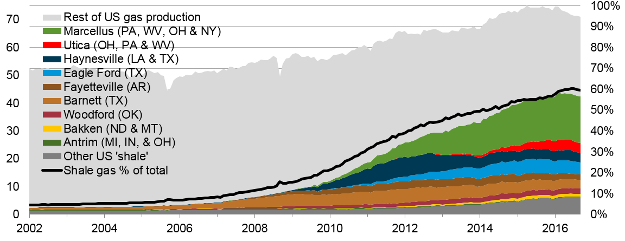
Estimated U.S. shale gas production was 42.4 Bcf/d in September 2016 about 60% of total U.S. dry production (71.1 Bcf/d)
Natural gas production (dry)
billion cubic feet per day
Shale gas production as a
percent of total gas production
Sources: EIA Natural Gas Monthly, STEO through September 2016 and DrillingInfo.
Notes:
The production data provided in this chart is EIA’s official shale gas estimate based on state administrative data collected by DrillingInfo Inc., drilling rig activity, and EIA’s analysis of data reporting trends. This is not survey data. Estimates are through March 2016. State abbreviations indicate primary state(s).
Rest of US 'shale‘ include:
Baxter (WY) (minor shale play)
Huron (WV) (minor shale play)
Mancos (CO &NM) (minor shale play)
Monterey (CA) (shale oil play)
Pearsall (TX) (minor shale play)
Pierre (ND) (minor shale play)
Wolfcamp (NM & TX) (tight oil play)
Yeso-Glorieta (NM & TX) (tight oil play)
Bonespring (NM & TX) (tight oil play)
Spraberry (NM & TX) (tight oil play)
Niobrara-Codell (CO & WY) (shale-sand oil play)

Slide 7
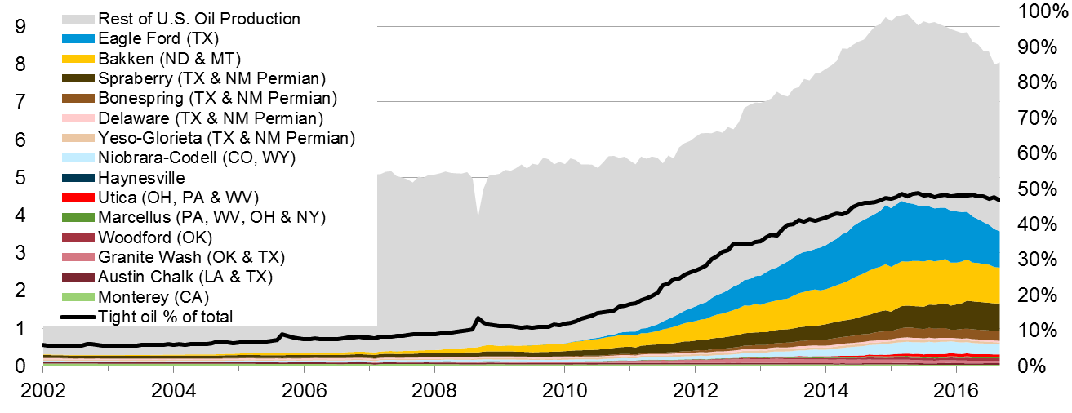
Estimated U.S. tight oil production was 3.9 MMbbl/d in September 2016 about 47% of total U.S. oil production (8.4 MMbbl/d)
Tight oil production
million barrels of oil per day
Tight oil production as a
percent of total oil production
Sources: EIA derived from state administrative data collected by DrillingInfo Inc. Data are through September 2016 and represent EIA’s
official tight oil estimates, but are not survey data. State abbreviations indicate primary state(s).
Notes:
Sources: DrillingInfo Inc. and EIA’s Drilling Productivity Report (DPR), through September 2016. Note: Information in the chart is estimated not surveyed. State abbreviations indicate primary state(s).

Slide 8
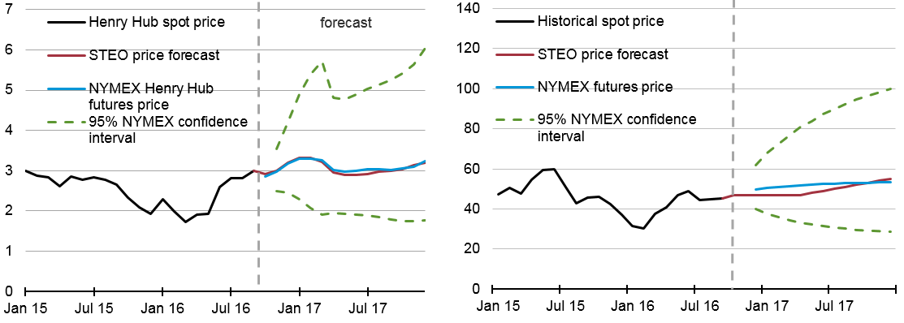
EIA forecasts Henry Hub spot prices to average $3.15/MMBtu this winter. West Texas intermediate crude oil spot price to average $47/b this winter.
Henry Hub natural gas price
dollars per million Btu
West Texas intermediate (WTI) crude oil price
dollars per barrel
Note: Confidence interval derived from options market information for the 5 trading days ending October 6, 2016 Intervals not calculated for months with sparse trading in near-the-money options contracts.
Source: EIA Short-Term Energy Outlook, October 2016, and CME Group.

Slide 9
U.S. Energy Outlook

Slide 10
Key takeaways from AEO2016
Energy use per dollar of Gross Domestic Product declines through 2040 allowing for economic growth without upward pressure on energy consumption and related emissions
Market forces drive up oil prices throughout the projection and U.S. production increases in response
Natural gas production increases despite relatively low and stable natural gas prices
Technological improvements are key drivers of U.S. oil and gas production
Net exports of liquefied natural gas range between 3.5 Tcf and 10.6 Tcf in 2040 depending on relative prices in foreign markets
EPA’s proposed medium and heavy-duty vehicle Phase 2 standards would increase fuel economy, resulting in 18% lower diesel consumption in 2040 compared with the Reference case

Slide 11
Reductions in energy intensity largely offset impact of gross domestic product (GDP) growth, leading to slow projected growth in energy use
U.S. primary energy consumption
quadrillion Btu
AEO2016 Reference
No CPP
2015
2015
History
Projections
Projections
32% of U.S. total
33%
Natural gas
29%
8%
14%
(excluding biofuels)
12%
Renewables
36%
33%
Petroleum and other liquids
34%
1%
Liquid biofuels
9%
1%
1%
Nuclear
8%
8%
16
10%
Coal
14%
Source: EIA, Annual Energy Outlook 2016

Slide 12
Combination of increased tight oil production and higher fuel efficiency drives projected decline in oil imports
U.S. liquid fuels supply
million barrels per day
High Oil and Gas Resource and Technology
Reference
History
2015
2015
Percent of supply
Net exports
+21%
24%
19%
44%
Tight oil
production
Net petroleum and other liquids
imports
25%
25%
23%
U.S. supply
100%
23%
21%
Other crude oil production
(excluding tight oil starting in 2000)
Natural gas
plant liquids
24%
17%
23%
10%
12%
Other
9%
Note: “Other” includes refinery gain, biofuels production, all stock withdrawals, and other domestic sources of liquid fuels
Source: EIA, Annual Energy Outlook 2016

Slide 13
U.S. natural gas production dominated by shale resources; alternative price and resource /technology assumptions could be quite different
U.S. dry natural gas production
trillion cubic feet
U.S. dry natural gas production
trillion cubic feet
billion cubic feet per day
History
Projections
Projections
2015
High Oil and Gas Resource and Technology
High Oil Price
2016 Reference
Low Oil Price
2015 Reference
Shale gas and
tight oil plays
Low Oil and Gas Resource and Technology
Other lower 48
Tight gas
onshore
Coalbed methane
Alaska
Lower 48 offshore
Alaska
Source: EIA, Annual Energy Outlook 2016
Notes:
13
13

Slide 14
Natural gas consumption growth is led by electricity generation and industrial uses; natural gas use rises in all sectors except residential
U.S. dry gas consumption
trillion cubic feet
billion cubic feet per day
History
Projections
Residential
Commercial
Transportation*
Industrial**
Electric power
12.0
11.2
9.6
12.5
12.6
9.1
0.9
1.7
1.7
3.2
3.7
3.7
4.6
4.6
4.6
2020
2030
2040
*Includes pipeline fuel
Source: EIA, Annual Energy Outlook 2016
**Includes combined heat-and-power and lease, plant, and export liquefaction fuel

Slide 15
Both natural gas and renewable generation surpass coal by 2030 in the Reference case, but only natural gas does so in the No CPP case
net electricity generation
billion kilowatthours
AEO2016 Reference
No CPP
2015
2015
History
Projections
Projections
Coal
Natural gas
Nuclear
Petroleum
Renewables
Source: EIA, Annual Energy Outlook 2016

Slide 16
Changing tax and cost assumptions contribute to stronger solar growth, with the CPP providing a boost to renewables
renewable electricity generation by fuel type
billion kilowatthours
2015
AEO2016 Reference
2015
No CPP
History
Projections
Projections
Wind
Municipal waste/
landfill gas
Solar
Geothermal
Biomass
Conventional hydroelectric power
Source: EIA, Annual Energy Outlook 2016

Slide 17
International Energy Outlook

Slide 18
Key findings in EIA’s long-term global outlook (IEO 2016)
World energy consumption increases from 549 quadrillion Btu in 2012 to 629 quadrillion Btu in 2020 and then to 815 quadrillion Btu in 2040, a 48% increase (1.4%/year). Non-OECD Asia (including China and India) account for more than half of the increase.
The industrial sector continues to account for the largest share of delivered energy consumption; the world industrial sector still consumes over half of global delivered energy in 2040.
Renewable energy is the world’s fastest-growing energy source, increasing by 2.6%/year; nuclear energy grows by 2.3%/year, from 4% of the global total in 2012 to 6% in 2040.
Fossil fuels continue to supply more than three-fourths of world energy use in 2040.

Slide 19
Key findings in EIA’s IEO 2016 (continued)
Among the fossil fuels, natural gas grows the fastest. Coal use plateaus in the mid-term as China shifts from energy-intensive industries to services and worldwide policies to limit coal use intensify. By 2030, natural gas surpasses coal as the world’s second largest energy source.
In 2012, coal provided 40% of the world’s total net electricity generation. By 2040, coal, natural gas, and renewable energy sources provide roughly equal shares (28-29%) of world generation.
With current policies and regulations, worldwide energy-related carbon dioxide emissions rise from about 32 billion metric tons in 2012 to 36 billion metric tons in 2020 and then to 43 billion metric tons in 2040, a 34% increase.

Slide 20
Global energy shares: renewables grow fastest, coal use plateaus, natural gas surpasses coal by 2030, and oil maintains its leading share
world energy consumption
quadrillion Btu
Source: EIA, International Energy Outlook 2016 and EIA, Analysis of the Impacts of the Clean Power Plan (May 2015)

Slide 21
As total world energy consumption grows, shares by end-use sector remain relatively unchanged
world delivered energy consumption by end-use sector
quadrillion Btu
Source: EIA, International Energy Outlook 2016

Slide 22
Renewables, natural gas, and coal all contribute roughly the same amount of global net electricity generation in 2040
world net electricity generation by source
trillion kilowatthours
Source: EIA, International Energy Outlook 2016

Slide 23
Liquefaction capacity additions over the 2015-19 time period will increase global capacity by over 30%
LNG capacity additions
billion cubic feet per day
Note: Capacity additions in 2015-19 include projects currently under construction, and represent nameplate capacity,
not adjusted for ramp-up
Source: U.S. Energy Information Administration estimates based on trade press
Notes:
Column1 2012 Low Oil Price Reference High Oil Price
OPEC crude and lease condensate 32.0 57.0 46.4 34.1
Non-OPEC crude and lease conde 42.6 45.1 53.0 58.0
Other Liquid Fuels 14.2 20.8 21.2 25.3

Slide 24
For more information
U.S. Energy Information Administration home page | www.eia.gov
Annual Energy Outlook | www.eia.gov/aeo
Short-Term Energy Outlook | www.eia.gov/steo
International Energy Outlook | www.eia.gov/ieo
Monthly Energy Review | www.eia.gov/mer
Today in Energy | www.eia.gov/todayinenergy
State Energy Profiles | www.eia.gov/state
Drilling Productivity Report | www.eia.gov/petroleum/drilling/
International Energy Portal | www.eia.gov/beta/international/?src=home-b1

