Slide 1
Winter Fuels Outlook
For
NCAC-USAEE
October 24, 2014 | Washington, DC
By
Adam Sieminski, Administrator
U.S. Energy Information Administration

Slide 2
Winter Outlook

Slide 3
Winter 2013-14 compared with winter 2014-15
NOAA’s central forecast is for 12% lower winter heating degree days.
Natural gas stocks are lower this winter, but production levels are elevated. We anticipate continued congestion in natural gas transportation into New England for home heating and electricity generation.
Propane stocks are beginning this winter much higher in PADD 1 (East Coast), PADD 2 (the Midwest) and PADD 3 (Gulf Coast) than last winter. Secondary and tertiary stocks have reportedly been building in the Midwest.
Corn harvest forecasts by the USDA call for a record crop yield. Last year’s large, wet corn harvest increased the demand for propane used in crop drying. The corn belt has been drier this year.
Total distillate stocks, which include heating oil as well as Ultra Low Sulfur Diesel (ULSD) are about the same as year-ago levels. Five states in the Northeast have lowered sulfur specifications for heating oil.
Coal stocks at electric utilities are at the low end of the 2006-2013 range.

Slide 4
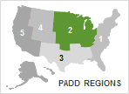
PADD 2 (Midwest) propane inventories are currently above the five-year average
PADD 2 propane* inventories
million barrels
Typical corn harvest dates
(Sept 20 – Nov 10)
28.1
(10/10/14)
27.3
previous 5-year average, as of 10/10/14
Source: EIA, Weekly Petroleum Status Report, data through October 10
*propane/propylene for fuel use only

Slide 5
U.S. propane production and trade trends
U.S. propane and propylene production, imports, and exports
million barrels per day
production
imports
exports
Source: EIA, Petroleum Supply Monthly through July 2014; August and September 2014 are estimates

Slide 6
Natural gas stocks are currently below the five-year average and five-year minimum, but have been climbing steadily
history
Base case
10% colder
Note: Normal range (gray band) represents the range between the minimum to maximum from Jan. 2009 to Dec. 2013
Source: EIA Short-Term Energy Outlook, October 2014

Slide 7
Key pipelines delivering natural gas into New England have been at or close to capacity on most days since the start of last winter
Source: Derived from the Ventyx Energy Velocity Suite. Scheduled volumes based on Algonquin Gas Transmission’s Stony Point compressor station and Tennessee Gas Pipeline’s Station 245-249 Segment using intra-day 2 nominations from November 1, 2013 to September 9, 2014.

Slide 8
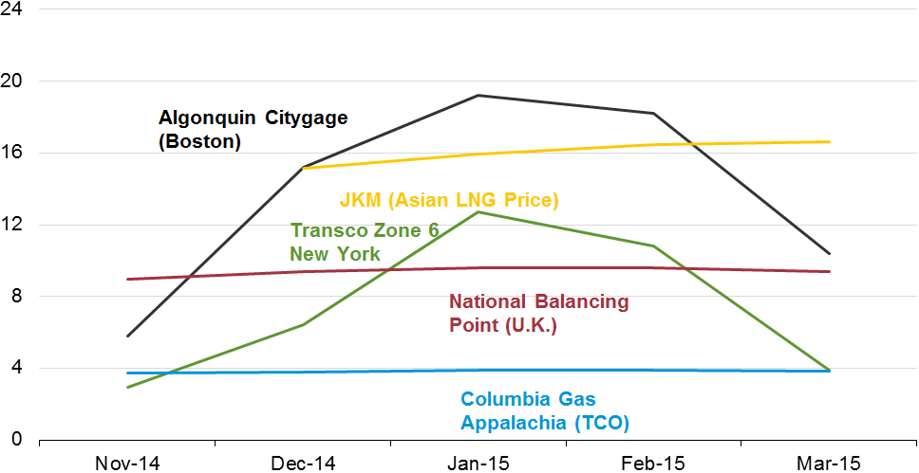
Current forward natural gas prices in Boston, and to a lesser extent New York, indicate the likelihood of constraints again this winter
Forward natural gas prices for winter months 2014-15 in selected markets as of early October
U.S. dollars per million British thermal unit
Source: Ventyx Energy Velocity Suite and Bloomberg. JKM is a proxy for LNG priced into Japan, Korea, and Malaysia. The Algonquin Citygates, Transco Zone 6 New York, and Columbia Gas Appalachia prices include the Henry Hub natural gas futures market price. Prices reflect recent settlements in early October.

Slide 9
Distillate inventories in key regions
EIA is using total distillate fuel inventories for heating oil notifications under Reliable Home Heating Fuels (RHHA).
For many states, the largest component of total distillate fuel is diesel fuel, which contains less than 15 ppm of sulfur content. Lower sulfur distillate may be used when higher sulfur heating oil is scarce.

Slide 10
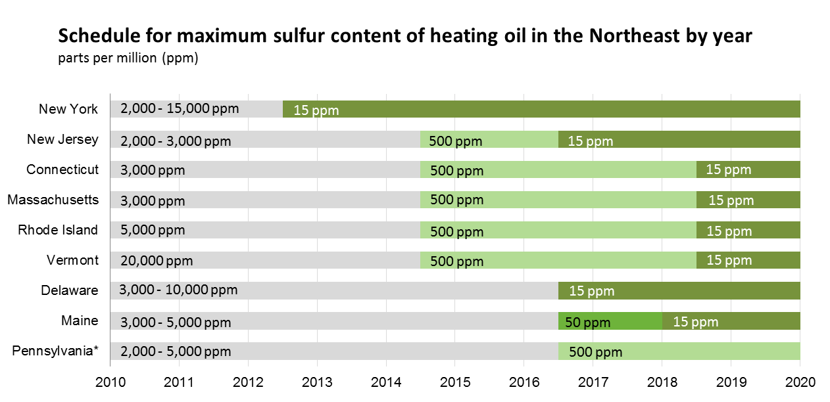
Heating oil sulfur specifications lowered in five states as of July 2014
15 ppm
15 ppm
Note: Specifications change on July 1 of the years shown, with the exception of Maine's 15 ppm requirement, which changes on January 1, 2018.
* Philadelphia, Pennsylvania changes from 2,000 ppm to 15 ppm on July 1, 2015.
Source: U.S. Energy Information Administration

Slide 11
Coal stocks at electric utilities are at the bottom of the multi-year range
U.S. coal stocks
million short tons
Historical range (2006-2013)
U.S. electric power coal stocks
Note: Range represents difference between minimum and maximum from 2006 to 2013
Source: EIA Short-Term Energy Outlook, October 2014

Slide 12
EIA actions to improve winter fuels information
More Detailed Weekly Propane Stock Data – In addition to weekly PADD-level propane stocks, EIA will publish figures for Kansas (Conway hub), Michigan, Minnesota and Wisconsin, and a 4-state total for Iowa, Illinois, Indiana and Ohio.
Notification to Governors of Low Stock Levels – Pursuant to the Reliable Home Heating Act, EIA now notifies state Governors when stocks of heating oil, natural gas, or propane in their PADD fall below the 5-year average for more than 3 weeks.
Expanded State Participation in EIA Weekly Price Reporting – The State Heating Oil and Propane Program (SHOPP) now includes 14 more states for a total of 38. The first data release was on October 16.
Increased Visibility on EIA Website and Targeted Communication with State Officials – EIA launched a special winter fuels webpage showcasing stock and price data. Beyond this, EIA will proactively reach out to both industry and public stakeholders in the states.

Slide 13
Oil and Gas Markets

Slide 14
U.S. is the largest producer of petroleum and natural gas in the world
estimated U.S., Russia, and Saudi Arabia petroleum and natural gas production
quadrillion Btu
million barrels per day of oil equivalent
United States
Russia
Saudi Arabia
natural
gas
petro-leum
2008
2009
2010
2011
2012
2013
2014e
Source: U.S. Energy Information Administration
Note: Petroleum production includes crude oil, natural gas liquids, condensates, refinery processing gain, and other liquids, including biofuels; barrels per day oil equivalent were calculated using a conversion factor of 1 barrel oil equivalent=5.55 million British thermal units (Btu)

Slide 15
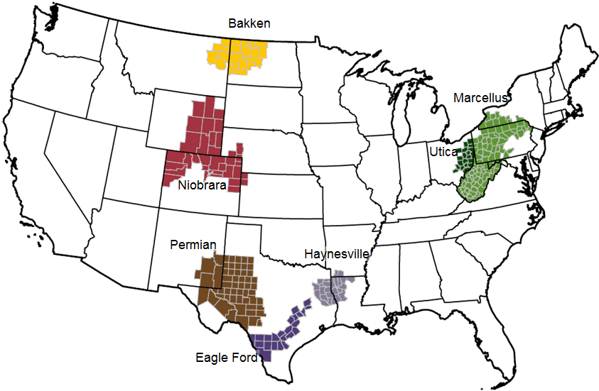
These seven regions accounted for 95% of U.S. oil production growth and all U.S. natural gas production growth from 2011-2013
Source: EIA, Drilling Productivity Report

Slide 16
The U.S. has experienced a rapid increase in natural gas and oil production from shale and other tight resources
Sources: EIA derived from state administrative data collected by DrillingInfo Inc. Data are through August 2014 and represent EIA’s official tight oil & shale gas estimates, but are not survey data. State abbreviations indicate primary state(s).

Slide 17
U.S. shale gas leads growth in total gas production through 2040, when production exceeds 100 billion cubic feet per day
U.S. dry natural gas production
trillion cubic feet
billion cubic feet per day
2012
history
projections
Shale gas
Non-associated onshore
Tight gas
Non-associated offshore
Alaska
Associated with oil
Coalbed methane
Source: EIA, Annual Energy Outlook 2014, Reference case
Notes:
17
17

Slide 18
Natural gas consumption growth is driven by electric power, industrial, and transportation use
U.S. dry gas consumption
trillion cubic feet
history
projections
11.0
electric
power
8.5
11.2
industrial*
9.1
0.7
1.7
transportation**
2.9
3.6
commercial
4.2
4.1
residential
*Includes combined heat-and-power and lease and plant fuel
**Includes pipeline fuel
Source: EIA, Annual Energy Outlook 2014, Reference case

Slide 19
U.S. becomes a net exporter of natural gas in the near future
U.S. dry natural gas
trillion cubic feet per year
billion cubic feet per day
history
2012
projections
100
75
Consumption
50
Domestic supply
Net exports
25
0
-25
Source: EIA, Annual Energy Outlook 2014 Reference case

Slide 20
Projected U.S. natural gas trade depends on assumptions regarding resources and future technology advances
Reference case
trillion cubic feet per year
High Oil and Gas Resource case
trillion cubic feet per year
billion cubic
feet per day
20
exports to Mexico
15
exports to Canada
10
5
lower 48
LNG exports
0
imports from Canada
-5
LNG imports
-10
Source: EIA, Annual Energy Outlook 2014, Reference case and High Oil and Gas Resource case

Slide 21
Resource and technology assumptions have major implications for projected U.S. crude oil production beyond the next few years
Reference case
million barrels per day
High Oil and Gas Resource case
million barrels per day
2012
2012
history
projections
history
projections
STEO October 2014 U.S. crude oil projection
tight oil
tight oil
other lower 48 states onshore
other lower 48 states onshore
lower 48 states offshore
lower 48 states offshore
Alaska
Alaska
Source: EIA, Annual Energy Outlook 2014; Short Term Energy Outlook, October 2014

Slide 22
U.S. rail carloads of crude oil and petroleum products exceed 1.5 million b/d in 2014
number of rail carloads per week
million barrels per day
Source: U.S. Energy Information Administration, based on Association of American Railroads

Slide 23
U.S. is already a major net exporter of petroleum products
U.S. petroleum product net exports
million barrels per day
2015(e)
Source: EIA, Annual Energy Outlook 2014 Reference case and Short Term Energy Outlook
Notes:
23
23

Slide 24
Growing U.S. oil production and rising demand in China have together made China the world’s largest net oil importer
net imports for China and the United States
million barrels per day
Aug-14
history
projections
Note: Net oil imports are defined as total liquid fuels consumption less domestic production
Source: EIA, Short-Term Energy Outlook, October 2014

Slide 25
Most of the growth in production between 2011 and 2015 consists of sweet grades with API gravity of 40 or above
U.S. crude oil production by type
million barrels of oil per day
history
forecast
Source: EIA, DrillingInfo, Colorado DNR, Texas RRC. http://www.eia.gov/analysis/petroleum/crudetypes/

Slide 26
Crude oil and associated liquids contain a wide variety of hydrocarbons
Source: EIA via Harvey Crude Assay Management System

Slide 27
There are several different distillation processes used in the petroleum industry; they are typically named for their function, not their configuration
EIA Refinery Survey
Complex Distillation
Tower
Cost
Splitter
Distillation Complexity
Stabilizer
Separation via Pressure Changes
Separation via Column Temperature Gradients
Heater
Treater
Flash
Drum
Distillation Efficiency

Slide 28
Distillation processes and resulting products
processed products for domestic use or exportable without license
processed
condensate
finished petroleum products and other processed hydrocarbon liquids
EIA Refinery Survey
other
processed
gas liquids
plant
condensate
splitter
complex
distillation
gas processing plant
stabilizer
finished product streams
dry gas
(exportable with
order/authorization)
fractionator
separator
separation via temperature gradients
wet gas
crude oil / lease condensate
(exportable under limited conditions)
flash drum
heater treater
water
field / lease separator
separation via pressure changes
mixed hydrocarbon wells
(gas, condensate, oil)

Slide 29
Areas of uncertainty in the outlook
China’s energy demand growth; particularly in transportation
EIA is working with MIT and others to upgrade the structural and macroeconomic determinates of transportation demand in all regions for IEO2015
Increasing global trade of natural gas and HGL in addition to oil
EIA is integrating the representation of oil and natural gas supply and other hydrocarbons
Global development of tight oil and shale gas resources
EIA is gathering geology and production information, and conducting outreach
Policy decisions on crude oil exports
Impact of geopolitical tensions on energy supply
EIA exploring options for representing these uncertainties in the outlook

Slide 30
For more information
U.S. Energy Information Administration home page | www.eia.gov
Annual Energy Outlook | www.eia.gov/aeo
Short-Term Energy Outlook | www.eia.gov/steo
International Energy Outlook | www.eia.gov/ieo
Monthly Energy Review | www.eia.gov/mer
Today in Energy | www.eia.gov/todayinenergy
State Energy Portal | www.eia.gov/state
Drilling Productivity Report | www.eia.gov/petroleum/drilling/

