Slide 1
How much will low prices stimulate oil demand?
For
Oil and Money
October 6, 2015 | London
by
Adam Sieminski, Administrator
U.S. Energy Information Administration

Slide 2
What are the key cyclical and structural factors driving oil demand?

Slide 3
Cyclical: EIA’s world oil demand growth projections for 2014 and 2015 were lowered significantly in late 2014 (from preliminary estimates)
changes in projected world oil demand growth year-over-year
million barrels per day
P
P
2015
2016
2014
P
P = Preliminary
Note: Starting in January of each year, each line shows the expected forecast of world oil demand growth year-over-year for the specified calendar year, which tends to move toward the actual realized growth outcome as the year progresses.
Source: Energy Information Administration, September 2015 Short-term Energy Outlook

Slide 4
Cyclical: EIA’s non-OECD GDP growth projections were steadily lowered for most of the past two years (from preliminary estimates)
changes in projected non-OECD GDP growth
percent
2014
P
P
2015
P
2016
P = Preliminary
Note: Starting in January of each year, each line shows the expected forecast of GDP growth for the specified calendar year, which tends to move toward the actual realized growth outcome as the year progresses.
Source: Energy Information Administration, September 2015 Short-term Energy Outlook

Slide 5
Cyclical: Employment growth in OECD countries is another important contributing factor for gasoline consumption
employment
indexed to 2010
Source: IHS Global Insight

Slide 6
Structural: U.S. light-duty vehicle stock fuel economy continues to rise while annual vehicle miles per driver remain below 2000 levels despite rising number of licensed drivers
U.S. transportation indicators
indexed to 2000
projected
2000 2015
fuel economy (mpg) 19.8 22.6
VMT per driver (thousand) 12.4 12.3
# licensed drivers (million) 190 222
Number of licensed drivers
light-duty vehicle
stock fuel economy
annual vehicle miles traveled
per licensed driver
Source: Annual Energy Outlook 2015, Reference case

Slide 7
Structural: Policies have also had an impact on recent global oil demand growth
Adoption and increases in CAFE standards
European fuel tax and diesel-friendly policies
Biofuel policies in the U.S. and Brazil

Slide 8
How is demand growth changing in developing countries?

Slide 9
Total oil consumption in Brazil, Russia, India, and China has grown steadily since 2010
Brazil, China, India, and Russia liquid fuels consumption
million barrels per day
History
Forecast
Source: Energy Information Administration, September 2015 Short Term Energy Outlook

Slide 10
The majority of recent growth in liquids consumption from the BRIC countries is from the transportation sector
BRIC change in liquid fuels consumption, 2010-2015
quadrillion Btu
Source: Energy Information Administration, preliminary analysis

Slide 11
Diesel consumption in Brazil, Russia, India, and China has averaged 6.5 million b/d in the last couple of years, while gasoline consumption has grown to over 4.5 million b/d so far in 2015
Brazil, China, India, and Russia diesel consumption
million barrels per day, 12 month moving average
Brazil, China, India, and Russia gasoline consumption
million barrels per day, 12 month moving average
Source: Bloomberg L.P., FACTS, JODI Data, India Petroleum Planning and Analysis Cell
Note: Data is through June 2015. China data is apparent consumption.

Slide 12
To what extent will a prolonged period of low oil prices result in a return to higher demand growth?

Slide 13
The direct price effects can raise gasoline demand---as occurred recently in the United States
dollars per gallon excluding taxes (nominal)
(4-quarter moving average)
gasoline product supplied
million barrels per day (4-quarter moving average)
Source: Energy Information Administration, Petroleum Supply Monthly and Petroleum Marketing Monthly (as of September 2015)

Slide 14
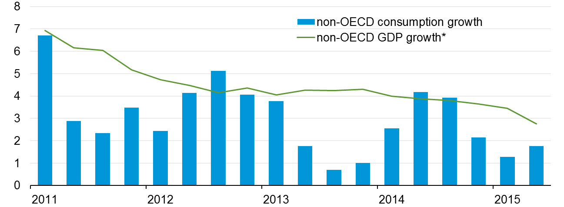
The macro impacts are also important---Non-OECD oil consumption growth declined recently as GDP growth slowed
oil consumption
percent change (year-on-year)
Source: Energy Information Administration, IHS Global Insight (as of September 2015)
* Oil consumption weighted GDP

Slide 15
Prices and economic growth are important, but policy, preferences, and technology may have a bigger long-term impact
What types of consumption and pricing policies will be enacted across the world?
Fuel subsidies
Environmental policies
Domestic security policies
What will light-duty vehicle trends look like?
Ownership rates
Efficiency and emissions standards
Technology/alternative fuels
Where will goods be produced and how will they be moved?
Will there be major industrial sector efficiency improvements or fuel switching?

Slide 16
How is the landscape of oil trading changing with the decreasing presence of key financial institutions?

Slide 17
Several financial institutions either sold or reduced their physical oil and commodities trading businesses
JP Morgan sells its physical commodities business to Mercuria ($3.5 billion, announced March 2014)
Morgan Stanley sells TransMontaigne, its petroleum distribution business, to NGL Energy partners ($200 million, announced June 2014)
Morgan Stanley sells its physical oil assets and trading business to Castleton Commodities ($1 billion, announced May 2015)
Barclays, Deutsche Bank, and UBS have all reduced or eliminated their commodity trading businesses in the past two years
Source: Evaluate Energy, Bloomberg L.P., Reuters

Slide 18
Trading volume for both WTI and Brent futures contracts is higher so far in 2015 compared to 2014
average daily trading volume
thousands of contracts, by month
Source: Bloomberg L.P., as of September 30, 2015

Slide 19
Open interest for both WTI and Brent are higher so far this year compared to 2014
average daily open interest
thousands of contracts, by month
Source: Bloomberg L.P., as of September 30, 2015

Slide 20
For more information
U.S. Energy Information Administration home page | www.eia.gov
Annual Energy Outlook | www.eia.gov/aeo
Short-Term Energy Outlook | www.eia.gov/steo
International Energy Outlook | www.eia.gov/ieo
Monthly Energy Review | www.eia.gov/mer
Today in Energy | www.eia.gov/todayinenergy
State Energy Profiles | www.eia.gov/state
Drilling Productivity Report | www.eia.gov/petroleum/drilling/
International Energy Portal | www.eia.gov/beta/international/?src=home-b1

