Slide 1
Energy Information Administration
EIA Overview
For
U.S.-China Oil & Gas Industry Forum
September 28, 2016 | Tysons Corner, VA
By
Adam Sieminski, EIA Administrator
Notes:
Thanks for having me here today—I am very excited to participate in my first OGIF.
Today I am going to discussing with you the important work that the U.S. Energy Information Administration does, and, in particular, the meaningful effects that it has on supporting markets and aiding in the discourse surrounding policy development.

Slide 2
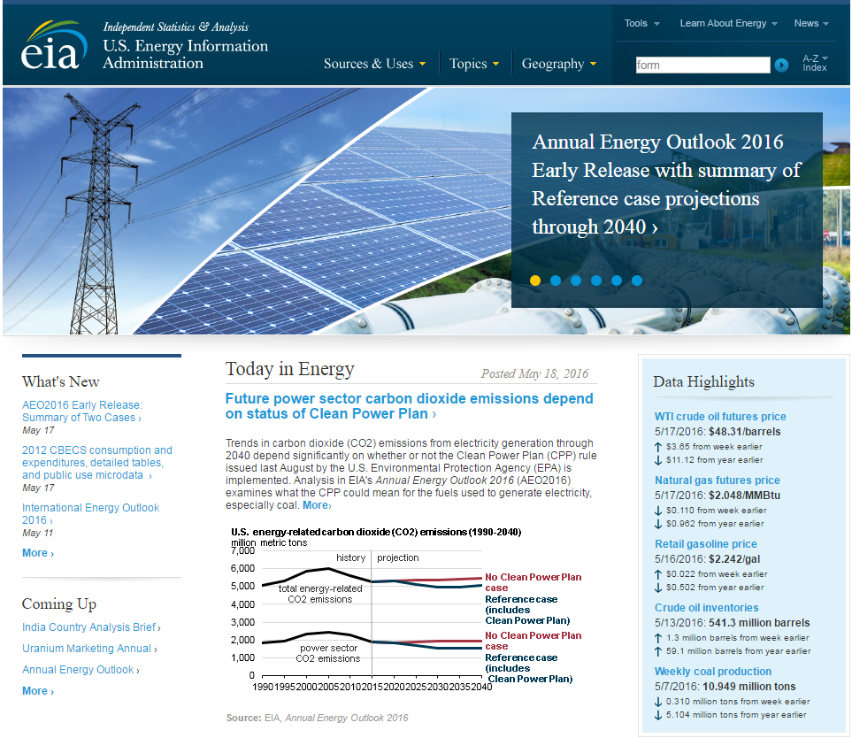
Mission: EIA collects, analyzes, and disseminates independent and impartial energy information to promote sound policymaking, efficient markets, and public understanding of energy and its interaction with the economy and the environment.
EIA is the Nation’s premier source of energy information and, by law, its data, analyses, and forecasts are independent of approval by any other officer or employee of the United States Government.
Notes:
The Department of Energy Organization Act of 1977 established EIA as the primary federal government authority on energy statistics and analysis, building upon systems and organizations first established in 1974 following the oil market disruption of 1973. Located in Washington, DC, EIA is an organization of about 370 federal employees, with an annual budget in Fiscal Year 2016 of $122 million.
The cornerstone of EIA’s mission was, and still is, its impartiality and independence, which promotes sound policymaking and efficient markets. Overall, EIA helps support a public understanding of energy and its interaction with the economy and the environment.

Slide 3
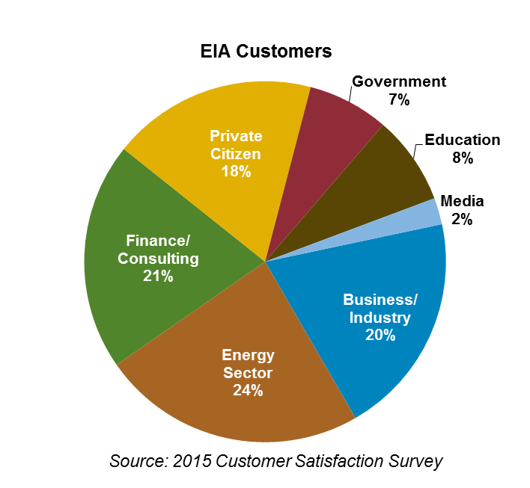
EIA information is used by a range of stakeholders
Examples of Activities
Government
Executive Agencies – WH, DOE, & EPA use EIA data to track energy markets and program performance and to analyze policy proposals
Congress – policy development and agency funding
State Governments – planning and program development
Energy Sector
Consumers – monitor price forecasts
Producers – track inventory statistics
Business/Industry
Manufacturers – market research
Finance/Consulting
Commodities Analysts – market response to supply data
Media/Education
Journalists – cite energy statistics
Teachers – use Energy Kids materials
Researchers – energy forecasting and modeling
Private Citizens
Public – research gasoline prices
Customer-focused Performance Results
Quality: 90% of customers are satisfied or very satisfied with the quality of EIA information
Timeliness: 95% of selected EIA recurring products meet their release date target
Notes:
EIA’s data and analyses reaches a range of stakeholders, both inside and outside the government.
The majority of our stakeholders are outside the government, with people involved in the energy sector, the financial and consulting business, general business and industry, and private citizens accounting for over 80% of our website visitors, according to recent survey results.

Slide 4
EIA’s data collection integrates all energy sectors
Notes:
EIA has federal authority to collect data across the energy sector and companies are compelled by statute to respond to our surveys.
We collect data across fuels (i.e., natural gas, petroleum, electricity, coal, etc.), both upstream—from how much reserves are in the ground to how much are being produced, midstream—from transformative processes such as refining and electric generation, to energy storage and overall distribution, and downstream—to how and by what sector the energy is being consumed. Our surveys and publications have varying levels of periodicity. We have hourly, weekly, monthly, annual, and quadrennial surveys and publications. Some of our surveys cover the entire census of companies within a particular segment of the energy sector, whereas other surveys are based on a sample of participants, which we use to prepare our estimates on.
Our data provides the foundation of our short-term energy outlook and our long-term energy projections.

Slide 5
Recent accomplishments
U.S. Drilling Productivity Report
Assessment of shale outside of the U.S.
Crude export analysis
EIA Flicker page and social media growth
EIA-930 Hourly Balancing Authority Operations Report
Monthly solar PV capacity and generation
Crude by rail
Expanded natural gas production survey and U.S. crude oil production data with API gravity
North American energy information cooperation
New natural gas storage regions in weekly data
Notes:
A core value at EIA is that we help people understand energy. We do this through constantly evaluating the direction of the energy market, and adapting our data collection and analysis efforts appropriately. It is imperative that we remain responsive to what is often a rapidly changing and dynamic environment.
For example, in response to increased production from the U.S. shale and tight resources, EIA has expanded the collection of its gas and oil production data, has started the publication of crude-by-rail statistics, now produces a monthly drilling productivity report, and has produced several studies relating to exports of liquids. We have also produced studies assessing shale resources outside the United States.
We have expanded our surveys to better understand the contribution of renewable electricity sources to the overall generation mix—we achieved this by producing statistics on monthly solar PV capacity and generation, including distributed solar.
Other recent accomplishments include participating in the North American Cooperation for Energy Information, signed by the North American Ministers in December 2014.
We are continuously evolving our web platforms and products to improve information accessibility—including an EIA excel add-in, which was recently launched.

Slide 6
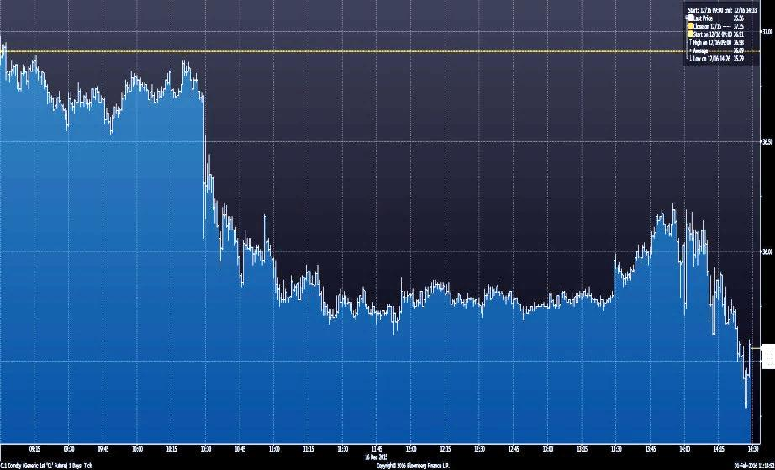
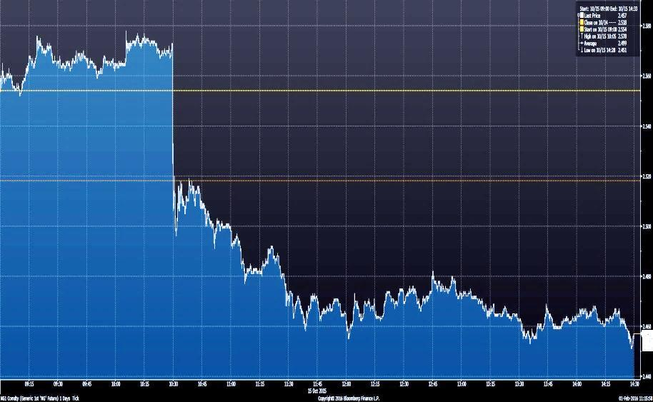
The release of EIA’s oil and natural gas inventory data has an immediate impact on energy markets
Producers, consumers, utilities, regulators, investors, and analysts use a wealth of EIA energy statistics in their day-to-day activities in the global energy marketplace.
The Weekly Natural Gas Storage Report (WNGSR) is designated as one of the nation’s Principal Federal Economic Indicators.
The Weekly Petroleum Status Report (WPSR) provides statistics on oil and petroleum product stocks, imports, and production.
10:30 am EIA petroleum data released
10:30 am EIA natural gas data released
Data Represent NYMEX Light, Sweet Crude Oil (WTI) Near-Month Futures Contract December 16, 2015
Source: Bloomberg Finance LP (February 1, 2016)
Data Represent NYMEX Henry Hub Natural Gas Near-Month Futures Contract October 15, 2015
Source: Bloomberg Finance LP (February 1, 2016)
Notes:
Producers, consumers, utilities, regulators, investors, and analysts use a wealth of EIA energy statistics in their day-to-day activities in the global energy marketplace. Examples of this include:
EIA’s Weekly Natural Gas Storage Report, which is designated as one of our nation’s Principal Federal Economic Indicators, as well as,
EIA’s Weekly Petroleum Status Report, which provides statistics on oil and petroleum product stocks, imports, and production.
The release of those two reports have immediate impact on energy markets.

Slide 7
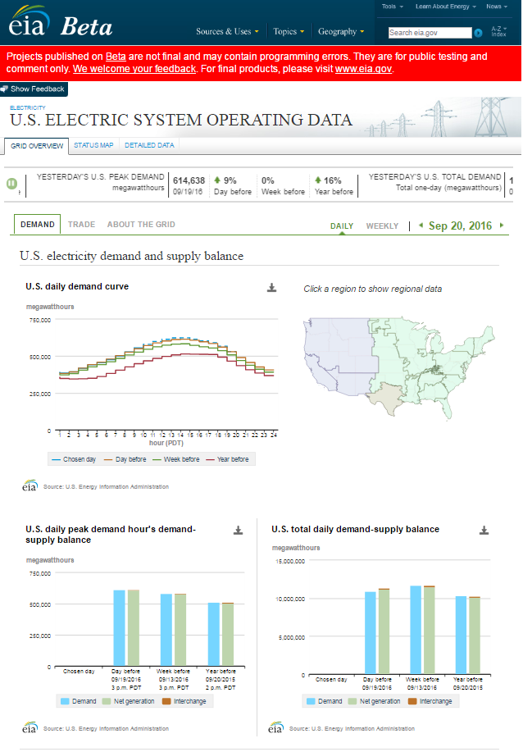
Hourly electric system operating data
EIA has released a public beta version of its near real-time hourly data on the operation of the U.S. electric system
Availability of data will inform investments in technologies and programs to take advantage of the time varying nature of electric system operations
Data collection and a highly visible webpage will serve situational awareness, policy, and educational objectives
Readily accessible long-term data series will support analysts interested in intra-day and seasonal patterns of demand
Notes:
Another example of how EIA data can have immediate impacts on markets is EIA’s report on hourly electric system operating data, which includes near real-time hourly data on the operation of the U.S. electric system.
The availability of this data helps inform investments in technologies and programs to take advantage of the time varying nature of electric system operations.
Additionally, data collection and a highly visible webpage will serve situational awareness, policy, and educational objectives, while having a readily accessible long-term data series will support analysts interested in intra-day and seasonal patterns of demand.

Slide 8
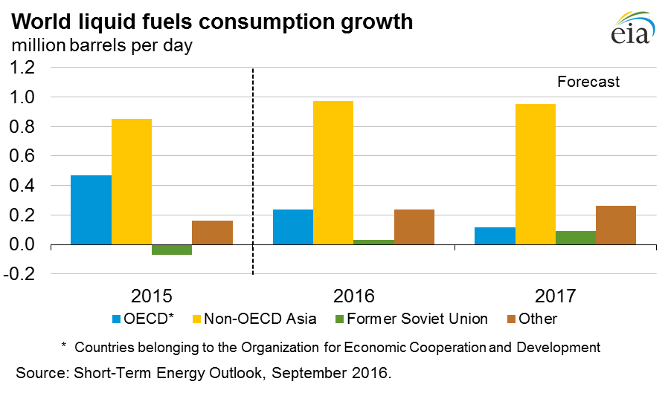
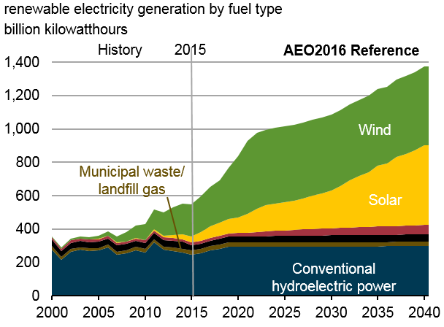
EIA analysis brings context and meaning to energy data
Short-Term Energy Outlook (monthly)
Forecasts U.S. supplies, demands, imports, stocks, and prices with a horizon of 12 to 24 months
Annual Energy Outlook
Presents 25- to 30-year projection and analysis of U.S. energy supply, demand, and prices
International Energy Outlook
Assesses international crude, liquid fuel, and natural gas markets through 2040
Ad Hoc Reporting and Analysis
Reports for Congress and key stakeholders (e.g. Iran sanctions, refinery outage, and energy production on Federal lands)
Today in Energy
Short article analyzing a topical energy trend, published daily on the EIA homepage
Source: Annual Energy Outlook, 2016
Notes:
As I mentioned earlier, EIA’s data collection serves as a foundation for the analysis that EIA produces. This analysis brings context and meaning to energy data.
Among the analysis we produce are:
Short-Term Energy Outlook (monthly)
Forecasts U.S. supplies, demands, imports, stocks, and prices with a horizon of 12 to 24 months
Annual Energy Outlook
Presents 25- to 30-year projection and analysis of U.S. energy supply, demand, and prices
International Energy Outlook
Assesses international crude, liquid fuel, and natural gas markets through 2040
Ad Hoc Reporting and Analysis
Reports for Congress and key stakeholders (e.g. Iran sanctions, refinery outage, and energy production on Federal lands)
Today in Energy
Short article analyzing a topical energy trend, published daily on the EIA homepage

Slide 9
EIA will continue key energy data projects in 2017
Begin 2017 Commercial Energy Building Consumption Survey (CBECS)
Complete data collection and publish preliminary results of the 2015 Residential Energy Consumption Survey (RECS)
Increase integration of EIA energy data with Canada and Mexico
Expand Mid-Term energy analysis capabilities with greater focus on international linkages affecting U.S. energy markets
Extend EIA’s energy by rail data beyond crude oil and ethanol to include shipments of propane
Fund the ongoing operations of new survey instruments, including oil and gas production data, hourly electricity data, and densified biomass
Notes:
Looking forward, EIA will continue evolving, and has many varying issues that it plans on pursuing in the coming year.
These include:
Milestones for two of our largest end-use surveys: the start of data collection for the 2017 Commercial Energy Building Consumption Survey and the completion of data collection and publication of preliminary results of the 2015 Residential Energy Consumption Survey
The expansion of Mid-Term energy analysis capabilities with greater focus on international linkages affecting U.S. energy markets
The extension of EIA’s energy by rail data beyond crude oil and ethanol to include shipments of propane

Slide 10
For more information
U.S. Energy Information Administration home page | www.eia.gov
Annual Energy Outlook | www.eia.gov/aeo
Short-Term Energy Outlook | www.eia.gov/steo
International Energy Outlook | www.eia.gov/ieo
Monthly Energy Review | www.eia.gov/mer
Today in Energy | www.eia.gov/todayinenergy
State Energy Portal | www.eia.gov/state
Drilling Productivity Report | www.eia.gov/petroleum/drilling/

Slide 11
Our core values and vision

Slide 12
EIA’s organization structure
EIA Administrator
Deputy Administrator
Assistant Administrator
for Energy Statistics
Assistant Administrator
for Energy Analysis
Assistant Administrator
for Communications
Assistant Administrator
for Resource and Technology Management
Office of Survey Development and Statistical Integration
Office of Energy Markets and Financial Analysis
Office of Communications
and Outreach
Office of Employee Services
Office of Energy Consumption and Efficiency Statistics
Office of Energy Consumption and Efficiency Analysis
Office of Web Management
Office of Information Technology
Office of Electricity, Renewables, and Uranium Statistics
Office of Petroleum, Natural Gas, and Biofuels Analysis
Office of Planning, Budget, Procurement, and Evaluation
Office of Oil, Gas, and Coal Supply Statistics
Office of Electricity, Coal, Nuclear, and Renewables Analysis
Office of Petroleum and Biofuels Statistics
Office of Integrated and International Energy Analysis
Office of Survey Support and Application Management

Slide 13
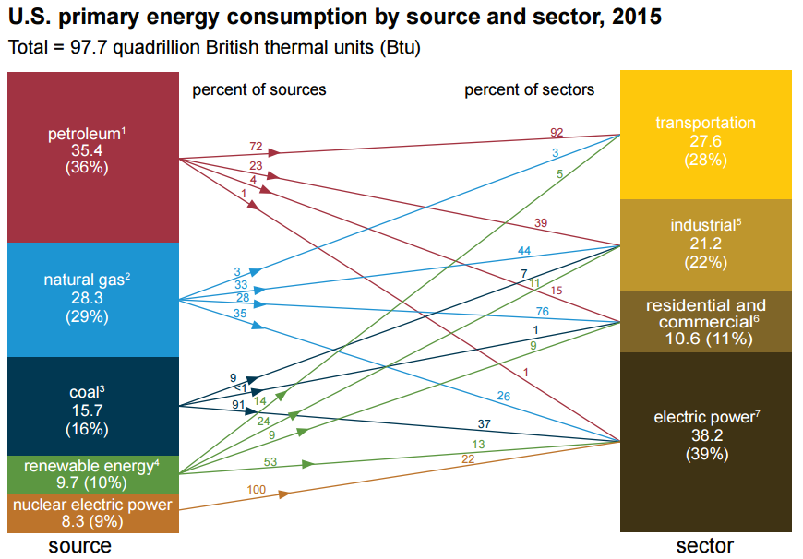
EIA’s data illustrate how energy is used
Source: U.S. Energy Information Administration, Monthly Energy Review (June 2016)

Slide 14
EIA is delivering impactful products that are helping people understand energy
Oil, Natural Gas, and Crude-by-Rail data
Began monthly collection of new crude oil and expanded natural gas production data from operators, including data on oil quality. EIA also added monthly reporting on crude by rail movements.
Distributed Solar
Initiated monthly state-level estimates of small-scale distributed solar photovoltaic (PV), including rooftop generation.
Energy Accessibility
EIA launched a new international energy data portal, and an Excel add-in allowing the public to find and download directly into a spreadsheet.
Petroleum Product Exports
Prepared reports and analyses of the implications of removing restrictions on U.S. crude oil exports, including modeling of prices, production, and trade effects.
North American Energy
The United States began collaboration with its Canadian and Mexican counterparts to create North American energy maps, to reconcile energy trade flows data between the three countries.
Electricity
Began collection of real-time electricity data from the EIA-930, the world’s first hourly energy data collection by a government statistical agency.

Slide 15
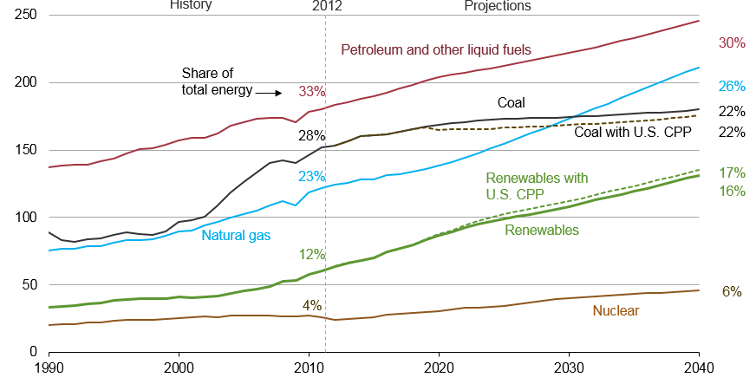
Global energy shares: renewables grow fastest, coal use plateaus, natural gas surpasses coal by 2030, and oil maintains its leading share
world energy consumption
quadrillion Btu
Source: EIA, International Energy Outlook 2016 and EIA, Analysis of the Impacts of the Clean Power Plan (May 2015)

Slide 16
Clean Power Plan accelerates shift to lower-carbon options for generation, led by growth in renewables and gas-fired generation
U.S. net imports
quadrillion Btu
History
Projections
2015
Liquids
Natural gas
Coal
Source: EIA, Annual Energy Outlook 2016

Slide 17
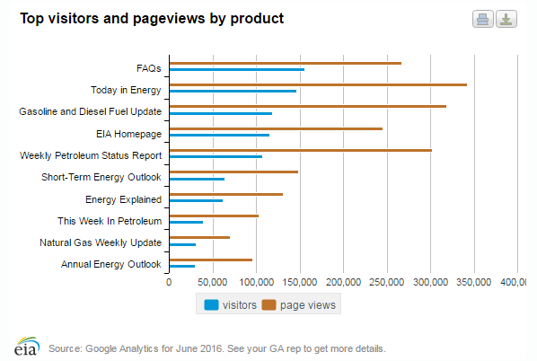
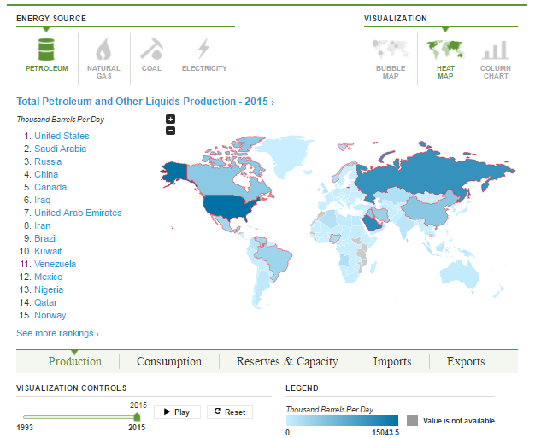
EIA is continuously evolving its web platforms and products to improve information accessibility
Top visitors and pageviews by product
International Energy Portal

