Slide 1
EIA’s Energy Outlook 2016
For
Dentons 2016 Energy Outlook
August 2, 2016 | Washington, DC
By
Adam Sieminski, Administrator

Slide 2
Key findings in the IEO2016 Reference case
World energy consumption increases from 549 quadrillion Btu in 2012 to 629 quadrillion Btu in 2020 and then to 815 quadrillion Btu in 2040, a 48% increase (1.4%/year). Non-OECD Asia (including China and India) account for more than half of the increase.
The industrial sector continues to account for the largest share of delivered energy consumption; the world industrial sector still consumes over half of global delivered energy in 2040.
Renewable energy is the world’s fastest-growing energy source, increasing by 2.6%/year; nuclear energy grows by 2.3%/year, from 4% of the global total in 2012 to 6% in 2040.
Fossil fuels continue to supply more than three-fourths of world energy use in 2040.

Slide 3
Key findings in the IEO2016 Reference case (continued)
Among the fossil fuels, natural gas grows the fastest. Coal use plateaus in the mid-term as China shifts from energy-intensive industries to services and worldwide policies to limit coal use intensify. By 2030, natural gas surpasses coal as the world’s second largest energy source.
In 2012, coal provided 40% of the world’s total net electricity generation. By 2040, coal, natural gas, and renewable energy sources provide roughly equal shares (28-29%) of world generation.
With current policies and regulations, worldwide energy-related carbon dioxide emissions rise from about 32 billion metric tons in 2012 to 36 billion metric tons in 2020 and then to 43 billion metric tons in 2040, a 34% increase.

Slide 4
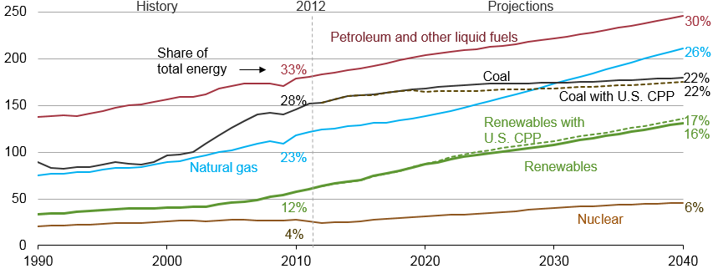
Renewables grow fastest, coal use plateaus, natural gas surpasses coal by 2030, and oil maintains its leading share
world energy consumption
quadrillion Btu
Source: EIA, International Energy Outlook 2016 and EIA, Analysis of the Impacts of the Clean Power Plan (May 2015)

Slide 5
Liquid fuels supplies from both OPEC and non-OPEC producers increase through 2040
world production of petroleum and other liquid fuels
million barrels per day
History
2012
Projections
Source: EIA, International Energy Outlook 2016

Slide 6
Renewables, natural gas, and coal all contribute roughly the same amount of global net electricity generation in 2040
world net electricity generation by source
trillion kilowatthours
Nuclear
Other renewables
Hydropower
Natural gas
Coal
Liquids
Source: EIA, International Energy Outlook 2016

Slide 7
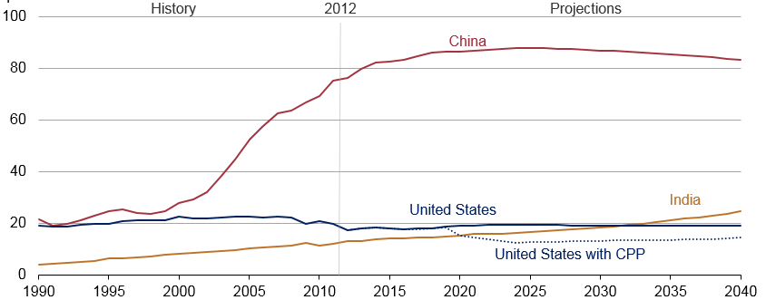
Of the world’s three largest coal consumers, only India is projected to continue to increase throughout the projection
coal consumption in the US, China, and India
quadrillion Btu
Source: EIA, International Energy Outlook 2016 and EIA, Analysis of the Impacts of the Clean Power Plan (May 2015)

Slide 8
Key takeaways from AEO2016
Energy use per dollar of Gross Domestic Product declines through 2040 allowing for economic growth without upward pressure on energy consumption and related emissions
Electricity demand growth slows while non-power sector generation increases, dampening the need for central power station generation
Market forces drive up oil prices throughout the projection and U.S. production increases in response
Natural gas production increases despite relatively low and stable natural gas prices
Technological improvements are key drivers of U.S. oil and gas production
Net exports of liquefied natural gas range between 3.5 Tcf and 10.6 Tcf in 2040 depending on relative prices in foreign markets
EPA’s proposed medium and heavy-duty vehicle Phase 2 standards would increase fuel economy, resulting in 18% lower diesel consumption in 2040 compared with the Reference case

Slide 9
Key takeaways from AEO2016 (continued)
EPA’s Clean Power Plan (CPP) requires states to reduce carbon dioxide emissions from existing fossil generators:
Details of the CPP implementation strategies selected by the states affect the overall generation mix, as well as consumer prices
CPP effects on coal production vary across regions
CPP, along with renewable tax credit extension and lower natural gas prices, contributes to a shift in the generation mix, with increases in generation from natural gas and renewables and reduced coal generation
Even if the CPP is not implemented, key factors combine to support a transition from coal to natural gas as the predominant fuel for electric generation
Extending or expanding existing laws and regulations, including efficiency policies for appliances and vehicles, the CPP, and EPA’s proposed Phase 2 standards for medium- and heavy-duty trucks results lower energy consumption and CO2 emissions than projected in the Reference case

Slide 10
Reductions in energy intensity largely offset impact of gross domestic product (GDP) growth, leading to slow projected growth in energy use
U.S. primary energy consumption
quadrillion Btu
AEO2016 Reference
No CPP
2015
2015
History
Projections
Projections
32% of U.S. total
33%
Natural gas
29%
8%
14%
(excluding biofuels)
12%
Renewables
36%
33%
Petroleum and other liquids
34%
1%
Liquid biofuels
9%
1%
1%
Nuclear
8%
8%
16
10%
Coal
14%
Source: EIA, Annual Energy Outlook 2016

Slide 11
U.S. crude oil production rises above previous historical high before 2030; alternative price and resource/technology cases can differ
U.S. crude oil production
million barrels per day
High Oil and Gas Resource and Technology
Reference
2015
2015
2015
History
Projections
Projections
High Oil and Gas
Resource and
Technology
U.S. maximum production level of
9.6 million barrels per day in 1970
High Oil Price
Reference
Tight oil
Low Oil Price
Lower 48 offshore
Low Oil and Gas Resource
and Technology
Alaska
Other lower 48 onshore
Source: EIA, Annual Energy Outlook 2016
Notes:
11
11

Slide 12
U.S. natural gas production dominated by shale resources; alternative price and resource /technology assumptions could be quite different
U.S. dry natural gas production
trillion cubic feet
U.S. dry natural gas production
trillion cubic feet
billion cubic feet per day
History
Projections
Projections
2015
High Oil and Gas Resource and Technology
High Oil Price
2016 Reference
Low Oil Price
2015 Reference
Shale gas and
tight oil plays
Low Oil and Gas Resource and Technology
Other lower 48
Tight gas
onshore
Coalbed methane
Alaska
Lower 48 offshore
Alaska
Source: EIA, Annual Energy Outlook 2016
Notes:
12
12

Slide 13
Both natural gas and renewable generation surpass coal by 2030 in the Reference case, but only natural gas does so in the No CPP case
net electricity generation
billion kilowatthours
AEO2016 Reference
No CPP
2015
2015
History
Projections
Projections
Coal
Natural gas
Nuclear
Petroleum
Renewables
Source: EIA, Annual Energy Outlook 2016

Slide 14
U.S. net energy imports trend downward, reflecting increased oil and natural gas production coupled with slowly growing or falling demand
U.S. net imports
quadrillion Btu
History
Projections
2015
Liquids
Natural gas
Coal
Source: EIA, Annual Energy Outlook 2016

Slide 15
For more information
U.S. Energy Information Administration home page | www.eia.gov
Annual Energy Outlook | www.eia.gov/aeo
Short-Term Energy Outlook | www.eia.gov/steo
International Energy Outlook | www.eia.gov/ieo
Monthly Energy Review | www.eia.gov/mer
Today in Energy | www.eia.gov/todayinenergy
State Energy Profiles | www.eia.gov/state
Drilling Productivity Report | www.eia.gov/petroleum/drilling/
International Energy Portal | www.eia.gov/beta/international/?src=home-b1

