Slide 1
U.S. Petroleum Industry Project Overview
For
Petroleum Marketers Association of America
May 18, 2016 | Washington, DC
By
Adam Sieminski, Administrator

Slide 2
Transportation fuels market studies – key takeaways
EIA can now provide detailed regional petroleum product analyses for the West Coast, East Coast, and Gulf Coast markets
EIA’s analyses have been expanded to cover jet fuel and retail markets
EIA can analyze individual refinery outages by refinery unit
Regions in PADD 1 and PADD 3 exhibit different supply vulnerabilities (PADDs 2 and 4 coming)
  Port operations & marine deliveries – New England/Florida
  Pipelines originating in the Gulf Coast – Southeast/Tx Inland/N. La/Ark
  Refinery operations & logistics – Tx/La Gulf Coast
  Central Atlantic- concentrated infrastructure in Philadelphia & NY

Slide 3
Each regional market chapter of the report includes a variety of information
Supply and demand balances
Infrastructure logistics
Demand centers
Supply vulnerabilities
Retail markets
Future anticipated changes

Slide 4
This effort continues an EIA strategy of providing data and analysis on a sub-PADD level
Project | Planned finish
PADD 5 (West Coast) transportation fuels study | September 2015
PADD 1 and 3 (East Coast and Gulf Coast) study | February 2016
PADD 5 (West Coast) crude supply study | May 2016
PADD 2 and 4 (Midwest and Rocky Mountains) study | 4th quarter 2016
PRISM petroleum system model | Ongoing
Improved Refinery Outage Report | 1st & 3rd quarter reports

Slide 5
U.S. petroleum and other liquids consumption driven by weather, disposable income, etc.
consumption
million barrels per day
Source: EIA, Short-Term Energy Outlook, May 2016

Slide 6
Wholesale gasoline prices and margins
dollars per gallon
Source: EIA, Short-Term Energy Outlook, May 2016

Slide 7
EIA expects WTI oil prices to remain low compared to recent history, but the market-implied confidence band is very wide
WTI price
dollars per barrel
Source: EIA, Short-Term Energy Outlook, May 2016

Slide 8
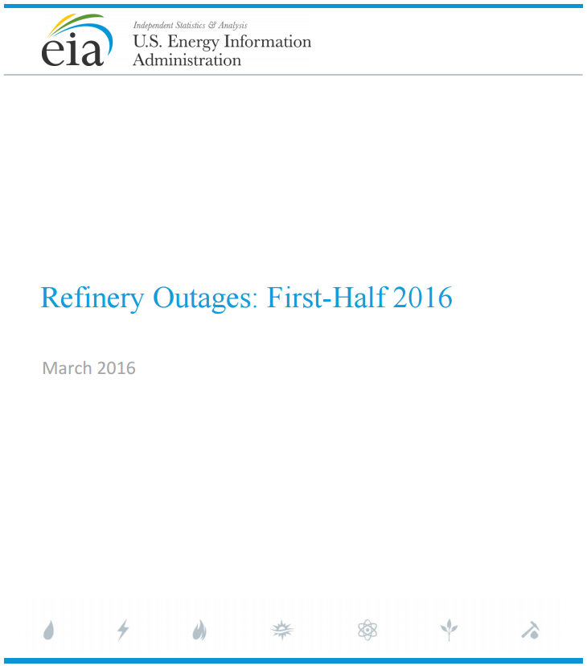
Refinery outages report
Examines planned U.S. refinery outages and the implications for available refinery production capacity, petroleum product markets, and the supply of gasoline, diesel fuel, and jet fuel
Considers the supply of petroleum products on regional (both PADD and sub-PADD) levels, rather than at a national level
Source: http://www.eia.gov/petroleum/refinery/outage/

Slide 9
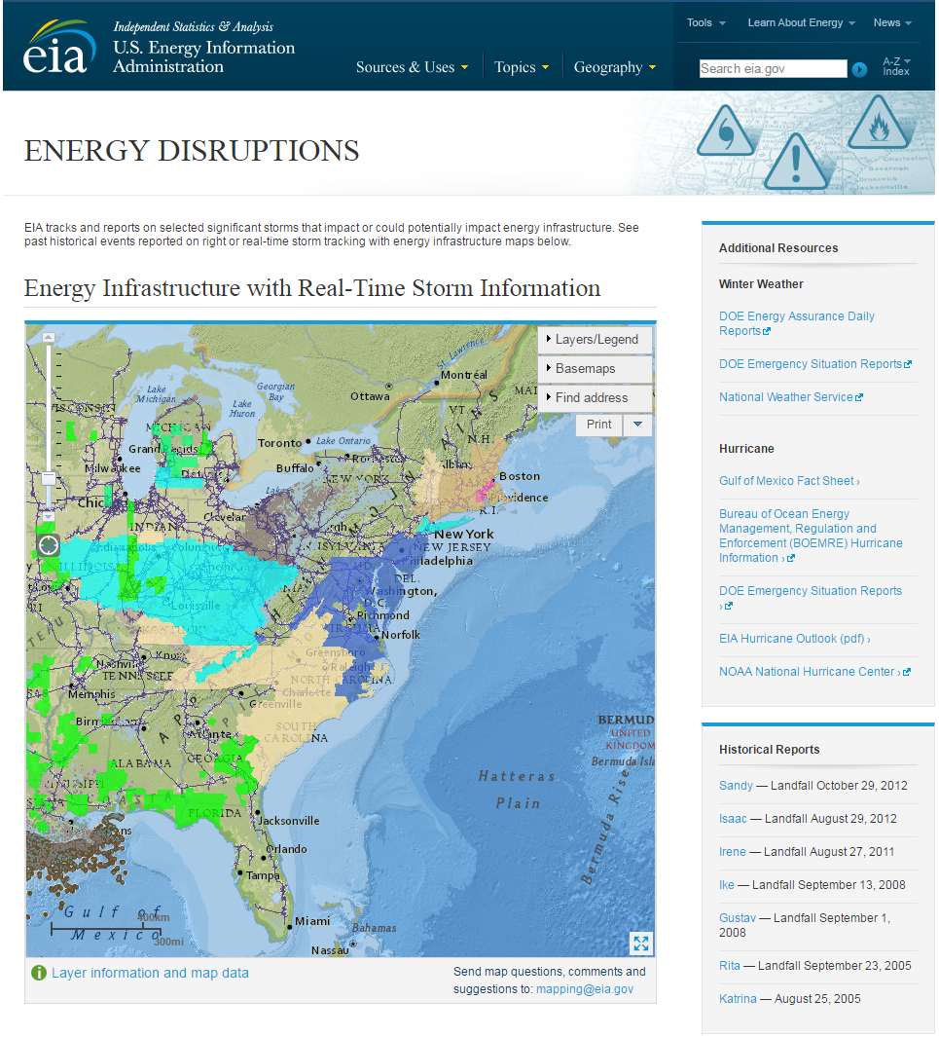
Energy disruptions map with real-time weather data
Tracks and reports on selected significant storms that impact or could potentially impact energy infrastructure
Includes past historical events and real-time storm tracking with energy infrastructure maps
Source: http://www.eia.gov/special/disruptions/

Slide 10
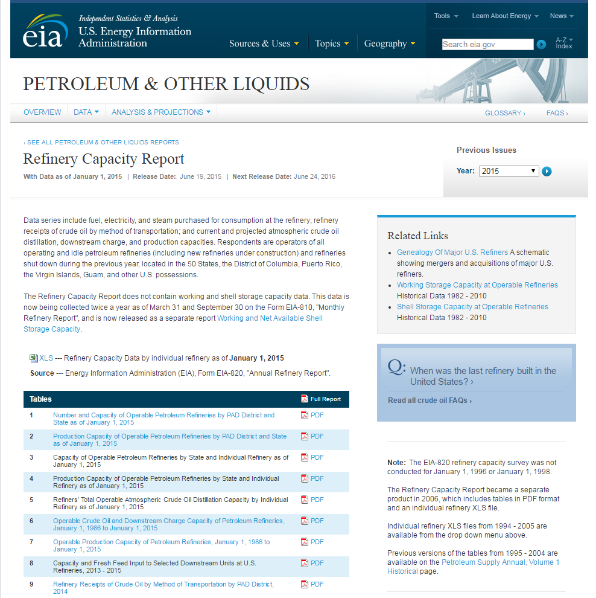
Refining capacity report
Includes fuel, electricity, and steam purchased for consumption at the refinery; refinery receipts of crude oil by method of transportation; and current and projected atmospheric crude oil distillation, downstream charge, and production capacities
Accounts for operators of all operating and idle petroleum refineries (including new refineries under construction) and refineries shut down during the previous year, located in the 50 States, the District of Columbia, Puerto Rico, the Virgin Islands, Guam, and other U.S. possessions
Source: http://www.eia.gov/petroleum/refinerycapacity/

Slide 11
For more information
U.S. Energy Information Administration home page | www.eia.gov
Short-Term Energy Outlook | www.eia.gov/steo
Annual Energy Outlook | www.eia.gov/aeo
International Energy Outlook | www.eia.gov/ieo
Monthly Energy Review | www.eia.gov/mer
Today in Energy | www.eia.gov/todayinenergy

