Slide 1
Annual Energy Outlook 2015
AEO2015 Rollout Presentation
Center for Strategic and International Studies
April 14, 2015 | Washington, D.C.
by
Adam Sieminski, Administrator

Slide 2
Key results from AEO2015
In most AEO2015 cases, U.S. net energy imports, including all fuels, decline and ultimately end by 2030 for the first time since the 1950s
Strong growth in domestic production of crude oil from tight formations through 2020 and limited growth in domestic demand after 2020 leads to a decline in net petroleum and other liquids imports
The United States transitions from being a net importer of natural gas to a net exporter by 2017 in all cases
U.S. energy consumption grows at a modest rate over the projection with reductions in energy intensity resulting from improved technologies and trends driven by existing laws and regulations
Renewables provide an increased share of electricity generation, reflecting rising long-term natural gas prices and the high capital costs of new coal and nuclear generation capacity

Slide 3
Key results from AEO2015 (continued)
Improved efficiency of energy consumption in end-use sectors and a shift away from more carbon-intensive fuels help to stabilize U.S. energy-related carbon dioxide emissions, which remain below the 2005 level through 2040
Growth of domestic crude oil and natural gas production varies significantly across regions and cases, leading to shifts in crude oil and natural gas flows between regions, requiring infrastructure adjustments
The AEO2015 cases generally reflect current policies, including final regulations and the sunset of tax credits under current law; consistent with this approach, EPA’s proposed Clean Power Plan rules for existing fossil-fired electric generating units or the effects of relaxing current limits on crude oil exports are not considered in AEO2015

Slide 4
Overview

Slide 5
Crude oil price projection is lower in the AEO2015 Reference case than in AEO2014, particularly in the near term
Brent crude oil spot price
2013 dollars per barrel
History
Projections
2013
AEO2014
AEO2015
Source: EIA, Annual Energy Outlook 2015 Reference case and Annual Energy Outlook 2014 Reference case

Slide 6
Reductions in energy intensity largely offset impact of GDP growth, leading to slow projected growth in energy use
U.S. primary energy consumption
quadrillion Btu
History
Projections
2013
2025
2040
Renewables (excluding liquid biofuels)
27%
29%
27%
Natural gas
8%
9%
10%
18%
19%
18%
Coal
8%
8%
8%
Nuclear
1%
1%
Liquid biofuels
1%
Petroleum and other liquids
36%
35%
33%
Source: EIA, Annual Energy Outlook 2015 Reference case

Slide 7
U.S. net energy imports continue to decline in the near term, reflecting increased oil and natural gas production coupled with slow demand growth
U.S. net energy imports
quadrillion Btu
History
2013
Projections
Low Oil Price
Reference
High Oil Price
High Oil and Gas Resource
Source: EIA, Annual Energy Outlook 2015

Slide 8
CO₂ emissions are sensitive to the influence of future economic growth and energy price trends on energy consumption
energy-related carbon dioxide emissions
million metric tons
History
Projections
2013
High Economic Growth
High Oil and Gas Resource
Reference
Low Economic Growth
Source: EIA, Annual Energy Outlook 2015

Slide 9
CO₂ emissions per dollar of GDP decline faster than energy use per dollar of GDP with a shift towards lower-carbon fuels
energy and emission intensity
index, 2005=1
History
Projections
2013
2005
Energy use per capita
Energy use per 2009
dollar of GDP
Carbon dioxide emissions
per 2009 dollar GDP
Source: EIA, Annual Energy Outlook 2015 Reference case

Slide 10
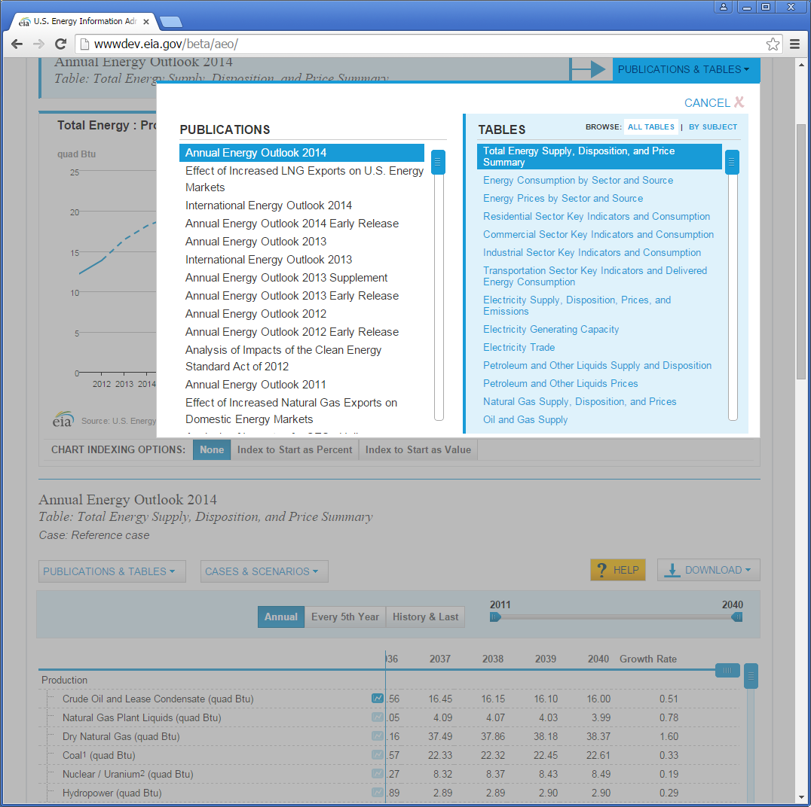
New AEO table browser
Signature product redeveloped for EIA’s state-of-the-art table browser experience
Compares up to 6 cases from AEO

Slide 11
Petroleum and other liquid supply

Slide 12
AEO2015 explores scenarios that encompass a wide range of future crude oil price paths
Brent crude oil spot price
2013 dollars per barrel
History
Projections
2013
High Oil Price
Reference
Low Oil Price
High Oil and Gas Resource
Source: EIA, Annual Energy Outlook 2015

Slide 13
U.S. crude oil production rises above previous historical highs before 2020 in all AEO2015 cases, with a range of longer-term outcomes
U.S. crude oil production
million barrels per day
History
2013
2013
2013
Reference
High Oil and Gas Resource
Low Oil Price
U.S. maximum production level of
9.6 million barrels per day in 1970
Tight oil
Lower 48 offshore
Other lower 48 onshore
Alaska
Source: EIA, Annual Energy Outlook 2015
Notes:
13
13

Slide 14
Growth of onshore crude oil production varies across supply regions, affecting pipeline and midstream infrastructure needs
change between 2013 and 2040 in U.S. lower 48 onshore crude oil production by region
million barrels per day
Dakotas/Rocky Mountains
11.0
West Coast
8.5
East
Southwest
Gulf Coast
11.2
9.1
Midcontinent
4.2
4.1
Source: EIA, Annual Energy Outlook 2015

Slide 15
Combination of increased tight oil production and higher fuel efficiency drive projected decline in oil imports
U.S. liquid fuels supply
million barrels per day
History
Projections
2013
2020
2040
14%
17%
33%
Natural gas
plant liquids
21%
21%
Net petroleum and other liquids imports
14%
29%
Tight oil
production
22%
17%
Other crude oil production
(excluding tight)
23%
25%
27%
Other
14%
12%
12%
Note: “Other” includes refinery gain, biofuels production, all stock withdrawals, and other domestic sources of liquid fuels
Source: EIA, Annual Energy Outlook 2015 Reference case

Slide 16
Net liquids imports provide a declining share of U.S. liquid fuels supply in most AEO2015 cases; in two cases the nation becomes a net exporter
net crude oil and petroleum product imports as a percentage of total U.S. supply
percent
2013
History
Projections
Low Oil Price
Reference
High Oil Price
High Oil and Gas Resource
Source: EIA, Annual Energy Outlook 2015

Slide 17
In the transportation sector, motor gasoline use declines; diesel fuel, jet fuel, and natural gas use all grow
transportation energy consumption by fuel
quadrillion Btu
History
2013
Projections
2030
2040
24%
Diesel
31%
31%
10%
Other*
3%
Jet fuel
4%
13%
CNG/LNG
14%
1%
4%
3%
Ethanol
2%
5%
3%
48%
44%
58%
Motor gasoline
Source: EIA, Annual Energy Outlook 2015 Reference case
*Includes aviation gasoline, propane, residual fuel oil, lubricants, electricity, and liquid hydrogen
Notes:
17
17

Slide 18
U.S. net exports of petroleum products vary with the level of domestic oil production given current limits on U.S. crude oil exports
U.S. petroleum product imports and exports
million barrels per day
Reference
High Oil and Gas Resource
Low Oil Price
History
2013
2013
2013
Total petroleum product net exports
Other petroleum product exports
Total petroleum product net exports
High Oil and Gas Resource
Reference
Low Oil Price
Motor gasoline exports
Distillate
exports
Other petroleum
product imports
Distillate imports
Motor gasoline imports
Source: EIA, Annual Energy Outlook 2015
Notes:
18
18

Slide 19
Natural gas

Slide 20
Future domestic natural gas prices depend on both domestic resource availability and world energy prices
average Henry Hub spot prices for natural gas
2013 dollars per million Btu
History
Projections
2013
High Oil Price
Reference
Low Oil Price
High Oil and Gas Resource
Source: EIA, Annual Energy Outlook 2015

Slide 21
Shale resources remain the dominant source of U.S. natural gas production growth
U.S. dry natural gas production
trillion cubic feet
billion cubic feet per day
History
Projections
2013
Shale gas and tight oil plays
Other lower 48 onshore
Tight gas
Coalbed methane
Lower 48 offshore
Alaska
Source: EIA, Annual Energy Outlook 2015 Reference case
Notes:
21
21

Slide 22
Natural gas consumption growth is driven by increased use in all sectors except residential
U.S. dry gas consumption
trillion cubic feet
billion cubic feet per day
History
Projections
Residential
Commercial
Transportation**
Electric power
Industrial*
10.9
8.9
9.4
8.2
0.9
1.6
3.3
3.6
4.9
4.2
Source: EIA, Annual Energy Outlook 2015 Reference case
*Includes combined heat-and-power and lease and plant fuel
**Includes pipeline fuel

Slide 23
Growth in manufacturing output and use of natural gas reflect high natural gas supply and low prices, particularly in near term
manufacturing natural gas consumption
quadrillion Btu
billion cubic feet per day
Food
Bulk chemicals
Refining and
related
Other
manufacturing
Metal based
durables
Iron and steel
Paper
Aluminum
Glass
Source: EIA, Annual Energy Outlook 2015 Reference case

Slide 24
Projected U.S. natural gas exports reflect the spread between domestic natural gas prices and world energy prices
U.S. natural gas imports and exports
trillion cubic feet
billion cubic feet per day
History
Projections
2013
2013
2013
Lower 48 states LNG exports
40
30
Alaska LNG exports
Pipeline exports to Mexico
20
10
0
Pipeline exports to Canada
Pipeline imports from Canada
-10
LNG imports
Reference
High Oil and Gas Resource
Low Oil Price
-20
Source: EIA, Annual Energy Outlook 2015
Notes:
24
24

Slide 25
Electricity

Slide 26
Growth in electricity use slows, but electricity use still increases by 24% from 2013 to 2040
Period Average Growth__ Electricity use GDP
1950s 9.8 4.2
1960s 7.3 4.5
1970s 4.7 3.2
1980s 2.9 3.1
1990s 2.4 3.2
2000-2013 0.7 1.9
2013-2040 0.8 2.4
U.S. electricity use and GDP
percent growth (rolling average of 3-year periods)
History
2013
Structural Change in Economy - Higher prices - Standards - Improved efficiency
Electricity use
Projections
Gross domestic product
Source: EIA, Annual Energy Outlook 2015 Reference case
Notes:
26

Slide 27
Over time the electricity mix gradually shifts to lower-carbon options, led by growth in renewables and gas-fired generation
electricity net generation
trillion kilowatthours
History
Projections
2013
1993
2025
2040
31%
27%
Natural gas
27%
13%
13%
16%
Renewables
18%
11%
53%
39%
38%
Coal
34%
19%
Petroleum and other liquids
19%
18%
16%
1%
1%
Nuclear
1%
4%
Source: EIA, Annual Energy Outlook 2015 Reference case
Notes:
27
27

Slide 28
Non-hydro renewable generation grows to double hydropower generation by 2040
renewable electricity generation by fuel type
billion kilowatthours
History
Projections
2013
Conventional Hydroelectric Power
Wind
Solar
Geothermal
Biomass
Municipal waste/Landfill gas
Source: EIA, Annual Energy Outlook 2015 Reference case
Notes:
28

Slide 29
Growth in wind and solar generation meets a significant portion of projected total electric load growth in all AEO2015 cases
U.S. renewable generation in all sectors by fuel
billion kilowatthours
2040
Wind
Solar
Biomass
and waste
Geothermal
Conventional
hydroelectric
power
Source: EIA, Annual Energy Outlook 2015

Slide 30
For more information
U.S. Energy Information Administration home page | www.eia.gov
Annual Energy Outlook | www.eia.gov/forecasts/aeo
Short-Term Energy Outlook | www.eia.gov/forecasts/steo
International Energy Outlook | www.eia.gov/forecasts/ieo
Today In Energy | www.eia.gov/todayinenergy
Monthly Energy Review | www.eia.gov/totalenergy/data/monthly
State Energy Portal | www.eia.gov/state
Drilling Productivity Report | www.eia.gov/petroleum/drilling

Slide 31
Preview of coming attractions

Slide 32
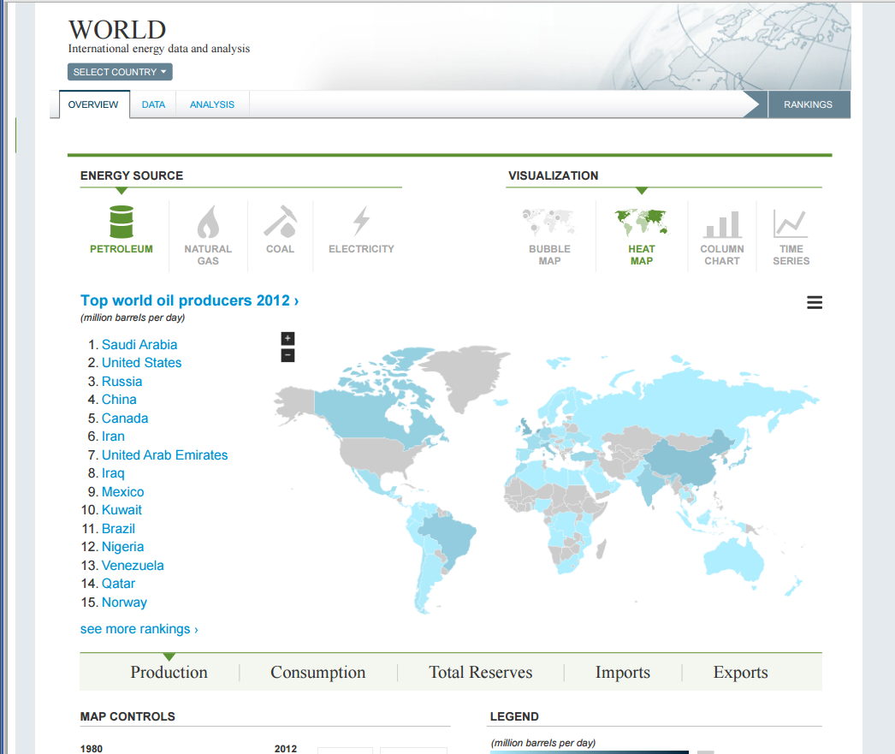
Upcoming: improved international energy web presence
New data browser to replace IES
Better map-based navigations and visualizations
Consolidate CABs/CANs
Status: dev integration
Launch: beta in April

Slide 33
Upcoming: EIA-930—hourly survey of electricity balancing authorities
First near-real time report for EIA
Dashboard view of the U.S. power grid
Highly anticipated by EIA customers
Status: dev largely complete; awaiting OES data to continue
Launch: TBD

Slide 34
Upcoming: Final four reports on EIA crude oil exports
Over the next two months, the final four reports will cover:
technical options for U.S. refineries to facilitate the processing additional light tight oil
implications of increasing light tight oil production for the overall U.S. refining system
an update to EIA’s May 29, 2014, report on projections of U.S. crude oil production by API gravity
the effects on oil prices, oil production, and oil trade if restrictions on U.S. crude oil exports were removed

Slide 35
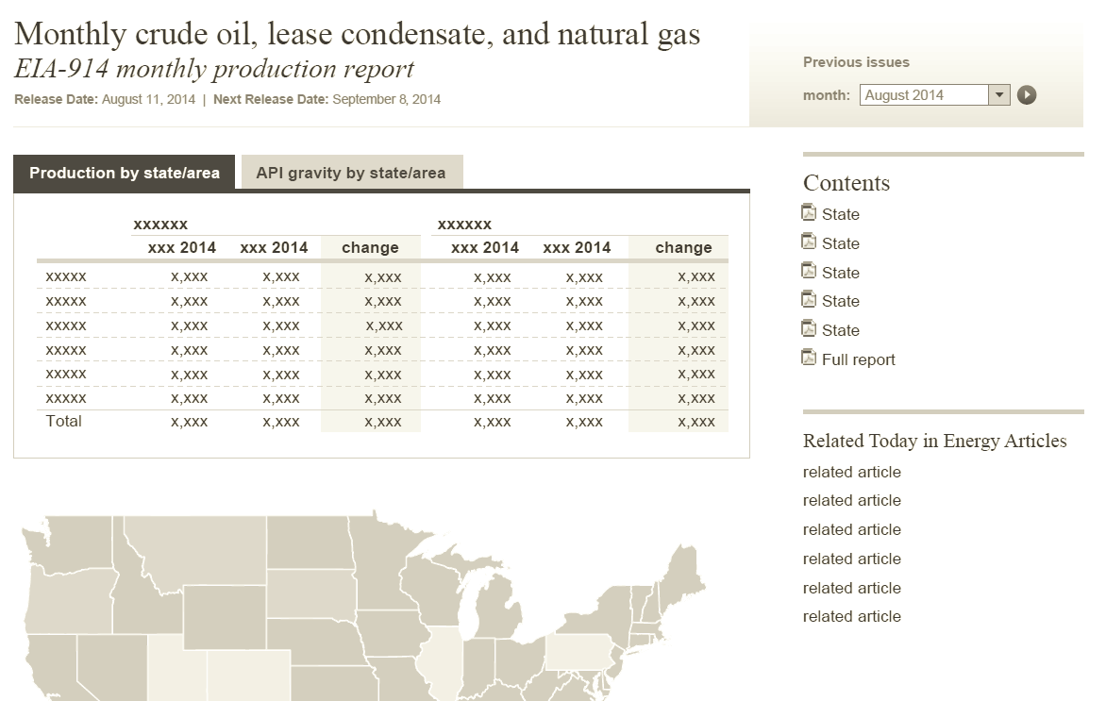
Now playing: Crude by rail and EIA-914—data updates
Both high priority
Crude by rail due out with PSM, March 30
Updated 914 expected in June with new data collection

Slide 36
Now playing: New Microsoft Excel add-in for Windows
Enables spreadsheet users – inside and outside of EIA – to pull recent EIA/FRED data into their existing workbooks

