Slide 1
North American Energy Markets
for
Energy Mexico 2016
January 26, 2016| Mexico City, Mexico
by
Adam Sieminski
U.S. Energy Information Administration

Slide 2
Oil supply and demand begin to rebalance in 2017
world liquid fuels production and consumption balance
million barrels per day
million barrels per day
Source: Short-Term Energy Outlook, January 2016

Slide 3
OPEC drives production growth as North American and other non-OPEC production declines
world crude oil and liquid fuels production growth
million barrels per day
Source: Short-Term Energy Outlook, January 2016

Slide 4
U.S. tight oil represents 30% of North American oil production and U.S. shale gas represents 41% of natural gas production
U.S. tight oil production
million barrels of oil per day
U.S. dry shale gas production
billion cubic feet per day
Sources: EIA derived from state administrative data collected by DrillingInfo Inc. Data are through December 2015 and represent EIA’s official tight oil & shale gas estimates, but are not survey data. State abbreviations indicate primary state(s).

Slide 5
EIA expects WTI oil prices to remain low compared to recent history, but the market-implied confidence band is very wide
WTI price
dollars per barrel
Source: Short-Term Energy Outlook, January 2016

Slide 6
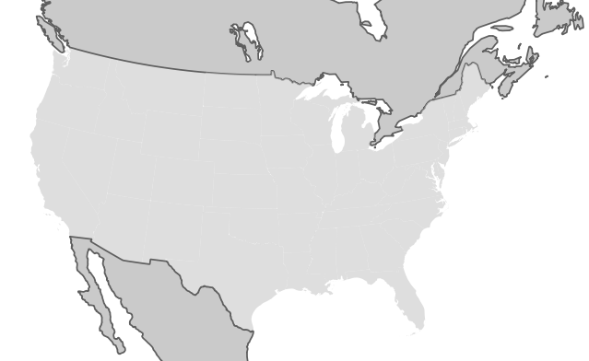
Natural gas trade with Mexico is up 67% since 2012 and petroleum trade with Canada is up 40%
Canada
3,739
7.22
960
United States
1.88
10,675
62,539
7,816
2.83
761
North American Energy Trade Flows
= Petroleum (thousand barrels per day)
= Natural gas (billion cubic feet per day)
= Electricity (Gigawatt hours)
0.678
Mexico
671
Note: Petroleum and natural gas trade data are year-to-date through October 2015. Electricity is 2013 annual data.
Source: U.S. Energy Information Administration

Slide 7
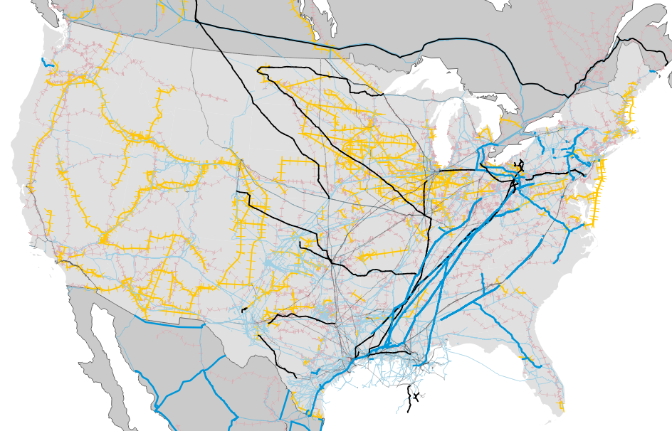
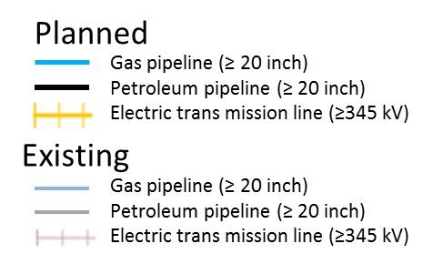
Infrastructure does not stop at the border; infrastructure plans are underway in all three countries
Source: EIA, Federal Energy Regulatory Commission, IHS Energy, ABB—Velocity Suite

