Slide 1
Natural gas and oil: U.S. outlook and global implications
for
World Steel Association 49th Annual Conference
Panel Discussion: Energy and Future Challenges in Environmental Regulation
October 12, 2015 | Chicago, IL
by
Howard Gruenspecht, Deputy Administrator

Slide 2
The U.S. has experienced a rapid increase in natural gas and oil production from shale and other tight resources
Sources: EIA derived from state administrative data collected by DrillingInfo Inc. Data are through August 2015 and represent EIA’s official tight oil & shale gas estimates, but are not survey data. State abbreviations indicate primary state(s).
Notes:
The production data provided in this chart is EIA’s official shale gas estimate based on state administrative data collected by DrillingInfo Inc., drilling rig activity, and EIA’s analysis of data reporting trends. This is not survey data. Estimates are through August 2015. State abbreviations indicate primary state(s).
Rest of US 'shale‘ include:
Baxter (WY) (minor shale play)
Huron (WV) (minor shale play)
Mancos (CO &NM) (minor shale play)
Monterey (CA) (shale oil play)
Pearsall (TX) (minor shale play)
Pierre (ND) (minor shale play)
Yeso-Glorieta (NM & TX) (tight oil play)
Delaware (NM & TX) (tight oil play)
Wolfcamp (NM & TX) (tight oil play)
Bonespring (NM & TX) (tight oil play)
Spraberry (NM & TX) (tight oil play)
Niobrara-Codell (CO & WY) (shale-sand oil play)

Slide 3
Natural Gas

Slide 4
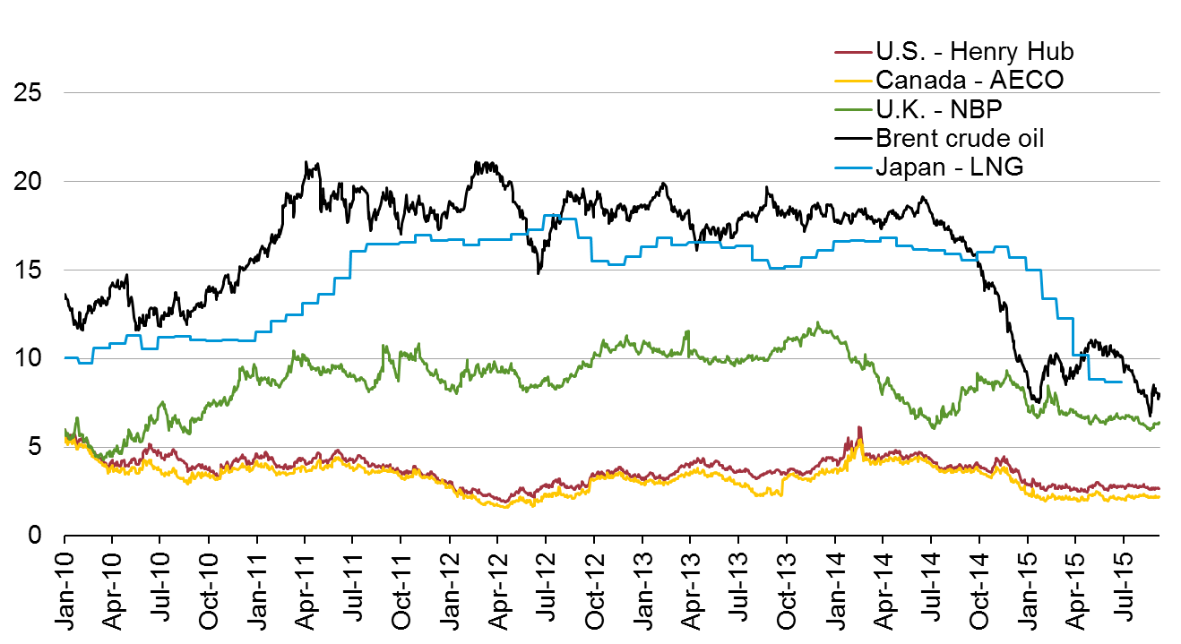
North American natural gas prices are low compared to prices in the rest of the world
Select global natural gas and crude oil prices with average monthly LNG prices in Japan
U.S. dollars per million British thermal unit
Source: U.S. Energy Information Administration based on Bloomberg data
Notes:
These different pricing approaches have resulted in very distinct regional natural gas prices.
For Europe and North America, these prices are spot market pricing at a representative spot market location. In Europe, the most liquid spot gas market is in the United Kingdom, for gas traded at their National Balancing Point (or NBP). The benchmark for natural gas prices in the United States is the Henry Hub in Louisiana.
There is not a liquid spot natural gas market in Asia, for that reason, the price on this graph is the average monthly LNG price in Japan. The black line represents the Brent crude oil price.
For the Japan average LNG price. You can notice that prices in Japan have somewhat tracked Brent on a lag. Putting further pressure on the Japanese LNG price is the increase in LNG that Japan demands since the Fukishima disaster in March 2011. Since May 2011, when Japan began to significantly ramp down their nuclear program LNG used in electric power generation sector has increased significantly (nearly 30%)
Also to note on this graph is the more muted relation that European prices have with Brent, as well as the increased divergence between prices in the United States and the United Kingdom.
This divergence is driven by the decrease in U.S. prices due to strong domestic production and ample levels of natural gas in storage. Conversely, the increase in prices in Europe is due to declining European production and colder than normal winters in 2010 and 2011 that have depleted storage in that region, causing a greater need for supply in the form of LNG.

Slide 5
Takeaways – Natural gas
North American natural gas production is more likely to be limited by demand than supply
U.S. natural gas demand growth is likely to be concentrated in electricity and industrial uses; natural gas exports and use in the transportation sector, where little natural gas is used today, are also likely to grow
Potential challenges to natural gas demand growth include
Slow growth in U.S. electricity demand
Competition from offshore “stranded” gas for global LNG exports and siting of gas-intensive industries.
Long-term cheap oil would be another significant challenge to LNG exports
Extent and nature of global price convergence in natural gas markets
Future policies that target particular sources or uses of energy or energy-related emissions can really matter for future natural gas demand

Slide 6
Future domestic natural gas prices depend on both domestic resource availability and world energy prices
average Henry Hub spot prices for natural gas
2013 dollars per million Btu
History
Projections
2013
High Oil Price
Reference
Low Oil Price
High Oil and Gas Resource
Source: EIA, Annual Energy Outlook 2015
Notes:
In the Reference case, the Henry Hub natural gas spot price (in 2013 dollars) rises from $3.69/million Btu in 2015 to $4.88/million Btu in 2020 and to $7.85/million Btu in 2040, as increased demand in domestic and international markets leads to the production of increasingly expensive resources.
The Henry Hub natural gas spot price is lowest in the High Oil and Gas Resource case, which assumes greater estimated ultimate recovery per well, closer well spacing, and greater gains in technological development. In the High Oil and Gas Resource case, the Henry Hub natural gas spot price peaks at $4.38/million Btu in 2040 (44% below the Reference case price that year).
Henry Hub natural gas spot prices are highest in the High Oil Price case, which assumes the same level of resource availability as the Reference case, but different Brent crude oil prices. In the High Oil Price case, the Henry Hub natural gas spot price remains close to the Reference case price through 2020; however, higher overseas demand for U.S. LNG exports raises the average Henry Hub price to $10.63/million Btu in 2040, which is 35% above the Reference case price.
The opposite occurs in the Low Oil Price case: low Brent crude oil prices cause oil-linked LNG contracts to become relatively less expensive and make U.S. LNG exports less competitive. Lower overseas demand for U.S. LNG exports causes the average Henry Hub price to reach only $7.15/million Btu in 2040, 9% lower than in the Reference case.

Slide 7
U.S. becomes a net exporter of natural gas in the near future
U.S. dry natural gas
trillion cubic feet per year
billion cubic feet per day
2013
History
Projections
100
75
Consumption
50
Production
25
0
Net exports
-25
Source: EIA, Annual Energy Outlook 2015
Notes:
This figure shows Reference case projections for consumption, domestic supply, and net imports of natural gas. In the AEO2015 Reference case, the U.S. becomes a net exporter of natural gas in 2018.
Although domestic natural gas consumption grows by about 23% from 2013 through 2040 (reaching near 32 trillion cubic feet in 2040), the growth in natural gas production (55% from 2013 through 2040) out paces consumption leading to net exports, primarily to Mexico and overseas as liquefied natural gas.
The growth in natural gas production is largely determined by oil and natural gas prices and the cost of developing those resources. Current gas prices (April spot gas was trading under $3 per MMBtu range last week) are not yet reducing production because of a variety of short-term market dynamics.
Longer-term factors include the current industry’s capability to efficiently develop resources, the success of the technology to quickly produce shale gas resources, and the rising crude oil prices which incentivizes the development of “wet” shale gas plays where crude oil and natural gas liquids, which have a significantly higher market value than natural gas, can greatly increase the economic return to producers.

Slide 8
Shale resources remain the dominant source of U.S. natural gas production growth
U.S. dry natural gas production
trillion cubic feet
billion cubic feet per day
History
Projections
2013
Shale gas and tight oil plays
Other lower 48 onshore
Tight gas
Coalbed methane
Lower 48 offshore
Alaska
Source: EIA, Annual Energy Outlook 2015 Reference case
Notes:
8
8
Three sources of future natural gas production growth (in order of importance):
1) shale gas, 2) tight gas, and 3) Alaska gas.
Shale gas production grows throughout the projections.
The six largest shale gas plays in relative order of cumulative production from 2013 through 2040:
Marcellus (150 Tcf, 2013-2040),
Haynesville (81 Tcf, 2013-2040),
Eagle Ford (53 Tcf, 2013-2040),
Barnett (39 Tcf, 2013-2040),
Utica (27 Tcf, 2013-2040),
Fayetteville (27 Tcf, 2013-2040)
Tight gas production growth occurs in the sedimentary basins located in the Rocky Mountains an Gulf Coast regions.
Alaska gas production grows during the projections due to the construction and operation of an LNG export facility, which goes into operation in 2027, eventually shipping 800 Bcf per year.

Slide 9
Natural gas consumption growth is concentrated in electricity generation and industry; gas use rises in all sectors except residential
U.S. dry gas consumption
trillion cubic feet
billion cubic feet per day
History
Projections
Residential
Commercial
Transportation**
Electric power
Industrial*
10.9
8.9
9.4
8.2
0.9
1.6
3.3
3.6
4.9
4.2
Source: EIA, Annual Energy Outlook 2015 Reference case
*Includes combined heat-and-power and lease and plant fuel
**Includes pipeline fuel
Notes:
Natural gas consumption grows with increased supply and more competitive prices. Consumption is widely dispersed throughout the economy. However, the largest share of the growth is in the electric power and industrial sectors, which benefit from more competitive natural gas supplies.
Natural gas use in the AEO2015 Reference case increases in all sectors except for residential, which declines due to increasing efficiency, a reduction in space heating needs, and slow population growth.
Industrial natural gas consumption grows strongly, rising from 9.1 quadrillion Btu in 2013 to 11.2 in 2040.
Although little natural gas has been used historically in the transportation sector, a small but growing share of natural gas is consumed in the transportation sector in AEO2015.

Slide 10
Projected U.S. natural gas exports reflect the spread between domestic natural gas prices and world energy prices
U.S. natural gas imports and exports
trillion cubic feet
billion cubic feet per day
History
Projections
2013
2013
2013
Lower 48 states LNG exports
40
30
Alaska LNG exports
Pipeline exports to Mexico
20
10
0
Pipeline exports to Canada
Pipeline imports from Canada
-10
LNG imports
Reference
High Oil and Gas Resource
Low Oil Price
-20
Source: EIA, Annual Energy Outlook 2015
Notes:
10
10
Reference case
The United States remains both an importer and exporter of natural gas over the projection period, although natural gas imports into the United States fall by 41% from 2013 to 2040 and natural gas exports from the United States, both via pipeline and overseas via LNG, grow by nearly four-fold over the same time period.
Pipeline exports of U.S. natural gas to Mexico grow by 6% per year, from 0.7 Tcf in 2013 to 3.0 Tcf in 2040, and pipeline exports to Canada grow by 0.1% per year, from 0.9 Tcf in 2013 to 0.93 Tcf in 2040 (Canadian exports peak in 2027 at 1.28 Tcf).
U.S. exports of LNG increase to 3.4 Tcf in 2030 and remain at that level through 2040. Just over 2.5 Tcf of that volume originates from the lower 48, with the remainder from Alaska.
Natural gas pipeline net imports from Canada remain below 2013 levels through 2040 in all the AEO2015 cases, but these imports do increase in response to higher natural gas prices in the latter part of the projection period.
Other cases
In the High Oil and Gas Resource case, abundant U.S. dry natural gas production keeps domestic natural gas prices lower than international prices, supporting the growth of U.S. LNG exports, which total 10.3 Tcf in 2037 and account for 66% of total U.S. natural gas exports in 2040.
In the Low Oil Price case, with lower world oil prices, U.S. LNG exports are less competitive and grow more slowly, to a peak of 0.8 Tcf in 2018, and account for 13% of total U.S. natural gas exports in 2040. At the time that the modeling for AEO2015 was frozen, there was only one LNG project actively under construction (Sabine Pass with a capacity of 0.8 Tcf or 2.2 Bcf/d)
The United States continues to import small volumes of LNG, largely to help satisfy peak winter demand in the Northeast.
Projected exports are sensitive to assumptions regarding conditions in U.S. and global natural gas markets.

Slide 11
Oil

Slide 12
World oil prices move together due to arbitrage
global crude oil prices
nominal dollars per barrel, monthly average
Source: U.S. Energy Information Administration, based on Bloomberg

Slide 13
Takeaways - Oil
Tight oil clearly matters for measures of U.S. oil import dependence, but its global significance is not yet clear
Policy debate over removing restrictions on exports of U.S. crude oil
Recent EIA analysis shows no significant effects for consumers, producers, or refiners in cases where domestic production remains below 11 million barrels per day (b/d)
If U.S. production were to approach or exceed 12 million b/d, as might occur under high resource assumptions, U.S. consumers realize a small reduction in gasoline prices and crude producers modestly raise output if crude export restrictions are removed; however, the largest effects (in opposite directions) are felt by producers and refiners
The Middle East remains the cockpit of “easy oil” and will remain central to the global oil market
Historical analogues provide some insight into alternative paths for future global oil markets -- between now and 2025, the change in the call on OPEC seems likely to fall between the 1973-85 and 2000-12 outcomes

Slide 14
AEO2015 explores scenarios that encompass a wide range of future crude oil price paths
Brent crude oil spot price
2013 dollars per barrel
History
Projections
2013
High Oil Price
Reference
Low Oil Price
High Oil and Gas Resource
HOGR/Low Price
Note: HOGR/LowPrice - High Oil and Gas Resource with Low Oil Price
Sources: EIA, Annual Energy Outlook 2015, and Effects of Removing Restrictions on U.S. Crude Oil Exports, September , 2015
Notes:
Keisha will add HOGR for brent to this slide
In the AEO2015 Reference case, the price of global marker Brent crude oil is $56/barrel (bbl) (in 2013 dollars) in 2015. Prices rise steadily after 2015 in response to growth in demand; however, downward price pressure from continued increases in U.S. crude oil production keeps the Brent price below $80/bbl through 2020. U.S. crude oil production starts to decline after 2020, but increased output from non-OECD and OPEC producers help to keep the Brent price below $100/bbl through 2028 and limit the Brent price increase through 2040, when it reaches $141/bbl.
There is significant variation in the alternative cases. In the Low Oil Price case, the Brent price is $52/bbl in 2015 and reaches $76/bbl in 2040. In the High Oil Price case, the Brent price reaches $122/bbl in 2015 and then more than $252/bbl in 2040. In the High Oil and Gas Resource case, with significantly more U.S. production than the Reference case, the Brent price averages $129/bbl in 2040.

Slide 15
Increased production of tight oil and greater fuel efficiency drive decline in petroleum and other liquid imports
U.S. liquid fuels supply
million barrels per day
History
Projections
2013
2020
2040
14%
17%
33%
Natural gas
plant liquids
21%
21%
Net petroleum and other liquids imports
14%
29%
Tight oil
production
22%
17%
Other crude oil production
(excluding tight)
23%
25%
27%
Other
14%
12%
12%
Note: “Other” includes refinery gain, biofuels production, all stock withdrawals, and other domestic sources of liquid fuels
Source: EIA, Annual Energy Outlook 2015 Reference case
Notes:
There are two main sources of future liquid fuels production growth:
1) tight oil; 2) natural gas plant liquids
Tight oil production in the Reference case peaks at 5.6 MMB/D in 2020, and declines slowly thereafter to 4.2 MMB/D in 2040.
The three largest regions of tight oil production (in order of importance, 2014-2040 cumulative) are:
1) Dakotas/Rocky Mountains (which includes the Bakken, 23.6 billion bbls) , 2) Southwest (which includes Permian Basin, 21.0 billion bbls), and 3) Gulf Coast (17.1 billion bbls)
Natural gas plant liquids production grows from 2.6 MMB/D in 2013 to 4.0 MMb/d in 2019 and remains at that level throughout the projections to 2040.
Carbon dioxide enhanced oil recovery (CO2 EOR) and Lower 48 offshore are additional sources of measurable growth,
CO2 enhanced oil recovery (EOR) production grows to 0.8 MMB/D in 2040, from 0.3 MMB/D today.
Lower 48 offshore production fluctuates with the timing of large, discrete discoveries that are brought into production. Overall production grows to 2.2 MMb/d in 2040 from 1.6 MMb/d today.

Slide 16
Resource and technology assumptions have major implications for projected U.S. crude oil production beyond the next few years
U.S. crude oil production
million barrels per day
History
2013
2013
2013
Reference
High Oil and Gas Resource
Low Oil Price
U.S. maximum production level of
9.6 million barrels per day in 1970
Tight oil
Lower 48 offshore
Other lower 48 onshore
Alaska
Source: EIA, Annual Energy Outlook 2015
Notes:
16
16
Reference case
In 2017, U.S. crude oil production is projected to surpass the 1970 oil production peak, and by 2020 hits a new peak 1 million barrels per day higher (10.6 million bbl/d).
Total U.S. oil production is expected to decline after 2020, due to the decline of onshore oil fields and the decline in tight oil production, which begins to dominate after 2021.
Other cases
The path of projected crude oil production varies significantly across the cases, with total U.S. crude oil production reaching high points of 16.6 million bbl/d in the High Oil and Gas Resource case (in 2039) and 10.0 million bbl/d in the Low Oil Price case (in 2020).
In the High Oil and Gas Resource, total U.S. crude oil production is higher than in the Reference case mainly as a result of growth in tight oil production, which rises at a substantially faster rate in the near term than in the Reference case.
In the High Oil and Gas Resource case, tight oil production grows in response to assumed higher estimated ultimate recovery (EUR) and technology improvements, closer well spacing, and development of new tight oil formations or additional layers within known tight oil formations.
Most of the difference in total crude oil production levels between the Reference and Low Oil Price cases reflects changes in production from tight oil formations. However, all sources of U.S. oil production are adversely affected by low oil prices. As crude oil prices fall and remain at or below $76/barrel (Brent) in the Low Oil Price case after 2014, poor investment returns lead to fewer wells being drilled in noncore areas of formations, which have smaller EURs than wells drilled in core areas. As a result, they have a more limited impact on total production growth in the near term.

Slide 17
U.S. reliance on net imports of petroleum and other liquids is virtually eliminated by 2035 in High Oil and Gas Resource case
net crude oil and petroleum product imports as a percentage of total U.S. supply
percent
2013
History
Projections
Low Oil Price
Reference
High Oil Price
High Oil and Gas Resource
Source: EIA, Annual Energy Outlook 2015
Notes:
In the Reference case, lower levels of domestic consumption of liquid fuels and higher levels of domestic production of crude oil push the net import share of crude oil and petroleum products supplied down from 33% in 2013 to 17% in 2040.
In the Low Oil Price case, lower crude production along with higher domestic petroleum product demand allows the net import share to increase from about 19% in 2020 to about 36% on 2040.
The United States becomes a net petroleum product exporter in 2021 in both the High Oil Price and High Oil and Gas Resource cases.
The excess petroleum product peaks in the High Price case at 10% in 2029, falling to 3% by 2040 as domestic crude production falls as a result of earlier resource development.
In the High Oil and Gas Resource case, the petroleum product excess grows steadily to about 29% by 2040 as a result of a continuing high level of resource development.

Slide 18
LONGER TERM PERSPECTIVE: Can OPEC and other major exporters cohere? – Comparison of change in world liquid fuel balances for two 12-year historical periods with EIA projections for 2013-25 from AEO2015 (million barrels per day)
 | Actual |  | Projected AEO 2015 Reference & HOGR Cases
 | 1973–85 | 2000–12 | 2013–25
World Liquids Demand | +3 | +12 | +12 to +13
OECD | -4 | -2 | +1
Non-OECD | +7 | +15 | +11
World Liquids Supply | -1 | +12 | +11 to +12
Non-OPEC Supply | +13 | + 6 | +10 to +15
OPEC Production | -14 | + 6 | -3 to +2
Source: EIA, Annual Energy Outlook 2015, April 2015

Slide 19
International energy

Slide 20
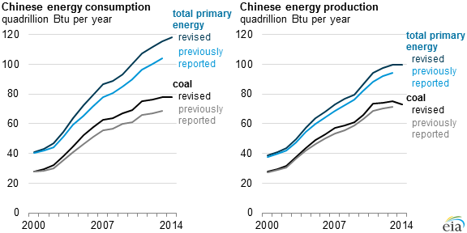
China’s energy use has grown rapidly over last 15 years, but has recently slowed
Notes:
SOURCE

Slide 21
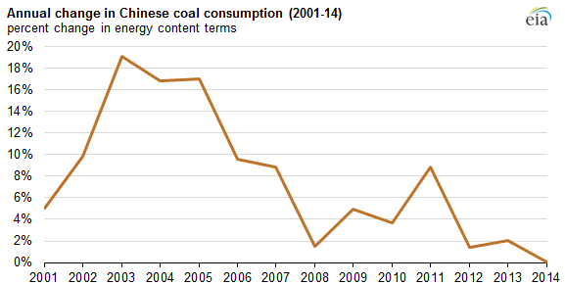
Growth in China’s coal consumption has slowed in recent years, but future path remains unclear

Slide 22
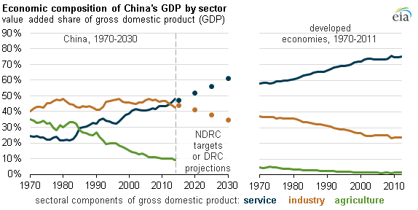
China’s energy consumption trends will be influenced by both economic growth rate and the economy’s sectoral composition

Slide 23
China’s energy outlook – what I’d like to learn about
What is the outlook for China’s electricity demand growth rate over the next 5 to 10 years, and how might it be impacted by shifts towards a more consumer- and service-oriented economy?
What mix of the following strategies will be used to tackle coal-related local pollution: emissions controls, fuel switching, end-use demand cuts, and shifting coal use away from key cities through remotely-sited gasification or generation?
What is the outlook for fuel demand in China’s transportation sector given the likelihood that China remains the top global market for vehicle sales, resulting in a rapid rise in the number of vehicles in use?
How can outside observers assess the actual role of energy policies:
distinguish between binding policies and ideas that are under consideration
reconcile inconsistencies across various plans/policies
understand the role of different governmental levels in fashioning and implementing energy policies
What is the current view of prospects for shale gas in China?

Slide 24
For more information
U.S. Energy Information Administration home page | www.eia.gov
Annual Energy Outlook | www.eia.gov/aeo
Short-Term Energy Outlook | www.eia.gov/steo
International Energy Outlook | www.eia.gov/ieo
Monthly Energy Review | www.eia.gov/mer
Today in Energy | www.eia.gov/todayinenergy
Drilling Productivity Report | www.eia.gov/petroleum/drilling

