Slide 1
Renewable Generation Technologies: Costs and Market Outlook
for
Harvard Electricity Policy Group
June 3, 2016 | Cambridge, MA
by
Howard Gruenspecht, Deputy Administrator

Slide 2
Key takeaways
EIA has a great interest in both data and analysis issues surrounding renewable electricity generation and has recently extended its work in these areas
Policies at both the state and federal levels have been the main drivers of growth in non-hydro renewable capacity and generation since 2009
Looking forward, support from recently extended tax credits as well as reductions in renewable technology costs (especially solar) are important to the growth of renewable generation through the early 2020s; the Clean Power Plan is an important driver beyond the early 2020s.
Slow/no electricity load growth and low natural gas prices are factors that tend to limit the opportunity for cost-effective renewable generation growth, although low natural gas prices may create “headroom” for regulators to choose renewables even when they engender higher costs
The levelized cost of electricity (LCOE) is not a good metric for choosing generation technologies to minimize system cost; avoided cost is a more useful concept

Slide 3
When the PTC assumption is properly aligned with realized policy, EIA’s wind projections have proven to be reasonably accurate
Total wind capacity projections in various Reference cases
gigawatts (GW)
“In 2009… [EIA] made a forecast for the next two decades: U.S. wind power would grow modestly, reaching 44 [GW] of generating capacity in 2030, while solar power would remain scarce, inching up to 12 GW. Just six years later, U.S. wind capacity is already up to 66 GW, and solar has shot up to 21 GW.” – Politico, June 2015 article “Why are the government’s energy forecasts so bad?”
Source: EIA, Form EIA-860, AEO 2009 [Pre- and Post-American Recovery and Reinvestment Act (ARRA)], and AEO 2015
Note: In 2013 the American Tax Payer Relief Act changed the Production Tax Credit (PTC) expiration from a placed-in-service deadline to a construction start date deadline for all qualifying technologies

Slide 4
Electricity use (including direct use) is expected to continue to grow, but the rate of growth slows over time as it has almost continuously over the past 60 years
U.S. electricity use and GDP
percent growth (rolling average of 3-year periods)
2015
Projections

Slide 5
Clean Power Plan accelerates shift to lower-carbon options for generation, led by growth in renewables and gas-fired generation; results are likely sensitive to CPP implementation approach
electricity net generation
trillion kilowatthours
History
AEO2016 Reference
No CPP
1993
2015
2040
2015
2040
38%
34%
33%
Natural gas
13%
Renewables
23%
11%
13%
27%
53%
33%
18%
Coal
26%
19%
20%
Petroleum and other liquids
Nuclear
15%
4%
1%
16%
1%
1%
Source: EIA, Annual Energy Outlook 2016
Notes:
5
5

Slide 6
Natural gas generation falls through 2021; both gas and renewable generation surpass coal by 2030 in the Reference case, but only natural gas does so in the No CPP case
net electricity generation
billion kilowatthours
Source: EIA, Annual Energy Outlook 2016

Slide 7
Changing tax and cost assumptions contribute to stronger solar growth, with the Clean Power Plan providing a boost to renewables
renewable electricity generation by fuel type
billion kilowatthours
2015
History
2015
AEO2016 Reference
No CPP
Wind
Municipal waste/
landfill gas
Solar
Geothermal
Biomass
Conventional hydroelectric power
Source: EIA, Annual Energy Outlook 2016
Notes:
7

Slide 8
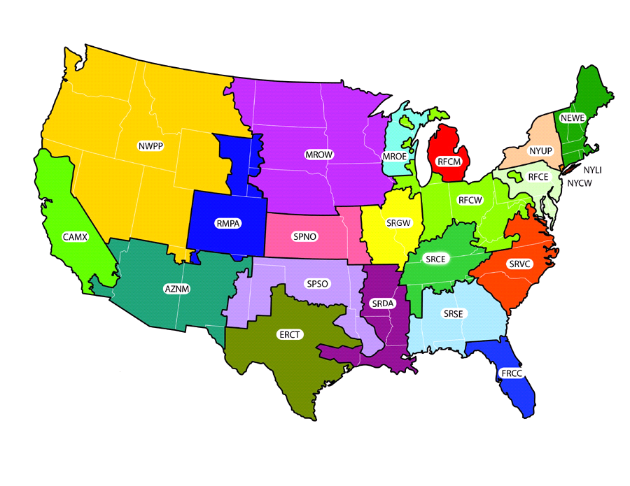
The average delivered price of coal to electricity generators varies widely across U.S. regions – transport costs are a key reason
2014 delivered coal prices, nominal $ per million Btu
$2.78
$2.27
$2.66
$2.27
N/A
$1.66
$1.81
N/A
$2.41
$2.64
$1.74
$1.94
$2.12
1.96
$2.44
$3.31
$2.28
$2.19
$2.21
$2.64
National Average | Minimum | Maximum
$2.35 | $1.66 | $3.31
$2.22
$2.82
Source: EIA, Annual Energy Outlook 2016

Slide 9
Lower costs and extension of renewable tax credits boost projected additions of wind and solar capacity prior to the 2022 effective date of the Clean Power Plan (CPP)
annual capacity additions
gigawatts
Source: EIA, Annual Energy Outlook 2016

Slide 10
New wind costs yield a capacity-weighted average of approximately $1770/kW (in 2015$), when compared to 2014 capacity additions
LBNL reports $1743/kW capacity-weighted average for 2014 (2015$, reported as $1710/KW in 2014$)
Region
 | 1 | 2 | 3 | 4 | 5 | 6 | 7 | 8 | 9 | 10 | 11 | 12 | 13 | 14 | 15 | 16 | 17 | 18 | 19 | 20 | 21 | 22
Net Cost (2015$/KW) | 1,654 | 2,444 | 2,256 | 1,861 | 2,301 | 2,301 | 2,301 | 2,301 | 2,301 | 2,256 | 2,256 | 2,444 | 2,256 | 2,444 | 2,444 | 2,444 | 1,555 | 1,555 | 2,021 | 2,021 | 2,021 | 1,555
2014 New Cap. (MW) | 577 | 0 | 0 | 1,259 | 0 | 0 | 0 | 37 | 0 | 317 | 240 | 0 | 0 | 0 | 0 | 0 | 0 | 1,781 | 0 | 331 | 20 | 235

Slide 11
Initial lower solar costs results in increased PV uptake, faster and deeper cost reductions over time
By 2020, costs drop by over 20% with new assumptions
For 2014, LBNL reports $3,800/kW capacity-weighted average (all tech), with $2,800/kW median for fixed-tilt c-Si
PV cost trajectory
2015$/kWAC
Source: EIA, Annual Energy Outlook 2016

Slide 12
EIA PV learning using updated initial costs is more optimistic than fleet average, but similar to the more limited data from fixed tilt systems
$/Wac
Cumulative Installed Capacity (MW)
Note: Current EIA thinking shows gross cost reduction from learning and macro cost adjustments, which are implicitly embedded in reported costs from LBNL and other public sources

Slide 13
Updated residential and commercial installed solar PV cost projections
residential installed cost
$/kWdc
commercial installed cost
$/kWdc
Source: EIA, Annual Energy Outlook 2016

Slide 14
For more information
U.S. Energy Information Administration home page | www.eia.gov
Electric Power Monthly | www.eia.gov/electricity/monthly
Annual Energy Outlook | www.eia.gov/aeo
Short-Term Energy Outlook | www.eia.gov/steo
Today in Energy | www.eia.gov/todayinenergy
Monthly Energy Review | www.eia.gov/mer
State Energy Profiles | www.eia.gov/state

