Slide 1
Oil and natural gas: market outlook and drivers
for
2016 Intellectual Capital Conference
May 25, 2016 | Baltimore, MD
by
Howard Gruenspecht, Deputy Administrator

Slide 2
Global supply has consistently exceeded demand since the start of 2014; EIA forecasts a return to market balance in the second half of 2017
world supply and demand
million barrels per day
implied stock change
million barrels per day
Source: EIA, Short-Term Energy Outlook, May 2016

Slide 3
EIA expects WTI oil prices to remain low compared to recent history, but the market-implied confidence band is very wide
WTI price
dollars per barrel
Source: EIA, Short-Term Energy Outlook, May 2016

Slide 4
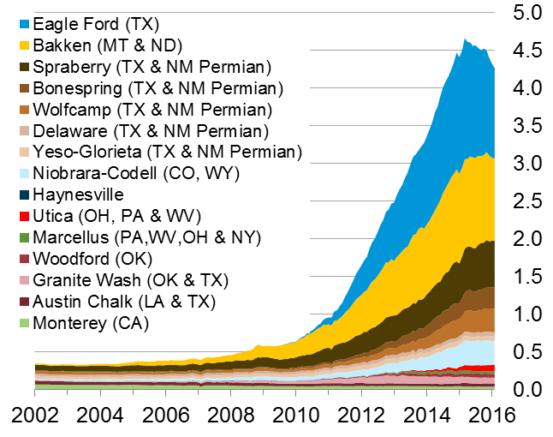
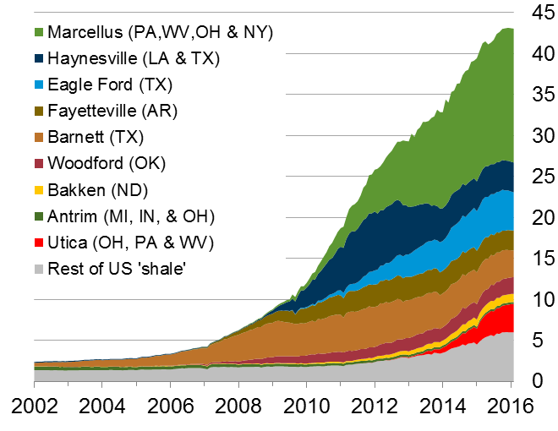
The U.S. has experienced a rapid increase in natural gas and oil production from shale and other tight resources
U.S. tight oil production
million barrels of oil per day
U.S. dry shale gas production
billion cubic feet per day
Sources: EIA derived from state administrative data collected by DrillingInfo Inc. Data are through February 2016 and represent EIA’s official tight oil & shale gas estimates, but are not survey data. State abbreviations indicate primary state(s).

Slide 5
Long lead times and past investment are contributing to growth from the Gulf of Mexico as Lower 48 production declines
U.S. crude oil production growth by area
change from fourth quarter, 2014 (million barrels per day)
Source: EIA, Short-Term Energy Outlook, May 2016

Slide 6
Crude supply trends outside the United States (red areas below) are key to future oil market balance: geopolitical developments, exporter decisions, and the timing and magnitude of supply effects stemming from reduced investment all matter
Source: EIA, Short-Term Energy Outlook and Drilling Productivity Report, May 2016; International Energy Agency

Slide 7
EIA forecasts global liquids consumption growth at 1.4 million b/d in 2016 and 1.5 million b/d in 2017
world liquid fuels consumption
million barrels per day
annual change
million barrels per day
Source: EIA, Short-Term Energy Outlook, May 2016

Slide 8
Non-OECD economic growth projections, a key driver of oil demand, have been reduced over the course of recent STEO forecasts
GDP growth in non-OECD countries
annual expectations by date of forecast
Source: EIA, Short-Term Energy Outlook, May 2016

Slide 9
U.S. Outlook

Slide 10
Reductions in energy intensity largely offset effects of economic and population growth, leading to slow projected growth in energy use
U.S. primary energy consumption
quadrillion Btu
History
Projections
Projections
2015
2015
AEO2016 Reference
No CPP
32% of U.S. total
33%
Natural gas
29%
8%
14%
(excluding biofuels)
12%
Renewables
36%
33%
Petroleum and other liquids
34%
1%
Liquid biofuels
9%
1%
1%
Nuclear
8%
8%
16%
10%
Coal
14%
Source: EIA, Annual Energy Outlook 2016

Slide 11
Combination of increased tight oil production and higher fuel efficiency drives projected decline in oil imports
U.S. liquid fuels supply
million barrels per day
AEO2016 Reference
History
2015
2020
2040
7%
19%
24%
Tight oil
production
35%
Net petroleum and other liquids
imports
25%
25%
21%
23%
21%
Other crude oil production
(excluding tight oil starting in 2000)
Natural gas
plant liquids
17%
23%
25%
10%
12%
Other
12%
Note: “Other” includes refinery gain, biofuels production, all stock withdrawals, and other domestic sources of liquid fuels
Source: EIA, Annual Energy Outlook 2016

Slide 12
In the transportation sector, motor gasoline use declines; diesel fuel, jet fuel, and natural gas use all grow
transportation energy consumption by fuel
quadrillion Btu
AEO2016 Reference
History
2015
2030
2040
24%
30%
Diesel
31%
10%
Jet fuel
Other*
2%
13%
1%
4%
CNG/LNG
14%
3%
2%
4%
5%
3%
58%
Ethanol
49%
44%
Motor gasoline
*Includes aviation gasoline, propane, residual fuel oil, lubricants, electricity, and liquid hydrogen
Source: EIA, Annual Energy Outlook 2016
Notes:
12
12

Slide 13
Takeaways – Natural gas
North American natural gas production is more likely to be limited by demand than supply
U.S. natural gas demand growth is likely to be concentrated in electricity and industrial uses; natural gas exports and use in the transportation sector, where little natural gas is used today, are also likely to grow
Potential challenges to natural gas demand growth include
  Slow growth in U.S. electricity demand
  Competition from offshore “stranded” gas for global LNG exports and siting of gas-intensive industries.
  Long-term cheap oil would be another significant challenge to LNG exports
  Extent and nature of global price convergence in natural gas markets
Future policies that target particular sources or uses of energy or energy-related emissions can really matter for future natural gas demand

Slide 14
Natural gas prices are projected to remain below $5 per million British thermal units through most of the projection period with or without the Clean Power Plan
average Henry Hub spot prices for natural gas
2015 dollars per million Btu
History
2015
Projections
Source: EIA, Annual Energy Outlook 2016

Slide 15
U.S. natural gas production exceeds consumption, making the United States a net exporter of natural gas in the very near future
U.S. energy production and consumption
quadrillion Btu
History
2015
Projections
2040
No CPP
2020
Net exports
Reference
-22%
No CPP
-23%
Reference
Net imports: 3%
Consumption
Domestic supply
Source: EIA, Annual Energy Outlook 2016

Slide 16
Shale resources remain the dominant source of U.S. natural gas production growth
U.S. dry natural gas production
trillion cubic feet
AEO2016 Reference
History
Projections
2015
Shale gas and
tight oil plays
Other lower 48
onshore
Tight gas
Coalbed methane
Alaska
Lower 48 offshore
Source: EIA, Annual Energy Outlook 2016
Notes:
16
16

Slide 17
Natural gas generation falls through 2021; both gas and renewable generation surpass coal by 2030 in the Reference case, but only natural gas does so without the Clean Power Plan
net electricity generation
billion kilowatthours
Source: EIA, Annual Energy Outlook 2016

Slide 18
Natural gas consumption growth is led by electricity generation and industrial uses; natural gas use rises in all sectors except residential
U.S. dry gas consumption
trillion cubic feet
billion cubic feet per day
History
Projections
Residential
Commercial
Transportation**
Industrial*
Electric power
12.0
11.2
9.6
12.5
12.6
9.1
0.9
1.7
1.7
3.2
3.7
3.7
4.6
4.6
4.6
2020
2030
2040
*Includes combined heat-and-power and lease, plant, and export liquefaction fuel
Source: EIA, Annual Energy Outlook 2016
**Includes pipeline fuel

Slide 19
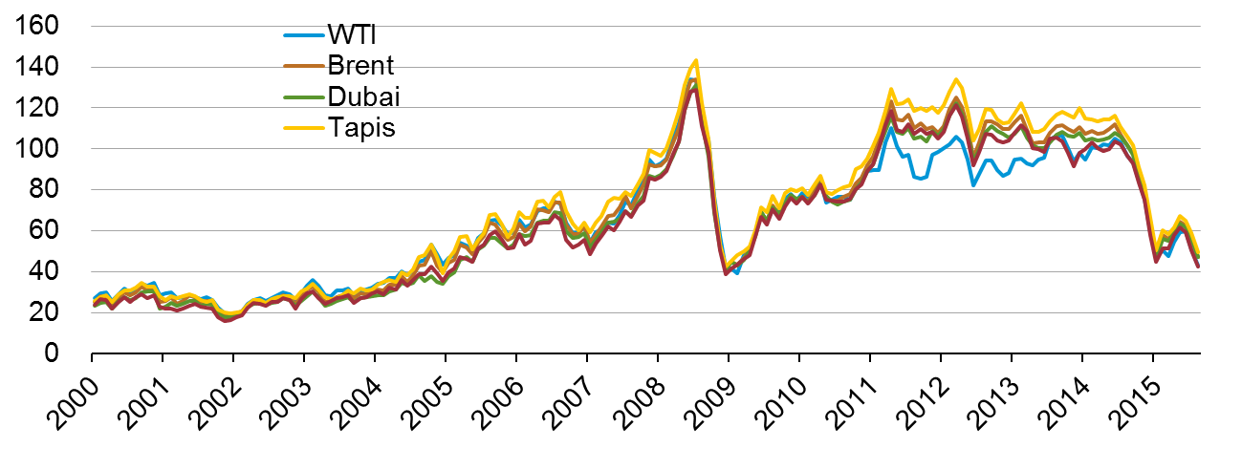
World oil prices move together due to arbitrage
Global crude oil prices
Nominal dollars per barrel, monthly average
Sources: Bloomberg, Thomson Reuters

Slide 20
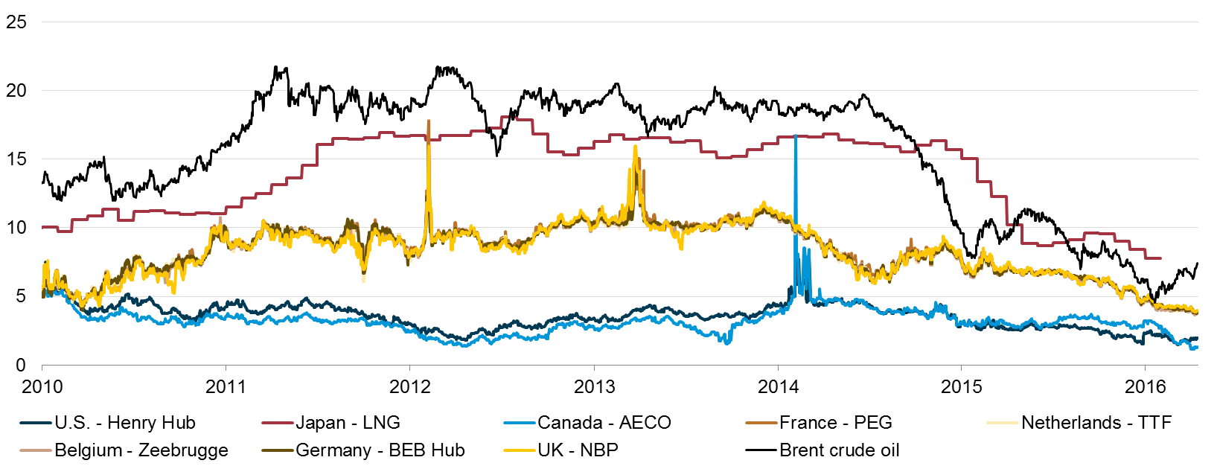
North American natural gas prices are low compared to prices in the rest of the world, although spreads have narrowed recently
select global natural gas and crude oil prices with average monthly LNG prices in Japan
U.S. dollars per million British thermal unit
Source: EIA, Bloomberg L.P.

Slide 21
Global Energy Outlook

Slide 22
Key findings in the IEO2016 Reference case
World energy consumption increases 48% increase (1.4% compound annual growth rate) between 2012 and 2040. Non-OECD Asia (including China and India) account for more than half of the increase.
The industrial sector continues to account for the largest share of delivered energy consumption; the world industrial sector still consumes over half of global delivered energy in 2040.
Renewable energy is the world’s fastest-growing energy source, increasing by 2.6%/year; nuclear energy grows by 2.3%/year, from 4% of the global total in 2012 to 6% in 2040.
Fossil fuels continue to supply more than three-fourths of world energy use in 2040.

Slide 23
Many global issues increase uncertainty…
Economic growth in key economies (China, Brazil, Russia, among others)
Implementation and strength of climate policies
Technology improvement rates (both supply and demand)
Unrest in oil producing countries
OPEC production
Future of nuclear generating capacity

Slide 24
Economic activity and population drive increases in energy use; energy intensity (E/GDP) improvements moderate this trend
average annual percent change (2012–40)
percent per year
Source: EIA, International Energy Outlook 2016

Slide 25
Renewables grow fastest, coal use plateaus, natural gas surpasses coal by 2030, and oil maintains its leading share
world energy consumption
quadrillion Btu
History
2012
Projections
30%
26%
33%
22%
22%
28%
17%
16%
23%
12%
6%
4%
Source: EIA, International Energy Outlook 2016 and EIA, Analysis of the Impacts of the Clean Power Plan (May 2015)

Slide 26
Projected carbon intensity of energy use (CO2/E) declines through 2040 in both OECD and non-OECD; non-OECD CO2/E rose over 2000–12
carbon intensity of energy consumption, 1990-2040
kilograms CO2 per million Btu
History
2012
Projections
Source: EIA, International Energy Outlook 2016

Slide 27
GDP drives electricity demand growth, but the electricity growth rate compared to the GDP growth rate becomes smaller over time
world GDP and net electricity generation
percent growth (rolling average of 3-year periods)
History
2012
Projections
Source: EIA, International Energy Outlook 2016

Slide 28
Renewables, natural gas, and coal all contribute roughly the same amount of global net electricity generation in 2040
world net electricity generation by source
trillion kilowatthours
Nuclear
Other renewables
Hydropower
Natural gas
Coal
Liquids
Source: EIA, International Energy Outlook 2016

Slide 29
Passenger-miles per person will rise as GDP per capita grows; travel growth is largely outside the OECD
passenger-miles per capita (left-axis) and GDP per capita (horizontal-axis) for
selected country groupings 2010–40
Source: EIA, International Energy Outlook 2016

Slide 30
Most of the growth in world oil consumption occurs in the non-OECD regions — especially Asia
world petroleum and other liquid fuels consumption
million barrels per day
Source: EIA, International Energy Outlook 2016

Slide 31
Liquid fuels supplies from both OPEC and non-OPEC producers increase through 2040
world production of petroleum and other liquid fuels
million barrels per day
History
2012
Projections
Source: Current thinking

Slide 32
LONGER TERM PERSPECTIVE: Can OPEC cohere? – Change in world liquid fuel balances for two 12-year historical periods with EIA projections for 2013-25 (million barrels per day)
 | Actual |  | Current Thinking
 | 1973–85 | 2000–12 | 2013–25
World Liquids Demand | +3 | +12 | +9 to +13
OECD | -4 | -2 | -2 to 0
Non-OECD | +7 | +15 | +11 to +13
World Liquids Supply | -1 | +12 | +9 to +13
Non-OPEC Supply | +13 | + 6 | + 9 to +12
OPEC Production | -14 | + 6 | -3 to +4

Slide 33
Non-OECD nations account for ¾ of projected growth in natural gas consumption
world natural gas consumption
trillion cubic feet
Source: Current Thinking

Slide 34
Non-OECD Asia, Middle East, and OECD Americas account for the largest increases in natural gas production
world change in natural gas production, 2012–40
trillion cubic feet
Source: EIA, International Energy Outlook 2016

Slide 35
Shale gas, tight gas, and coalbed methane become increasingly important to gas supplies, not only for the U.S., but also China and Canada
natural gas production by type
trillion cubic feet
China
Canada
United States
Shale gas
Tight gas
Coalbed methane
Other gas
Note: Other natural gas includes natural gas produced from structural and stratigraphic traps (e.g. reservoirs), historically referred to as ‘conventional’ production.
Source: Current thinking

Slide 36
For more information
U.S. Energy Information Administration home page | www.eia.gov
Annual Energy Outlook | www.eia.gov/aeo
Short-Term Energy Outlook | www.eia.gov/steo
International Energy Outlook | www.eia.gov/ieo
Monthly Energy Review | www.eia.gov/mer
Today in Energy | www.eia.gov/todayinenergy
International Energy Portal | www.eia.gov/beta/international/?src=home-b1

