Slide 1
Oil and natural gas: market outlook and drivers
for
American Foundry Society
May 18, 2016 | Washington, DC
by
Howard Gruenspecht, Deputy Administrator

Slide 2
Global supply has consistently exceeded demand since the start of 2014; EIA forecasts a return to market balance in the second half of 2017
world supply and demand
million barrels per day
implied stock change
million barrels per day
Source: EIA, Short-Term Energy Outlook, May 2016

Slide 3
EIA expects WTI oil prices to remain low compared to recent history, but the market-implied confidence band is very wide
WTI price
dollars per barrel
Source: EIA, Short-Term Energy Outlook, May 2016

Slide 4
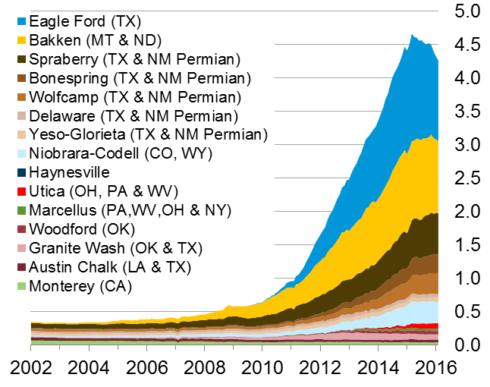
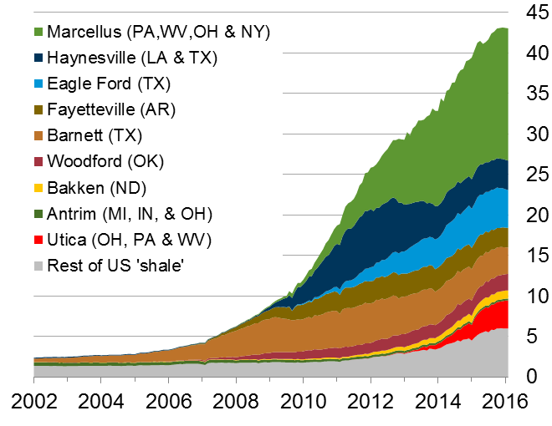
The U.S. has experienced a rapid increase in natural gas and oil production from shale and other tight resources
U.S. tight oil production
million barrels of oil per day
U.S. dry shale gas production
billion cubic feet per day
Sources: EIA derived from state administrative data collected by DrillingInfo Inc. Data are through February 2016 and represent EIA’s official tight oil & shale gas estimates, but are not survey data. State abbreviations indicate primary state(s).

Slide 5
Long lead times and past investment are contributing to growth from the Gulf of Mexico as Lower 48 production declines
U.S. crude oil production growth by area
change from fourth quarter, 2014 (million barrels per day)
Source: EIA, Short-Term Energy Outlook, May 2016

Slide 6
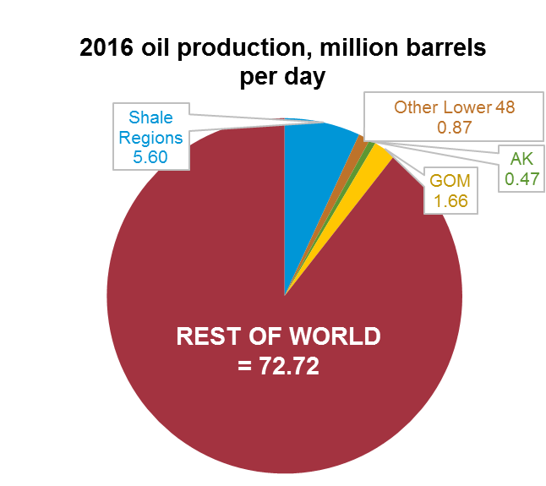
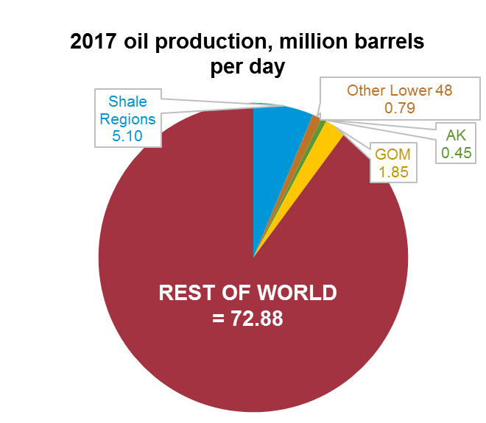
Crude supply trends outside the United States (red areas below) are key to future oil market balance: geopolitical developments, exporter decisions, and the timing and magnitude of supply effects stemming from reduced investment all matter
Source: EIA, Short-Term Energy Outlook and Drilling Productivity Report, May 2016; International Energy Agency

Slide 7
EIA forecasts global liquids consumption growth at 1.2 million b/d in 2016 and 1.3 million b/d in 2017
world liquid fuels consumption
million barrels per day
annual change
million barrels per day
Source: EIA, Short-Term Energy Outlook, May 2016

Slide 8
Non-OECD economic growth projections, a key driver of oil demand, have been reduced over the course of recent STEO forecasts
GDP growth in non-OECD countries
annual expectations by date of forecast
Source: EIA, Short-Term Energy Outlook, May 2016

Slide 9
Global Energy: Drivers and Projections

Slide 10
Economic activity and population drive increases in energy use; energy intensity (E/GDP) improvements moderate this trend
average annual percent change (2012–40)
percent per year
Source: EIA, International Energy Outlook 2016

Slide 11
Renewables grow fastest, coal use plateaus, natural gas surpasses coal by 2030, and oil maintains its leading share
world energy consumption
quadrillion Btu
History
2012
Projections
30%
26%
33%
22%
22%
28%
17%
16%
23%
12%
6%
4%
Source: EIA, International Energy Outlook 2016 and EIA, Analysis of the Impacts of the Clean Power Plan (May 2015)

Slide 12
Most of the growth in world oil consumption occurs in the non-OECD regions — especially Asia
world petroleum and other liquid fuels consumption
million barrels per day
Source: EIA, International Energy Outlook 2016

Slide 13
Passenger-miles per person will rise as GDP per capita grows; travel growth is largely outside the OECD
passenger-miles per capita (left-axis) and GDP per capita (horizontal-axis) for
selected country groupings 2010–40
Source: EIA, International Energy Outlook 2016

Slide 14
Liquid fuels supplies from both OPEC and non-OPEC producers increase through 2040
world production of petroleum and other liquid fuels
million barrels per day
History
2012
Projections
Source: EIA, International Energy Outlook 2016

Slide 15
Non-OECD nations account for 76% of projected growth in natural gas consumption
world natural gas consumption
trillion cubic feet
Source: EIA, International Energy Outlook 2016

Slide 16
Non-OECD Asia, Middle East, and OECD Americas account for the largest increases in natural gas production
world change in natural gas production, 2012–40
trillion cubic feet
Source: EIA, International Energy Outlook 2016

Slide 17
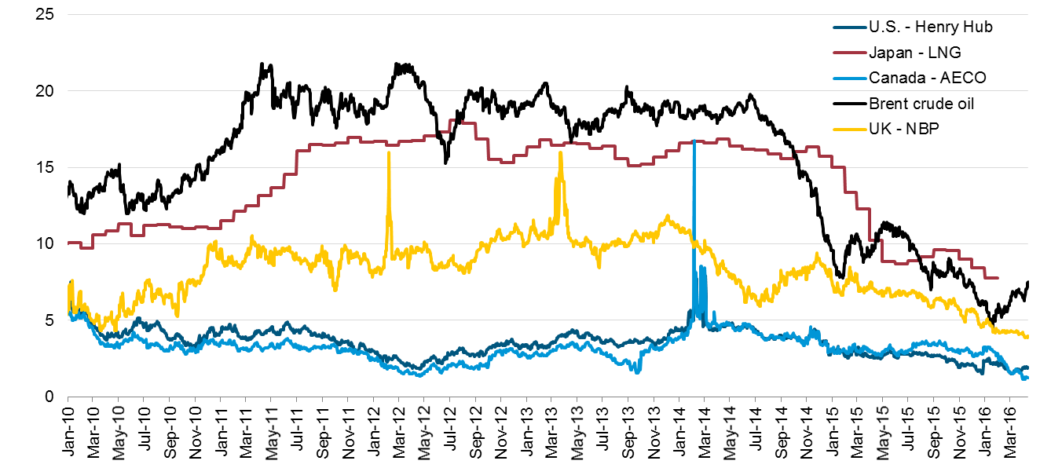
North American natural gas prices are low compared to prices in the rest of the world, although spreads have narrowed recently
select global natural gas and crude oil prices with average monthly LNG prices in Japan
U.S. dollars per million British thermal unit
Source: U.S. Energy Information Administration, Bloomberg L.P.

Slide 18
U.S. Energy Outlook

Slide 19
Key updates in AEO2016
Incorporation of the U.S. Environmental Protection Agency’s final rules for the Clean Power Plan
Updated renewable capital costs
Latest California zero-emission vehicle sales mandates, which have been adopted by a number of other states
Extension of the production tax credit for wind and 30% investment tax credit for solar
Lower near-term crude oil prices

Slide 20
Reductions in energy intensity largely offset impact of gross domestic product (GDP) growth, leading to slow projected growth in energy use
U.S. primary energy consumption
quadrillion Btu
History
Projections
Projections
2015
2015
AEO2016 Reference
No CPP
32% of U.S. total
33%
Natural gas
29%
8%
14%
(excluding biofuels)
12%
Renewables
36%
33%
Petroleum and other liquids
34%
1%
Liquid biofuels
9%
1%
1%
Nuclear
8%
8%
16%
10%
Coal
14%
Source: EIA, Annual Energy Outlook 2016

Slide 21
U.S. net energy imports continue to decline (except for liquids in the near term) reflecting increased oil and natural gas production coupled with slowly growing or falling demand
U.S. net imports
quadrillion Btu
History
Projections
2015
Liquids
No CPP
AEO2016 Reference
Natural gas
Coal
Source: EIA, Annual Energy Outlook 2016

Slide 22
CO2 emissions are lower in AEO2016 Reference case than AEO2015 Reference Case, even without the Clean Power Plan (CPP)
energy-related carbon dioxide emissions
million metric tons
History
Projections
2015
AEO2015 Reference
No CPP
AEO2016 Reference
Source: EIA, Annual Energy Outlook 2016

Slide 23
U.S. Electricity

Slide 24
Clean Power Plan accelerates shift to lower-carbon options for generation, led by growth in renewables and gas-fired generation; results are likely sensitive to CPP implementation approach
electricity net generation
trillion kilowatthours
History
AEO2016 Reference
No CPP
1993
2015
2040
2015
2040
38%
34%
33%
Natural gas
13%
Renewables
23%
11%
13%
27%
53%
33%
18%
Coal
26%
19%
20%
Petroleum and other liquids
1%
Nuclear
15%
1%
4%
1%
16%
Source: EIA, Annual Energy Outlook 2016
Notes:
24
24

Slide 25
Natural gas generation falls through 2021; both gas and renewable generation surpass coal by 2030 in the Reference case, but only natural gas does so in the No CPP case
net electricity generation
billion kilowatthours
Source: EIA, Annual Energy Outlook 2016

Slide 26
Lower costs and extension of renewable tax credits boost projected additions of wind and solar capacity prior to the 2022 effective date of the Clean Power Plan (CPP)
annual capacity additions, gigawatts
AEO2016 Reference
Source: EIA, Annual Energy Outlook 2016

Slide 27
Reference case projects slightly higher levels of total capacity because of higher levels of renewable capacity
total electric generating capacity
gigawatts
History
AEO2016 Reference
No CPP
2015
2015
Other renewables
103
103
246
203
102
Hydro
Solar
128
149
Wind
477
570
Natural gas/oil
576
100
Nuclear
99
99
284
176
215
Coal
Notes: prior to 2000 wind and solar data is not broken out, and is reflected in ‘Other Renewable’; Hydro includes pumped storage
Source: EIA, Annual Energy Outlook 2016
Notes:
27
27

Slide 28
Changing tax and cost assumptions contribute to stronger solar growth, with the Clean Power Plan providing a boost to renewables
renewable electricity generation by fuel type
billion kilowatthours
2015
History
2015
AEO2016 Reference
No CPP
Wind
Municipal waste/
landfill gas
Solar
Geothermal
Biomass
Conventional hydroelectric power
Source: EIA, Annual Energy Outlook 2016
Notes:
28

Slide 29
U.S. Natural Gas

Slide 30
Shale resources remain the dominant source of U.S. natural gas production growth
U.S. dry natural gas production
trillion cubic feet
AEO2016 Reference
History
2015
Projections
Shale gas and
tight oil plays
Other lower 48
onshore
Tight gas
Coalbed methane
Alaska
Lower 48 offshore
Source: EIA, Annual Energy Outlook 2016
Notes:
30
30

Slide 31
Natural gas consumption growth is led by electricity generation and industrial uses; natural gas use rises in all sectors except residential
U.S. dry gas consumption
trillion cubic feet
billion cubic feet per day
History
Projections
Residential
Commercial
Transportation**
Industrial*
Electric power
12.0
11.2
9.6
12.5
12.6
9.1
0.9
1.7
1.7
3.2
3.7
3.7
4.6
4.6
4.6
2020
2030
2040
*Includes combined heat-and-power and lease, plant, and export liquefaction fuel
Source: EIA, Annual Energy Outlook 2016
**Includes pipeline fuel

Slide 32
For more information
U.S. Energy Information Administration home page | www.eia.gov
Annual Energy Outlook | www.eia.gov/forecasts/aeo
Short-Term Energy Outlook | www.eia.gov/forecasts/steo
International Energy Outlook | www.eia.gov/forecasts/ieo
Today In Energy | www.eia.gov/todayinenergy
Monthly Energy Review | www.eia.gov/totalenergy/data/monthly
State Energy Portal | www.eia.gov/state

