Slide 1
Effects of low oil prices
for
19th Annual Energy Risk Summit
May 12, 2015 | Houston, TX
by
Howard Gruenspecht, Deputy Administrator
Notes:
Thank you for the kind introduction.
It’s a pleasure to be here to continue the exchange of ideas between EIA and CSIS.
The trends discussed here focus on the AEO2015, which is a shorter edition completed under a newly adopted two-year release cycle. Under this approach, full and shorter editions of the AEO will be produced in alternating years. The shorter edition of the AEO includes a more limited number of model updates, predominantly to reflect historical data updates and changes in legislation and regulation. It includes a publication that discusses the Reference case and five alternative cases (Low and High Economic Growth Case, Low and High Oil Prices cases, and a High Oil and Gas Resource case), and an accompanying Assumptions Report.
Other AEO reports—including documentation for each of the NEMS models and a Retrospective Review—will be completed only in years when the full edition of the AEO is published.
The AEO2015 Reference case and alternative cases provide the basis for examination and discussion of energy market trends and serve as a starting point for analysis of potential changes in U.S. energy policies, rules, or regulations or potential technology breakthroughs.

Slide 2
Historical oil prices (and EIA forecast through 2016)
crude oil price
price per barrel (real 2010 dollars)
Prices shown are quarterly averages:
dashed lines are EIA projections
Sources: U.S. Energy Information Administration, Thomson Reuters

Slide 3
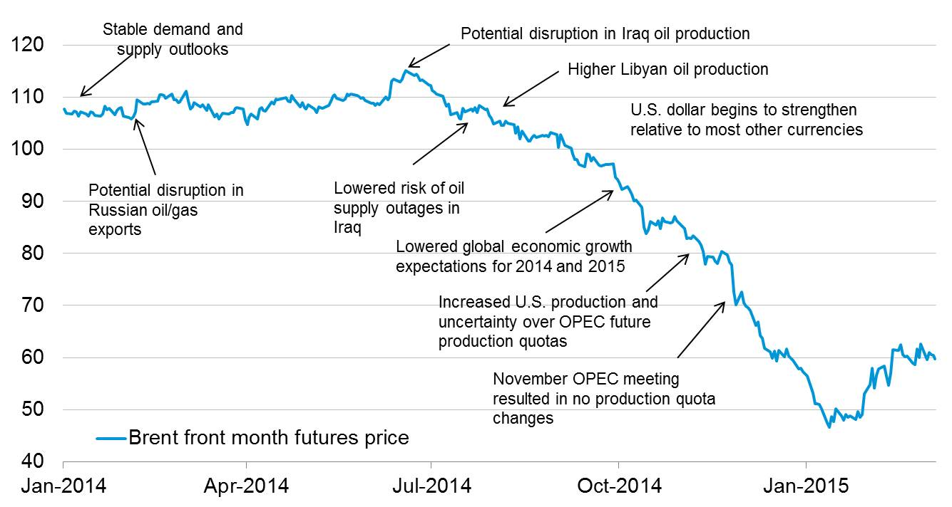
Brent crude oil prices were relatively stable through the first half of 2014; increased oil supply and lower global economic growth expectations lowered prices from July 2014 to January 2015
dollars per barrel
Source: EIA, Bloomberg

Slide 4
Key takeaways
Oil prices: EIA’s forecast for Brent averages $61/b in 2015 and $70/b in 2016. The market-implied 95% confidence band for Brent (estimated from WTI futures and options prices) is extremely wide – with a range from $40/b to $110/b at the end of 2016.
Demand: Non-OECD Asia remains a key driver of global forecast liquids consumption growth of roughly 1.2 million b/d in 2015 and 1.3 million b/d in 2016; lower demand growth is a major a downside risk to the price forecast
U.S. oil production: Lower-48 oil production falls to its 4Q2014 level in 3Q2015, and then remains below that level for the following 3 quarters, before returning to that level in 3Q2016 as production growth resumes under EIA’s price scenario; near-term production in the federal offshore (growing) and Alaska (declining) are not responsive to recent price changes
The economy and consumers: EIA’s energy forecast reflects a U.S. economic growth outlook for 2015-16 that is somewhat stronger than 2013-14 experience
Energy expenditures as a share of GDP are forecast at 6.3% in 2015, their lowest level since 2002, reflecting both lower oil prices and energy efficiency
Average U.S. household projected gasoline spending is $675 less in 2015 than in 2014, and about $530 less in 2016 than in 2014

Slide 5
Oil prices rise from mid-2015 through mid-2016 in EIA’s forecast – however, the market-implied confidence band is very wide
WTI price
dollars per barrel
Source: EIA, Short-Term Energy Outlook, May 2015

Slide 6
Total U.S. crude production is forecast to decline between 2Q15 and 1Q16; output growth then resumes growth in 2016, reflecting EIA’s price forecast
U.S. crude oil production growth by area
cumulative growth compared with 4Q14 (million barrels per day)
Source: EIA, Short-Term Energy Outlook, May 2015

Slide 7
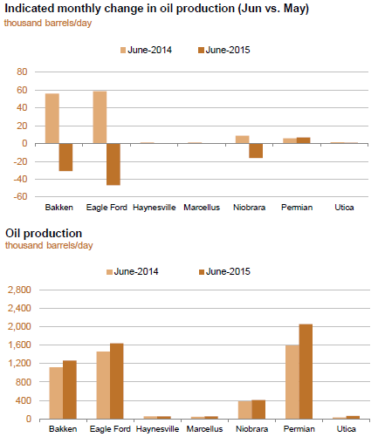
EIA’s latest DPR forecasts June oil production below the May level in the Bakken, Eagle Ford, and Niobrara regions

Slide 8
North American oil production growth slows with lower oil prices but remains the main driver of global production growth
world crude oil and liquid fuels production growth
million barrels per day
Source: EIA, Short-Term Energy Outlook, May 2015

Slide 9
EIA forecasts global liquids consumption growth at 1.2 million bbl/d in 2015 and 1.3 million bbl/d in 2016
world liquid fuels consumption
million barrels per day
annual change
million barrels per day
Source: EIA, Short-Term Energy Outlook, May 2015

Slide 10
Various events could lead to changes in global supply or demand that could push future crude oil prices higher or lower than the forecast
Event
Oil demand growth surprises to the upside (economy- or price-driven)
Key OPEC producers cut output more than expected
Iraq production is significantly disrupted (ISIL? other discord?)
Social unrest in oil-dependent countries leads to supply disruptions
Non-OPEC production slows more than expected
World economic growth is lower than projected (e.g., China)
Saudi Arabia keeps production at 9.6-9.7 million bbl/d in 2016
Reduction in unplanned production outages
Iranian sanctions are lifted
Increase Prices
Decrease Prices

Slide 11
Gov’t deficits, high reliance on oil revenue, and asset coverage of gov’t spending are indicators of geopolitical stress exposure
less risk
more risk
more risk
less risk
Source: EIA, International Monetary Fund (IMF), individual country investment authorities

Slide 12
U.S. gasoline demand is forecast to increase 1.4% percent in 2015 reflecting a combination of factors
Source: EIA, Short-Term Energy Outlook, May 2015

Slide 13
Average household energy expenditures fall by 15% in 2015, then increase somewhat in 2016 (based on EIA price forecast)
household energy expenditures
dollars
$4,568 $4,534 $3,832 $4,009
Sources: 2013 expenditures and income from BLS Consumer Expenditure Survey. The average household in the BLS survey (called a consuming unit) averages 2.5 people and 1.3 income earners. Expenditures for 2014-16 based on average prices from EIA Short-Term Energy Outlook, May 2015

Slide 14
Longer-term perspective

Slide 15
EIA’s long-term price scenarios cover a wide range of potential prices
Brent crude oil spot price
2013 dollars per barrel
History
Projections
2013
High Oil Price
Reference
Low Oil Price
High Oil and Gas Resource
Source: EIA, Annual Energy Outlook 2015
Notes:
In the AEO2015 Reference case, the price of global marker Brent crude oil is $56/barrel (bbl) (in 2013 dollars) in 2015. Prices rise steadily after 2015 in response to growth in demand; however, downward price pressure from continued increases in U.S. crude oil production keeps the Brent price below $80/bbl through 2020. U.S. crude oil production starts to decline after 2020, but increased output from non-OECD and OPEC producers help to keep the Brent price below $100/bbl through 2028 and limit the Brent price increase through 2040, when it reaches $141/bbl.
There is significant variation in the alternative cases. In the Low Oil Price case, the Brent price is $52/bbl in 2015 and reaches $76/bbl in 2040. In the High Oil Price case, the Brent price reaches $122/bbl in 2015 and then more than $252/bbl in 2040. In the High Oil and Gas Resource case, with significantly more U.S. production than the Reference case, the Brent price averages $129/bbl in 2040.

Slide 16
Lower oil prices, if sustained, have a significant impact on projected U.S. production
Reference case
Low price case
million barrels per day
million barrels per day
History
Projections
History
Projections
2013
2013
Tight oil
Tight oil
Other lower 48 states onshore
Other lower 48 states onshore
Lower 48 states offshore
Lower 48 states offshore
Alaska
Alaska
Source: EIA, Annual Energy Outlook 2015
Notes:
16
16
U.S. production of crude oil in the AEO2015 Reference case increases from ___ million barrels per day in 2013 to ___ million barrels per day in ___, __% higher than in AEO2014. Despite a decline after ___, U.S. crude oil production remains above ___ million barrels per day through 2040. Higher production volumes result mainly from increased onshore oil production, predominantly from tight (very low permeability) formations. Offshore crude oil maintains a steady supply of domestic crude oil production, fluctuating between ___ and ___ million barrels per day through 2040, as the pace of development activity quickens and new large development projects, predominantly in the deepwater and ultra deepwater portions of the Gulf of Mexico, are brought into production.
The faster growth of tight oil production through ____ in AEO2015 Reference case results in higher domestic crude oil production than in AEO2014 throughout most of the projection. The pace of oil directed drilling in the near-term is much stronger than in AEO2014, as producers continue to locate and target the ‘sweet spots’ of plays currently under development and find additional tight formations that can be developed with the latest technologies. In the AEO2015 Reference case, tight oil production increases from ___ million barrels per day in 2013 (__% of total U.S. crude oil production) to ___ million barrels per day in ____ (__% of total U.S. crude oil production). As in the AEO2014, tight oil production declines after ___ in the AEO2015 as more development moves into lower-productivity areas. Total U.S. liquids production in AEO2015 is generally lower than in AEO2014 primarily due to lower NGPL production.

Slide 17
Can OPEC cohere? – comparison of change in world liquid fuel balances for two 12-year historical periods with EIA projections for 2013-25 from AEO2015 (million barrels per day)
 | Actual |  | Projected AEO 2014 Reference & HOGR Cases
 | 1973–85 | 2000–12 | 2013–25
World Liquids Demand | +3 | +12 | +12 to +13
OECD | -4 | -2 | +1
Non-OECD | +7 | +15 | +11
World Liquids Supply | -1 | +12 | +11 to +12
Non-OPEC Supply | +13 | + 6 | +10 to +15
OPEC Production | -14 | + 6 | -3 to +2
Source: EIA, Short-Term Energy Outlook, April 2015

Slide 18
For more information
U.S. Energy Information Administration home page | www.eia.gov
Annual Energy Outlook | www.eia.gov/forecasts/aeo
Short-Term Energy Outlook | www.eia.gov/forecasts/steo
International Energy Outlook | www.eia.gov/forecasts/ieo
Today In Energy | www.eia.gov/todayinenergy
Monthly Energy Review | www.eia.gov/totalenergy/data/monthly
State Energy Portal | www.eia.gov/state
Drilling Productivity Report | www.eia.gov/petroleum/drilling
Notes:
And with that, all that remains is to remind you of some of the many energy information products available from EIA, and to thank you for your kind consideration of EIA’s latest outlook
Now I’ll turn back over to our hosts from the CSIS to begin the dialogue.

Slide 19
Henry Hub spot prices are expected to average $2.93/million Btu in 2015 and $3.32/million Btu in 2016
Henry Hub spot price
dollars per million Btu
Source: EIA, Short-Term Energy Outlook, May 2015

Slide 20
Natural gas production is expected to increase by 4.5 bcf/day in 2015 and by 1.3 bcf/day in 2016
U.S. natural gas production and imports
billion cubic feet per day
annual change
billion cubic feet per day
Source: EIA, Short-Term Energy Outlook, May 2015

Slide 21
Industrial and power sectors drive natural gas consumption growth in the forecast
natural gas consumption
billion cubic feet per day
annual change
billion cubic feet per day
Source: EIA, Short-Term Energy Outlook, May 2015

Slide 22
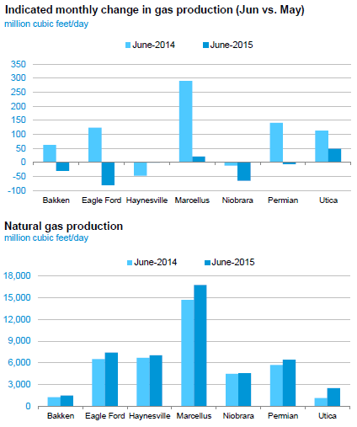
EIA’s latest DPR forecasts June natural gas production below the May level in the Bakken, Eagle Ford, and Niobrara regions

Slide 23
New condensate splitter projects in the United States
Project | Capacity (Mbbl/sd) | State | Est. Cost² ($MM) | Completion | Status
Kinder Morgan - Galena Park | 50 | Texas | 180 | 2015 | under construction
Kinder Morgan - Galena Park | 50 | Texas | 180 | 2016 | under construction
Marathon - Canton | 25 | Ohio | 180 | 2015 | under construction
Kinder Morgan - Galena Park | 50 | Texas | 200e | 2017 | proposed
Buckeye/Trafigura – Corpus Christi | 50 | Texas | 200 | 2016 | proposed
Magellan – Corpus Christi | 50 | Texas | 250e | 2017 | proposed
Magellan – Corpus Christi | 50 | Texas | 200e | 2018 | proposed
Phillips 66 – Sweeny | 75 | Texas | 242 | 2018 | proposed
Targa - Houston Ship Channel | 35 | Texas | 115 | 2018 | proposed
Marathon - Catlettsburg | 35 | Kentucky | 150 | 2016 | front-end engineering design
CCI – Corpus Christi | 100 | Texas | 500 | 2016 | front-end engineering design
Note: Mbbl/sd = thousand barrels per stream day; MM = millions; e = Estimated costs, when stated costs not available from news reports or company filings.
Source: U.S. Energy Information Administration, compiled from industry sources as of January 2015.

