Slide 1
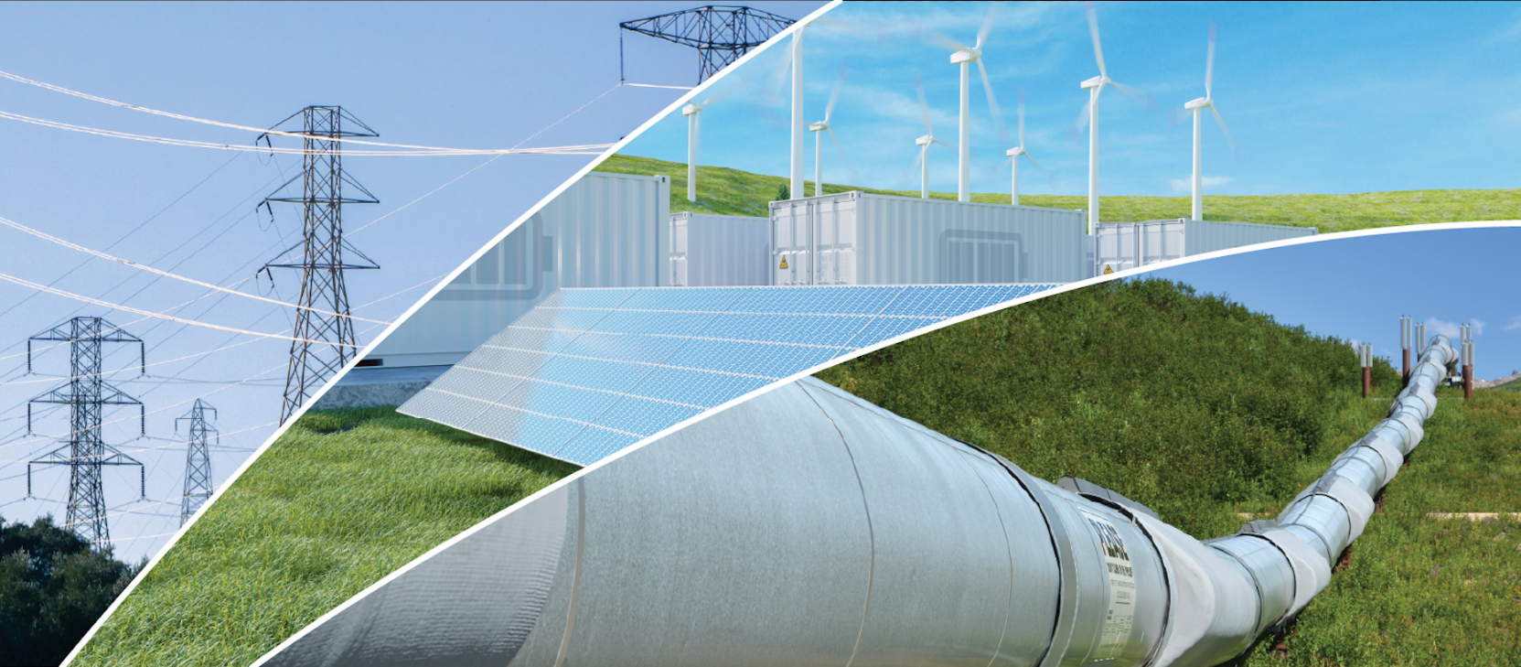
Annual Energy Outlook 2022 with projections to 2050
Narrative Figures
March 3, 2022
www.eia.gov/aeo
#AEO2022

Slide 2
You can access chart data by right-clicking the chart.

Slide 3
Consumption

Slide 4
Figure 1
Source: U.S. Energy Information Administration, Annual Energy Outlook 2022 (AEO2022) Reference case

Slide 5
Figure 2
Energy consumption by fuel
AEO2022 Reference case
quadrillion British thermal units
Petroleum and other liquids consumption by sector
AEO2022 Reference case
quadrillion British thermal units
Source: U.S. Energy Information Administration, Annual Energy Outlook 2022 (AEO2022) Reference case

Slide 6
Figure 3
Energy-related CO₂ emissions by fuel source
AEO2022 Reference case
billion metric tons
U.S. energy-related CO₂ emissions
AEO2022 economic growth cases
billion metric tons
Source: U.S. Energy Information Administration, Annual Energy Outlook 2022 (AEO2022)
Note: Series does not include greenhouse gases other than carbon dioxide (CO₂). Industrial sector CO₂ emissions do not include process emissions, such as the emissions from cement clinker production.

Slide 7
Figure 4
Indexed delivered energy by end-use sector
AEO2022 Reference case
2021 = 1.0
Indexed delivered energy across end-use sectors
AEO2022 economic growth cases
2021 = 1.0
Source: U.S. Energy Information Administration, Annual Energy Outlook 2022 (AEO2022)

Slide 8
Figure 5
Industrial energy consumption by fuel
AEO2022 Reference case
quadrillion British thermal units
Industrial energy consumption by subsector
AEO2022 Reference case
quadrillion British thermal units
Source: U.S. Energy Information Administration, Annual Energy Outlook 2022 (AEO2022) Reference case

Slide 9
Figure 6
electricity
natural gas
petroleum and other liquids
other
electricity
natural gas
petroleum and other liquids
other
Source: U.S. Energy Information Administration, Annual Energy Outlook 2022 (AEO2022) Reference case

Slide 10
Figure 7
Transportation sector consumption by mode
AEO2022 Reference case
quadrillion British thermal units
Transportation sector consumption by fuel
AEO2022 Reference case
quadrillion British thermal units
light-duty
vehicles
medium- and
heavy-duty
vehicles
air
commercial
light trucks
rail
marine
other
Source: U.S. Energy Information Administration, Annual Energy Outlook 2022 (AEO2022) Reference case

Slide 11
Figure 8
security systems
tablets, phones, smart speakers and rechargeable devices
small kitchen appliances
PCs and related equipment
pool pumps, heaters, and spas
ceiling fans and dehumidifiers
televisions and related equipment
cooking
lighting
laundry and dishwashing
refrigeration
and freezing
water heating
space heating
space cooling
characterized miscellaneous electric loads
(MELS)
other MELs
Source: U.S. Energy Information Administration, Annual Energy Outlook 2022 (AEO2022) Reference case

Slide 12
Figure 9
water heating,
cooking, and
space heating
lighting
ventilation
space cooling
refrigeration and freezing
characterized miscellaneous electric loads
(MELs)
other MELs
lab and diagnostic equipment
transformers
water services, parking lot lighting, and other non-building uses
IT and office equipment
Source: U.S. Energy Information Administration, Annual Energy Outlook 2022 (AEO2022) Reference case

