Slide 1
International Energy Outlook 2023 with projections to 2050
October 11, 2023
www.eia.gov/ieo
#IEO2023

Slide 2
What does EIA do?
The U.S. Energy Information Administration (EIA) is the statistical and analytical agency within the U.S. Department of Energy.
EIA is the nation's premier source of energy information.
By law, our data, analyses, forecasts, and projections are independent of approval by any other officer or employee of the U.S. government.
Our International Energy Outlook 2023 (IEO2023) explores long-term energy trends across the globe.

Slide 3
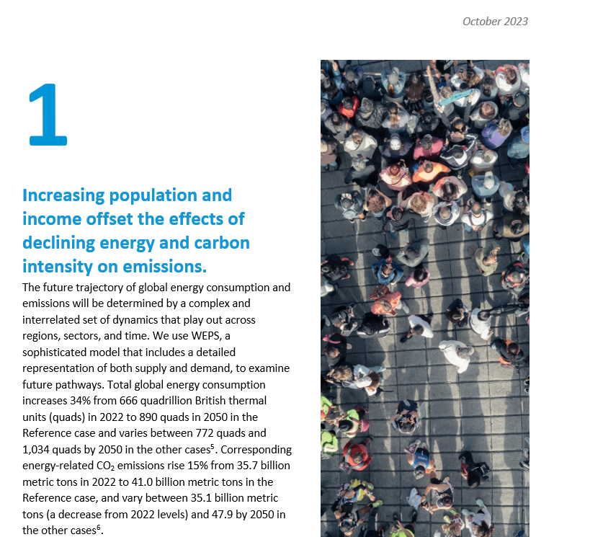
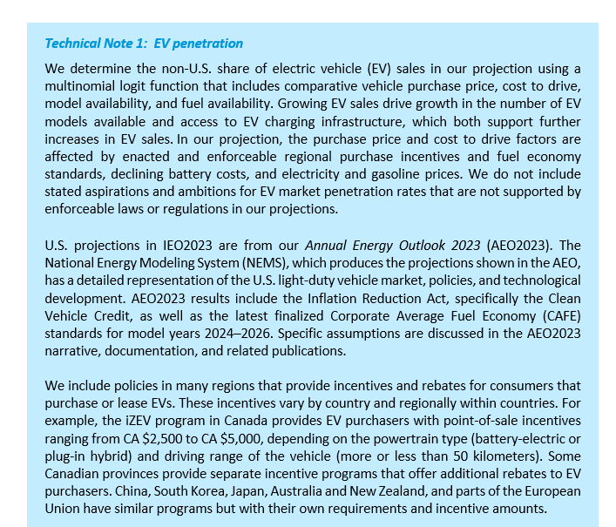
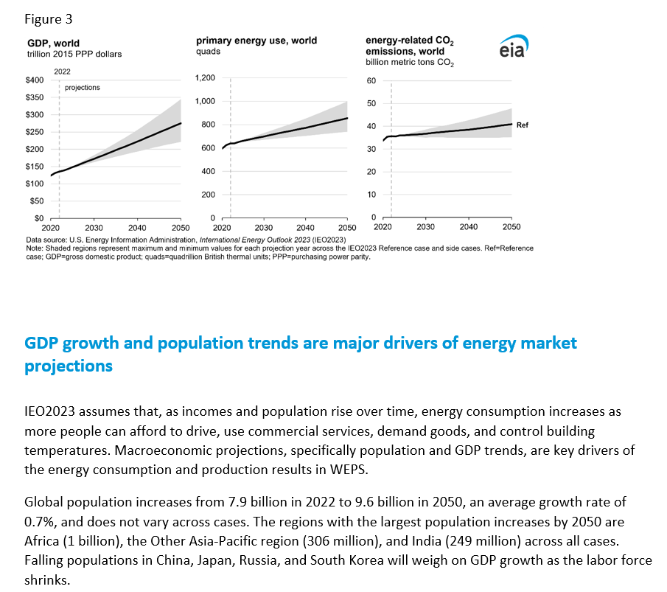
What’s new in the International Energy Outlook 2023?
Narrative improvements carried from the Annual Energy Outlook 2023 (AEO2023), including technical notes and an emphasis on the range of results
New cases examining capital costs of zero-carbon technologies
Modeling improvements:
New analysis regions
New oil and natural gas model
Higher temporal resolution in the electricity model
Assumptions about the impacts of Russia’s full-scale invasion of Ukraine

Slide 4
The IEO2023 includes cases that vary technical and economic assumptions
All cases reflect current laws and regulations as of March 2023, and the U.S. results come directly from the AEO2023, which assumes U.S. laws and regulations as of November 2022 remain unchanged.
Case | Assumptions
Reference | Global average annual GDP (purchasing power parity) percentage change (2022–2050): 2.6% Brent: $102 per barrel (2022$) in 2050 Zero-carbon technologies’ 2022–2050 cost reductions: up to 20%
Economic Growth | Low: 1.8% average annual GDP percentage change (2022–2050) High: 3.4% average annual GDP percentage change (2022–2050)
Oil Price | Low: $48 per barrel (2022$) in 2050 High: $187 per barrel (2022$) in 2050
Zero-Carbon Technology Cost (electric power sector) | Low: 40% reduction in capital costs below Reference case by 2050 High: No reduction in costs
Note: Zero-carbon technologies include solar, wind, battery storage, and nuclear.

Slide 5
IEO2023 Highlights
Increasing population and income offset the effects of declining energy and carbon intensity on emissions.
The shift to renewables to meet growing electricity demand is driven by regional resources, technology costs, and policy.
Energy security concerns hasten a transition from fossil fuels in some countries, although they drive increased fossil fuel consumption in others.

Slide 6
Things to keep in mind
Although we model a number of cases, we do not comprehensively address all issues that could drive significant change, like in a forecast.
New policies, geopolitical events, and technology breakthroughs will happen that shift the trajectory of the global energy system.
Therefore:
IEO2023 is not a forecast.
IEO2023 represents a set of policy-neutral baselines that focus on the current trajectory of the global energy system.

Slide 7
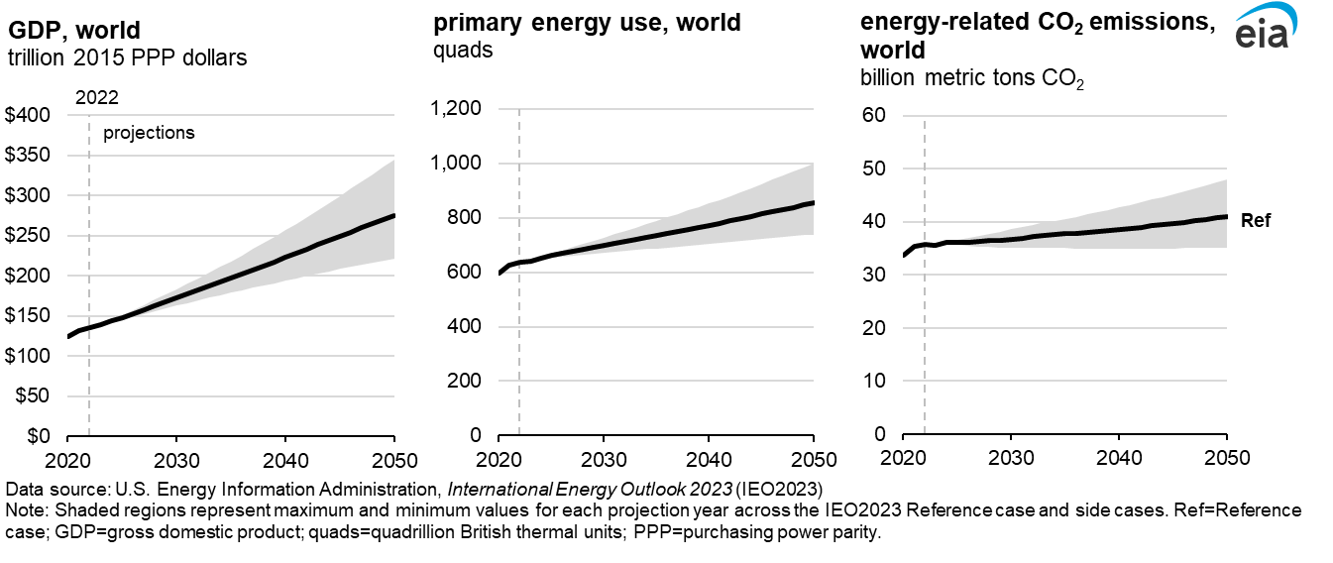
Across most cases, energy-related CO₂ emissions continue to rise through 2050 under current laws

Slide 8
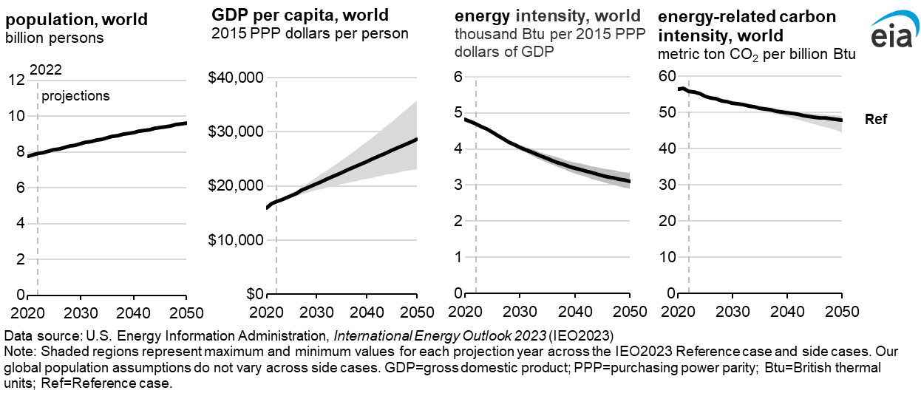
The upward pressures of population and GDP growth outweigh the downward pressures of energy and carbon intensity on emissions

Slide 9
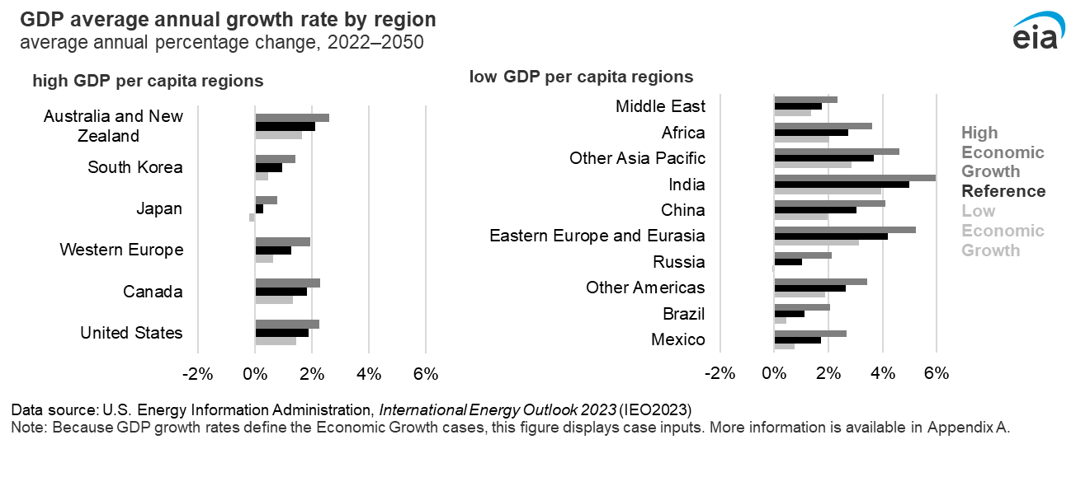
India leads the world in economic growth, and growth rates vary for other regions

Slide 10
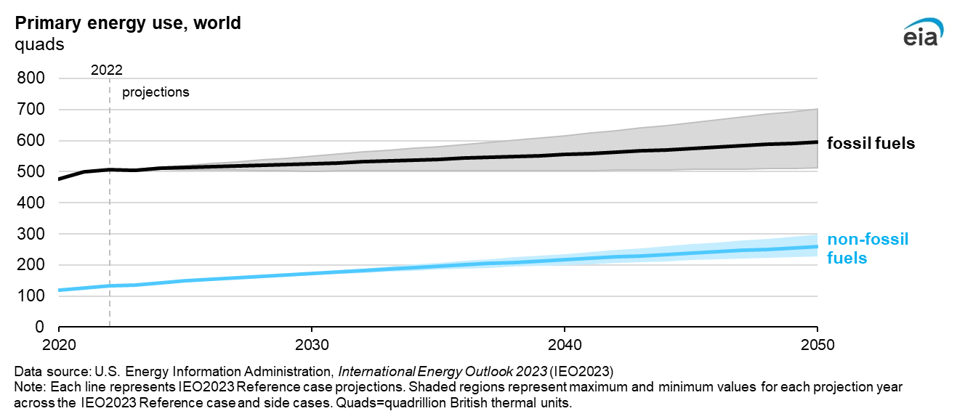
Increasing demand and current policies drive steady growth in fossil fuel energy—and faster growth in non-fossil fuel sources

Slide 11
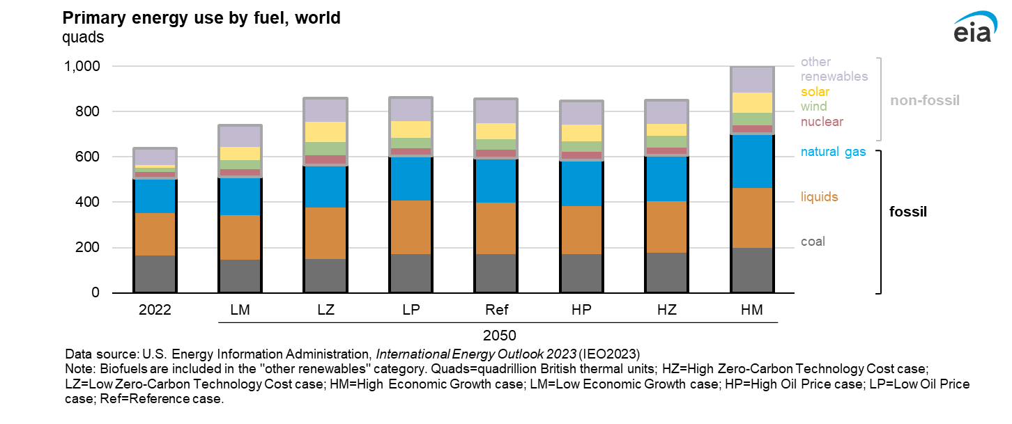
Renewable energy grows the fastest as a share of primary energy consumption across all cases due to current policy and cost drivers

Slide 12
IEO2023 Highlights
Increasing population and income offset the effects of declining energy and carbon intensity on emissions.
The shift to renewables to meet growing electricity demand is driven by regional resources, technology costs, and policy.
Energy security concerns hasten a transition from fossil fuels in some countries, although they drive increased fossil fuel consumption in others.

Slide 13
IEO2023 Highlights
Increasing population and income offset the effects of declining energy and carbon intensity on emissions.
The shift to renewables to meet growing electricity demand is driven by regional resources, technology costs, and policy.
Energy security concerns hasten a transition from fossil fuels in some countries, although they drive increased fossil fuel consumption in others.

Slide 14
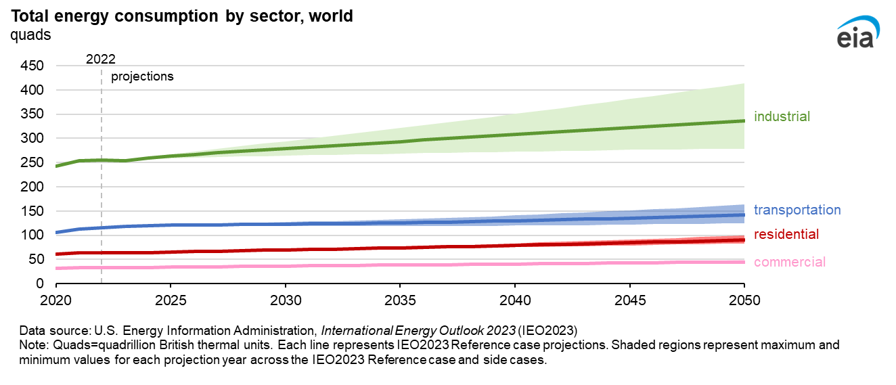
Across all IEO2023 cases, energy consumption increases, and global demand grows fastest in the industrial and residential sectors

Slide 15
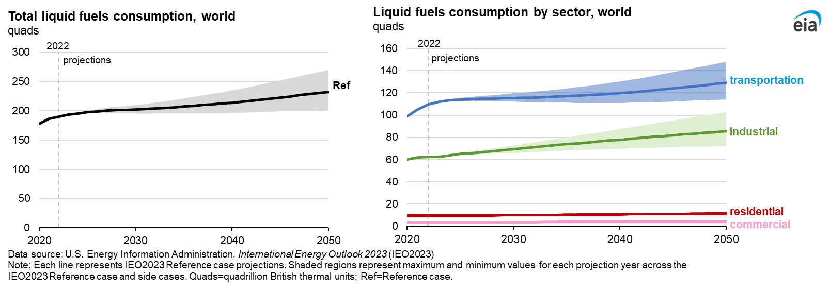
Under current laws, liquid fuels consumption increases through 2050 across all cases, driven by growth in the industrial sector

Slide 16
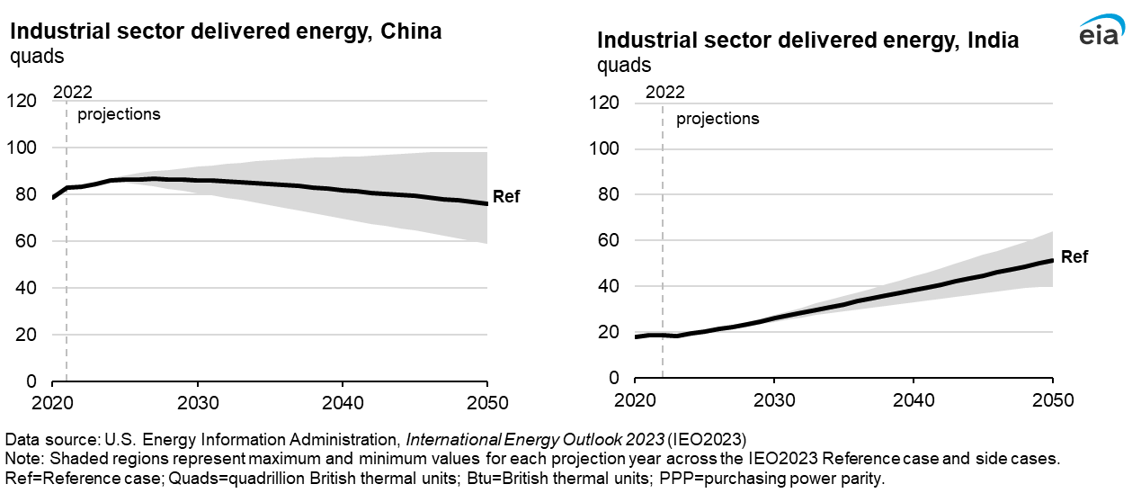
Industrial energy use varies across regions and is primarily determined by industrial gross output and energy efficiency; India’s industrial sector has the steepest growth

Slide 17
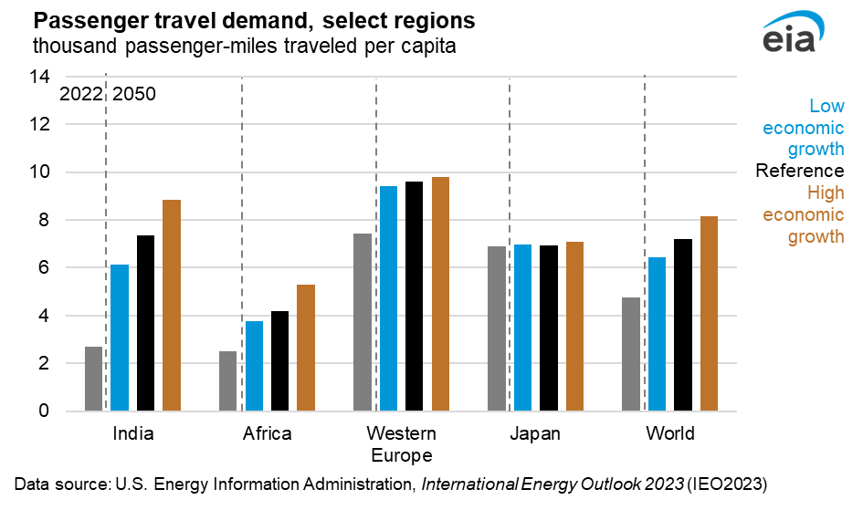
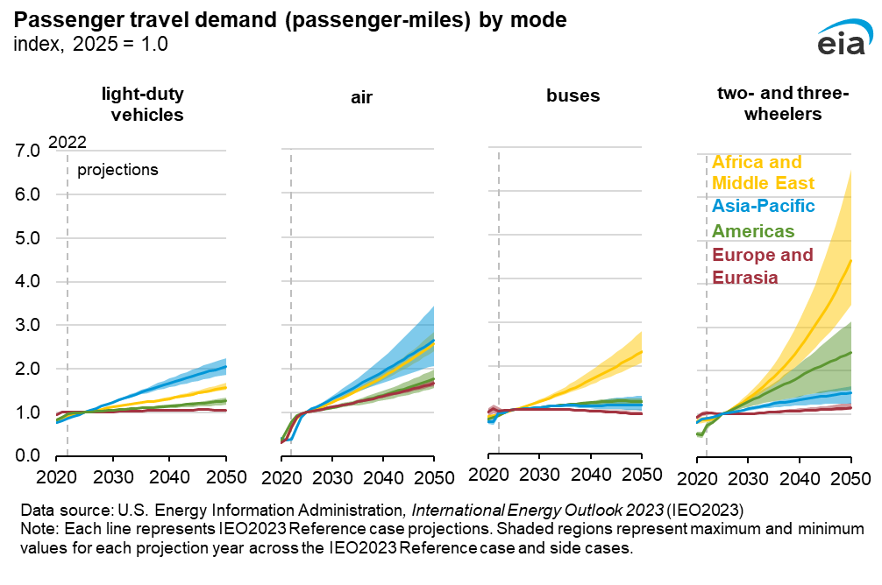
Increasing passenger demand drives global transportation consumption; Rising income enables travelers to shift from inexpensive, more efficient modes to more convenient, less efficient modes

Slide 18
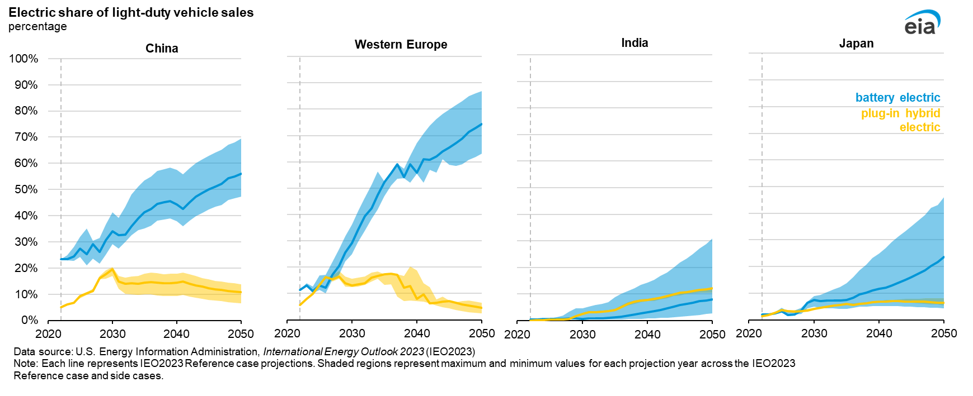
Electric vehicle sales grow due to policy incentives, battery costs, efficiency standards, and electricity prices

Slide 19
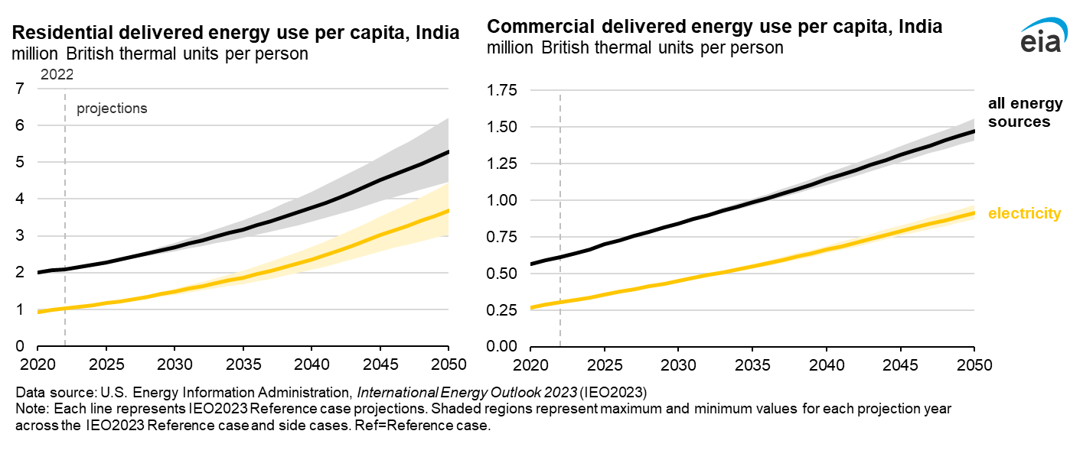
As India’s economy expands, building electrification supports a rapidly expanding service sector and electricity use almost triples in homes

Slide 20
IEO2023 Highlights
Increasing population and income offset the effects of declining energy and carbon intensity on emissions.
The shift to renewables to meet growing electricity demand is driven by regional resources, technology costs, and policy.
Energy security concerns hasten a transition from fossil fuels in some countries, although they drive increased fossil fuel consumption in others.

Slide 21
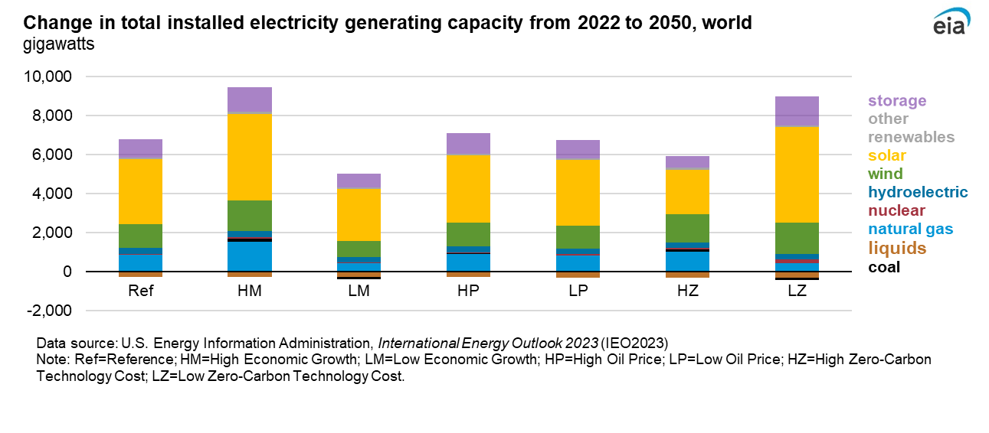
By 2050, global coal-fired and liquid fuel-fired electricity generating capacity decrease in most modeled cases

Slide 22
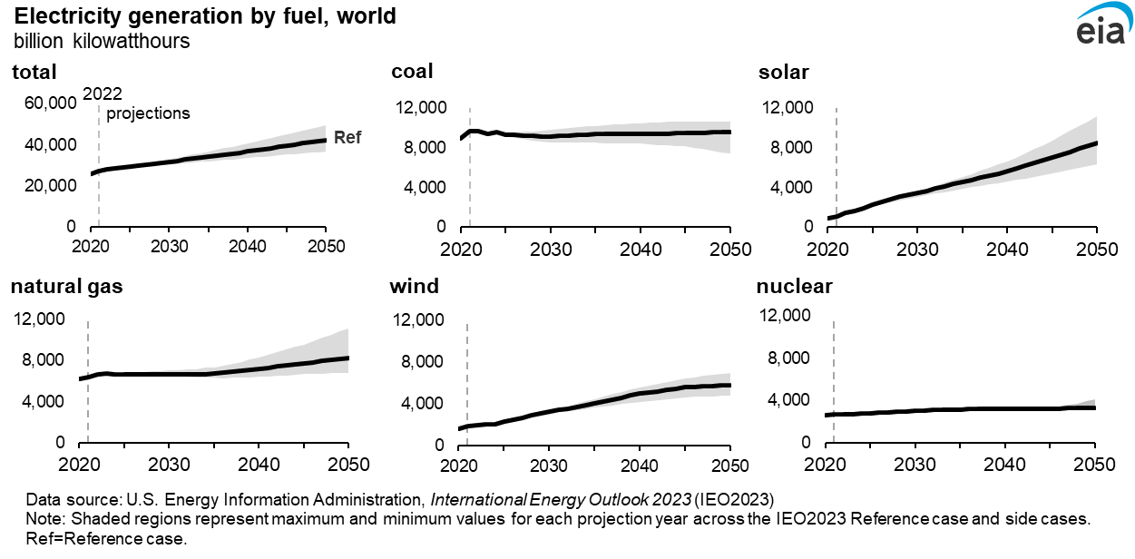
Total electricity generation worldwide increases 30% to 76% relative to 2022 across cases, and renewables and nuclear supply 54% to 67% of the total demand across cases in 2050

Slide 23
IEO2023 Highlights
Increasing population and income offset the effects of declining energy and carbon intensity on emissions.
The shift to renewables to meet growing electricity demand is driven by regional resources, technology costs, and policy.
Energy security concerns hasten a transition from fossil fuels in some countries, although they drive increased fossil fuel consumption in others.

Slide 24
Energy security considerations that favor locally available resources contribute to zero-carbon technology growth, which varies by region

Slide 25
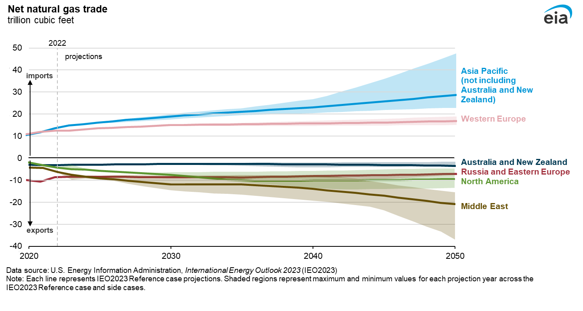
Asia and Europe import more natural gas to meet growing demand, mostly supplied by growing production from the Middle East

Slide 26
IEO2023 Highlights
Increasing population and income offset the effects of declining energy and carbon intensity on emissions.
The shift to renewables to meet growing electricity demand is driven by regional resources, technology costs, and policy.
Energy security concerns hasten a transition from fossil fuels in some countries, although they drive increased fossil fuel consumption in others.

Slide 27
View the full report, including data used in this presentation: eia.gov/ieo
Contact us: InternationalEnergyOutlook@eia.gov

