Slide 1
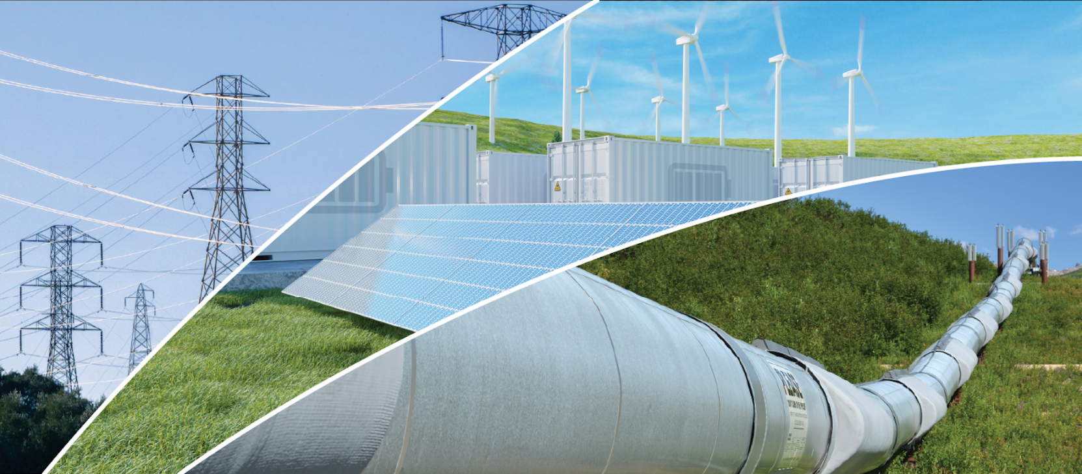
Annual Energy Outlook 2022 with projections to 2050
Narrative Figures
March 3, 2022
www.eia.gov/aeo
#AEO2022

Slide 2
You can access chart data by right-clicking the chart.

Slide 3
Production

Slide 4
Figure 21
production
production
consumption
consumption
Source: U.S. Energy Information Administration, Annual Energy Outlook 2022 (AEO2022) Reference case

Slide 5
Figure 22
Dry natural gas production
AEO2022 side cases
trillion cubic feet
Liquefied natural gas (LNG) exports and capacity
AEO2022 Reference case
trillion cubic feet
2021
history projections
2021
history projections
current/under construction U.S. LNG export capacity as of 2021
High Oil and
Gas Supply
High Oil Price
Reference
Low Oil Price
Low Oil and
Gas Supply
Source: U.S. Energy Information Administration, Annual Energy Outlook 2022 (AEO2022)

Slide 6
Figure 23
U.S. natural gas trade, AEO2022 oil and natural gas supply cases
Reference case
trillion cubic feet
Low Oil and Gas Supply case
trillion cubic feet
High Oil and Gas Supply case
trillion cubic feet billion cubic feet per day
LNG exports
net exports
pipeline exports
to Mexico
pipeline exports
to Canada
pipeline imports
from Canada
LNG imports
Source: U.S. Energy Information Administration, Annual Energy Outlook 2022 (AEO2022)

Slide 7
Figure 24
Dry natural gas production from shale resources, AEO2022 oil price cases
Reference case
trillion cubic feet
Low Oil Price case
trillion cubic feet
High Oil Price case
trillion cubic feet
2021
history projections
Southwest
East
Gulf Coast
Southwest
East
Gulf Coast
rest of United States
rest of United States
rest of United States
rest of United States
Source: U.S. Energy Information Administration, Annual Energy Outlook 2022 (AEO2022)
Note: Shale resources includes natural gas production from tight oil formations and excludes natural gas from tight gas formations.

Slide 8
Figure 25
net exports
electric power
commercial
residential
transportation
industrial
Source: U.S. Energy Information Administration, Annual Energy Outlook 2022 (AEO2022)

Slide 9
Figure 26
North Sea Brent crude oil price
AEO2022 side cases
2021 dollars per barrel
High Oil Price
High Oil and Gas Supply
Reference
Low Oil Price
Low Oil and Gas Supply
Source: U.S. Energy Information Administration, Annual Energy Outlook 2022 (AEO2022)

Slide 10
Figure 27
Crude oil production, AEO2022 oil price cases
Reference case
million barrels per day
High Oil Price case
million barrels per day
Low Oil Price case
million barrels per day
tight oil
Alaska
Gulf of Mexico
other
tight oil
Alaska
Gulf of Mexico
other
tight oil
Alaska
Gulf of Mexico
other
Source: U.S. Energy Information Administration, Annual Energy Outlook 2022 (AEO2022)

Slide 11
Figure 28
Total petroleum and other liquids trade
AEO2022 Reference case
million barrels per day
Crude oil trade
AEO2022 Reference case
million barrels per day
Source: U.S. Energy Information Administration, Annual Energy Outlook 2022 (AEO2022) Reference case

Slide 12
Figure 29
Crude oil supply to domestic refineries
AEO2022 Reference case
million barrels per day
Refinery utilization
AEO2022 Reference case
percentage
2021
history projections
2021
history projections
Source: U.S. Energy Information Administration, Annual Energy Outlook 2022 (AEO2022) Reference case

Slide 13
Figure 30
Biomass-based diesel production
AEO2022 Reference case
million barrels per day
Biomass-based diesel production as a percentage of petroleum diesel production
AEO2022 Reference case
percentage
2021
history projections
2021
history projections
Source: U.S. Energy Information Administration, Annual Energy Outlook 2022 (AEO2022) Reference case

Slide 14
Figure 31
U.S. energy-related biofuels AEO2022 Reference case
million barrels per day
biomass-based diesel
total ethanol
Source: U.S. Energy Information Administration, Annual Energy Outlook 2022 (AEO2022) Reference case

